Slide 1
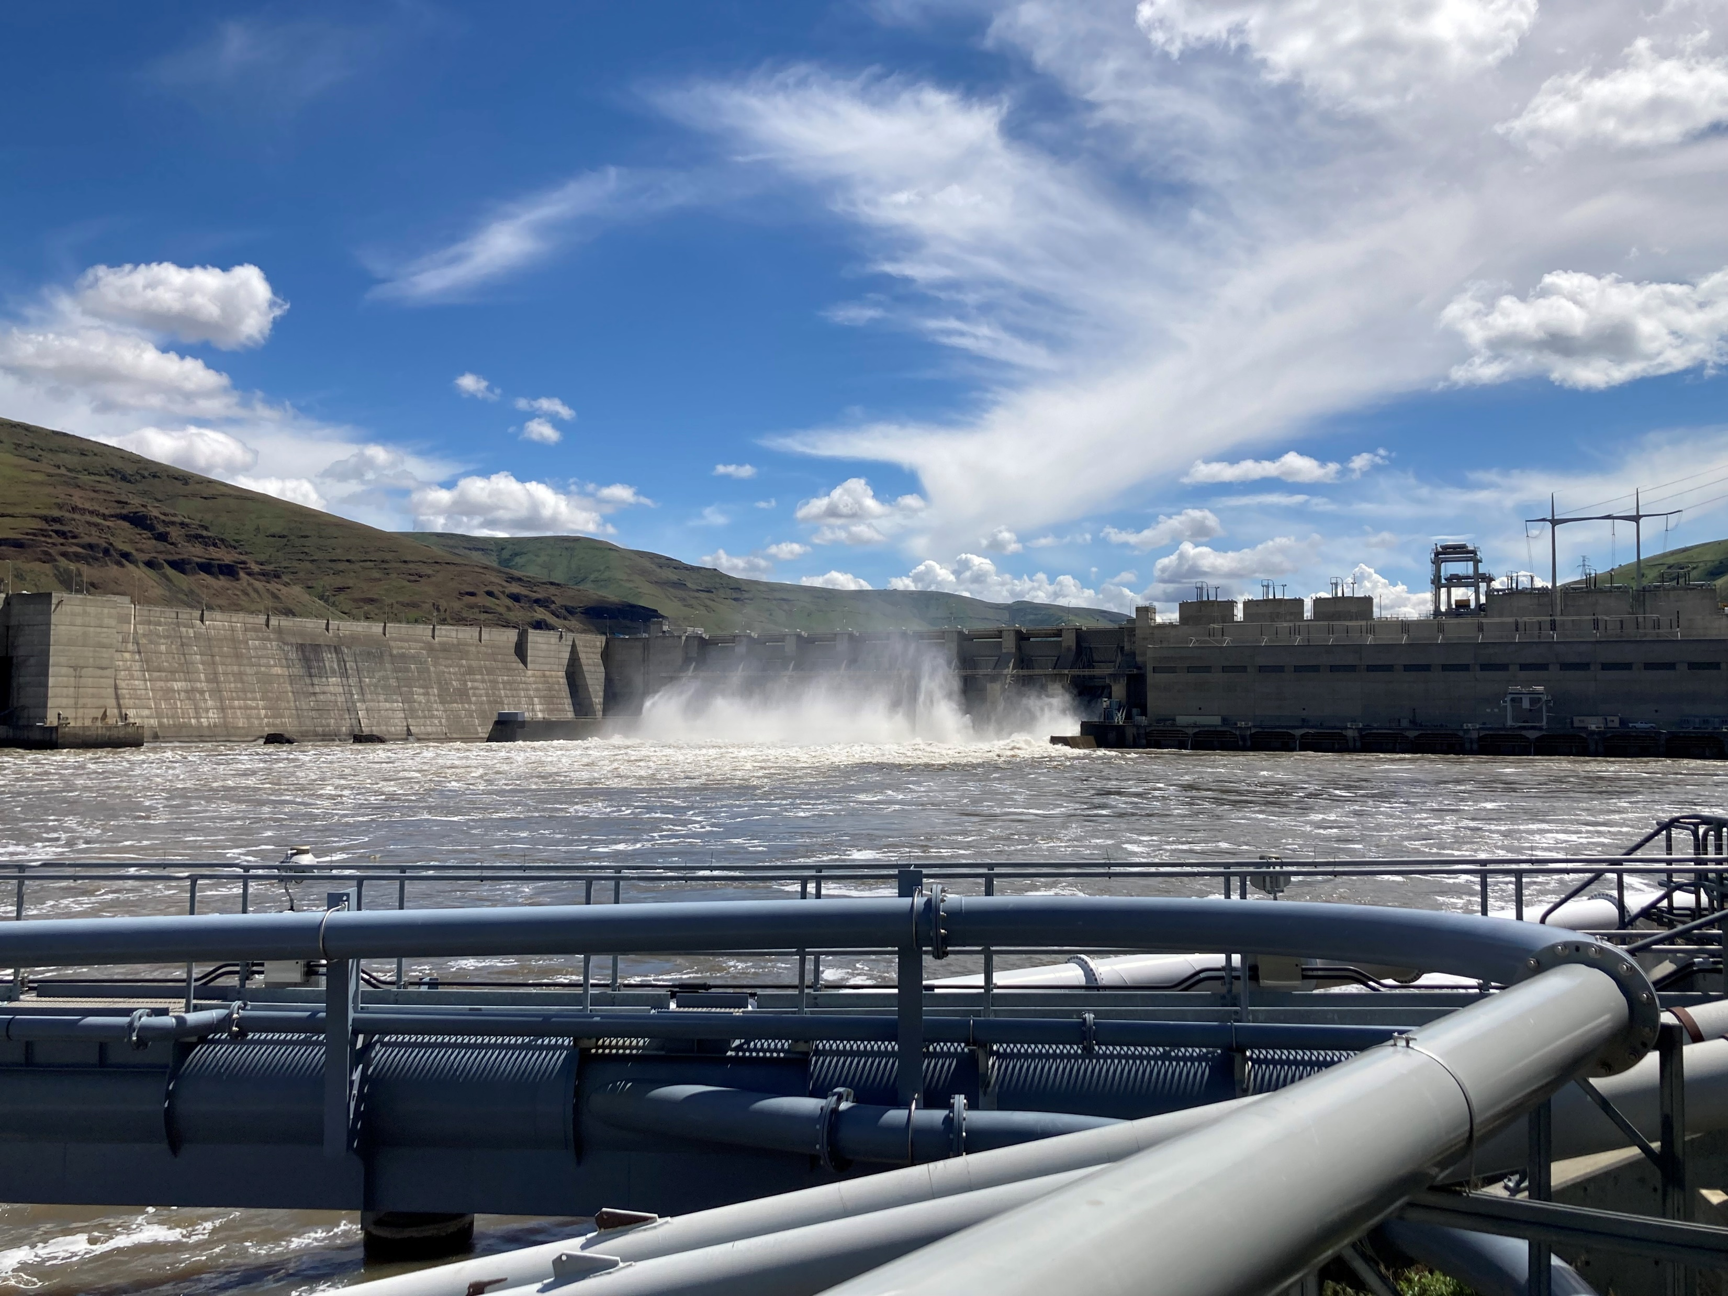

Slide 2
2022 Stay Term Sheet
(Including 2023 Operational Adjustments)
Jan
Feb
Mar
Apr
May
Jun
Jul
Aug
Sep
Oct
Nov
Dec
Lower Granite
Little Goose
Lower Monumental
Ice Harbor
McNary
John Day
The Dalles
Bonneville
No Spill
Finite
Spill
Max Spill
(125%)
Flex Spill
125%/20kcfs)
Moderate Spill (18kcfs)
Low Spill¹
Finite Spill
(12 hr/wk)
No Spill
No Spill
Finite
Spill
Flex Spill
(125%/30%)
Moderate Spill (30%)
Low Spill¹
Finite Spill
(12 hr/wk)
No Spill
No Spill
Finite
Spill
Max Spill
(125%)
Flex Spill
(125%/40%)
Moderate Spill (17kcfs)
Low Spill¹
Finite Spill
(12 hr/wk)
No Spill
No Spill
Finite
Spill
Max Spill
(125%)
Moderate Spill (30%)
Low Spill¹
Finite Spill
(12 hr/wk)
No Spill
No Spill
Finite
Spill
Max Spill
(125%)
Moderate Spill (57%)
Low Spill¹
Finite Spill
(12 hr/wk)
No Spill
No Spill
Flex Spill
(125%/32%)
Moderate Spill (35%)
Low Spill¹
No Spill
No Spill
Moderate
Spill (40%)
Moderate Spill (40%)
Low Spill¹
Low Spill
(Ice and Trash Sluiceway)
Low Spill
Max Spill
(150kcfs)
Moderate Spill (95kcfs)
Low Spill¹
Low Spill
(B2CC, PH1 ITS, 2 SBs 1 stop day time only )
¹Lower Granite, Little Goose, and Lower Monumental at 1 RSW/ASW or 7 kcfs; Ice Harbor at 1 RSW or 8.5 kcfs; McNary and John Day at 20kcfs; The Dalles at 30%; and Bonneville at 50kcfs.

Slide 3
2022 Snake River Spill Volume
Notes:
Mean spill discharge at the Snake River dams was 46.6 kcfs, which was well above the 2006-2022 mean of 36.3 kcfs.
Spill discharge started out average, but increased to the highest on record in mid June.
Spill as a percentage of flow at Snake River dams averaged 59.5%, which was far above the long-term (2006-2022) mean of 39.3%.
Daily mean spill percentages were close to 65% through April and early May (Figure 8). However, spill percentages dropped to levels substantially below those maintained in 2020 and 2021.

Slide 4
2022 Snake River Percentage Spill
Notes:
Mean spill discharge at the Snake River dams was 46.6 kcfs, which was well above the 2006-2022 mean of 36.3 kcfs.
Spill discharge started out average, but increased to the highest on record in mid June.
Spill as a percentage of flow at Snake River dams averaged 59.5%, which was far above the long-term (2006-2022) mean of 39.3%.
Daily mean spill percentages were close to 65% through April and early May (Figure 8). However, spill percentages dropped to levels substantially below those maintained in 2020 and 2021.

Slide 5
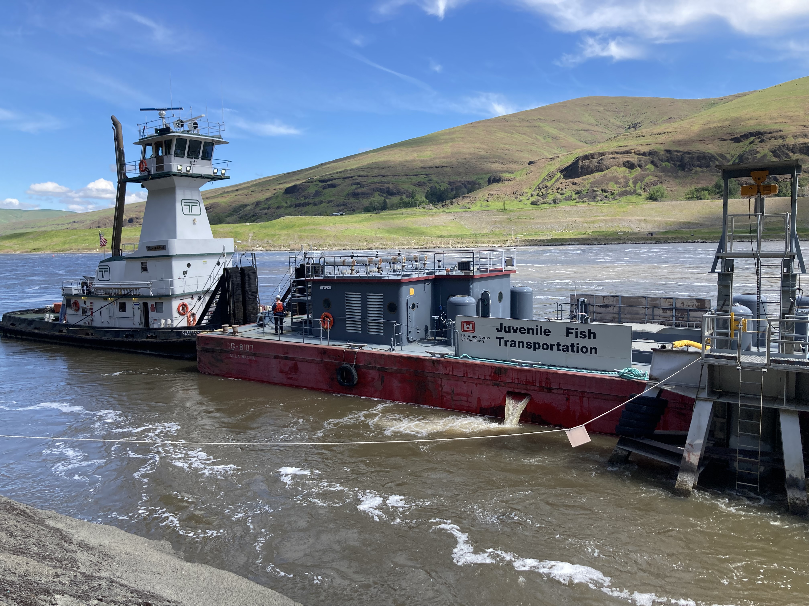

Slide 6
Transport
Notes:
Our preliminary estimates of the percentage transported of nontagged wild and hatchery spring-summer Chinook salmon smolts in 2022 are 30.6% and 23.9%, respectively.
For steelhead, the estimates are 36.7% and 24.0% for wild and hatchery smolts, respectively.
Estimated percentages transported in 2022 were below average, but substantially higher than in 2020 or 2021.
The overall proportion of smolts transported in 2022 was about equal to the 2006-2022 average run timing contributed to increased transportation rates

Slide 7

Declining transportation rates: should we be concerned?
Jonathan Ebel
Idaho Department of Fish and Game
2023 LSRCP Annual Meeting
April 26, 2023

Slide 8
Transport Program
1968: Research on transport efficacy begins
1985: USACE declared transport as the primary management strategy
  Maximum transport (80-95%)
1991-1992: ESA listing of SR sockeye and sp/su Chinook
Powerhouse
Spillway
Bypass/ Collection
Turbine
Spill
Barge
Back to River

Slide 9
Transport Evaluations
Powerhouse
Spillway
NOAA: Transport to Bypass SAR ratios (T:B)
Bypass/ Collection
Turbine
Spill
Transport (T)
Bypass (B)
Comparative Survival Study
Transport (T)
Bypass (C1)
No detection* (C0)
No detection*
Transport to In-river ratio (TIR)
T : C0
Barge
Back to River

Slide 10
Transport vs In-River: All or nothing scenarios
Use CSS estimated SARs
  Transport Group
  C0 group
Assume 1 million smolts at Lower Granite Dam
Assume either all fish in given year were either transported or migrated in river (and did not experience the bypass at LGR, LGS, LMN)

Slide 11
NOR Steelhead - Aggregate
Spill provided at lower flows
Transport program typically returns more NOR steelhead

Slide 12
NOR Chinook - Aggregate
Transport program rarely benefits NOR Chinook

Slide 13
HOR Steelhead: Aggregate
HOR Steelhead returns have not benefited from transport since 2008

Slide 14
HOR Chinook:
Selected hatcheries
Sawtooth
Dworshak
Mixed Bag:
Some years = no difference
Some years = transport would have returned 2X the adults
McCall
Catherine Ck

Slide 15
Transport: Conclusions
Wild steelhead benefit the more from transport than other fishes
Improved river conditions through higher spill and maintaining Minimum Operating Pools has decreased the observed benefit of transport
In most years, 100% transport would have returned more adults than 100% in-river, but not significantly more.

Slide 16
Should we be concerned?

