Slide 1
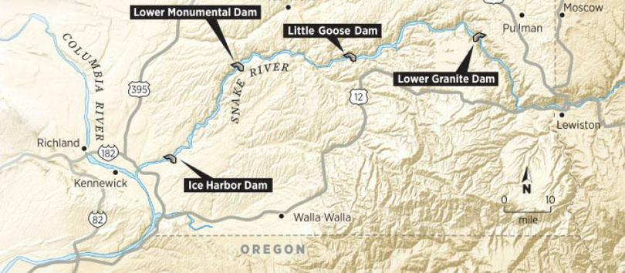
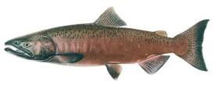
LSRCP Spring/Summer Chinook Monitoring and Evaluation Update and Priorties
Rod Engle USFWS-LSRCP

Slide 2
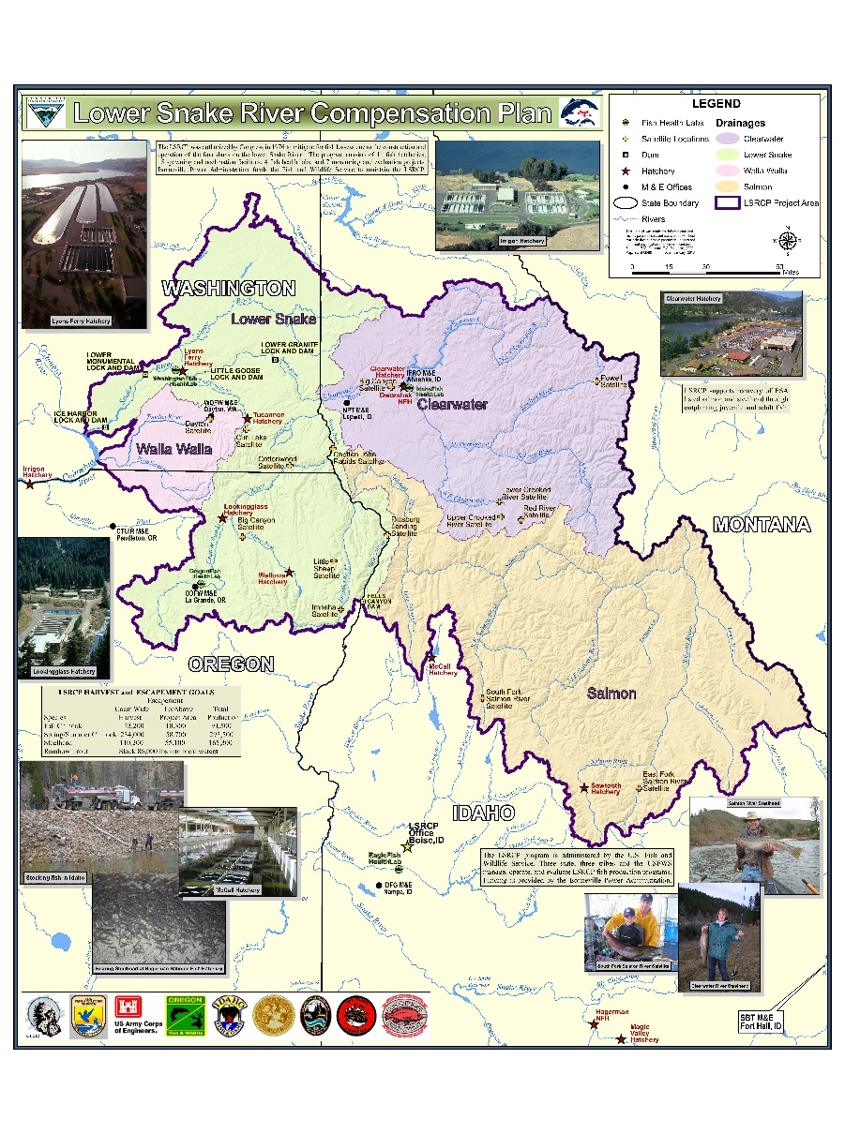
M&E Update
ISRP review highlights
Current performance and programmatic changes for improvement
AOP discussions on performance from ISRP
M&E Priority Project List
Future items

Slide 3
Reporting not complete for 2021

Slide 4
Table 3. Allocation of compensation (adults) by State as suggested by Columbia Basin Fisheries Technical Committee (reproduced from WDFW 1974). This allocation was not to be used as a specific indicator of release sites.
 | Washington |  |  | Oregon |  | Idaho
Area or Basin | Spring Chinook salmon | Fall Chinook salmon | Steelhead | Spring Chinook salmon | Steelhead | Spring-Summer Chinook | Steelhead
Snake River
Below Lewiston |  | 5,000
Lewiston – Hells Canyon |  | 9,728 | 2,208
Hells Canyon Dam |  | 3,648 |  |  | 1,368 | 1,200 | 1,368
Tucannon River | 1,152 |  | 1,632
Clearwater River |  | 68 |  |  |  | 288 | 20,736
Asotin Creek |  |  | 816
Grande Ronde River |  |  |  | 5,856 | 7,632
Salmon River |  |  |  |  |  | 46,656 | 16,896
Imnaha River |  | 68 |  | 3,216 | 1,920
Small Tributaries |  |  |  |  | 264 | 288 | 264
Totals | 1,152 | 18,512 | 4,656 | 9,072 | 11,184 | 48,432 | 39,264
Notes:
All numbered tables and figures are from the Draft LSRCP 2018 Biennial Report (Version February 2020).
The Clearwater and Salmon River breakdown of spring/summer Chinook and steelhead reflected where the committee thought salmon/steelhead production was coming from. As the table caption states, the committee was specific to say that these areas should not be used as specific indicator of release sites (ie. There’s flexibility).
The Hells Canyon

Slide 5
Large shift in production from Salmon to Clearwater basin.
Why?
Further refinements of programs to achieve cooperator desires, ESA.
Fishing, flexibility.
Since last review (2010), approximately 2.815 M smolt production has been added to address goals.
Clearwater Pipeline would increase additional 3.0 M to existing infrastructure.

Slide 6
Performance

Slide 7
Spring/Summer Chinook Example
Increased Performance
Low Densities
Better release sites
Good homing
Releases that are ready-to-migrate
Better in-river survival, hydrosystem survival.
Smolt programs over parr programs
Endemic or localized stock
0.87
0.42
Increasing Costs ($)
Increased Brood Need (and Reduced Fisheries)
Started program with 6.74 M with expected survival of 0.87% = 58,700
Current program is 10.4 M with measured, mean survival of 0.42% (BY07-16) = 43,783
Notes:
Change to total production of LSRCP and performance as a metric of meeting the goal
Started program with 6.74 M with expected survival of 0.87% = 58,700
Current program is 10.4 M with measured survival of 0.42% = 43,783 adults

