Slide 1
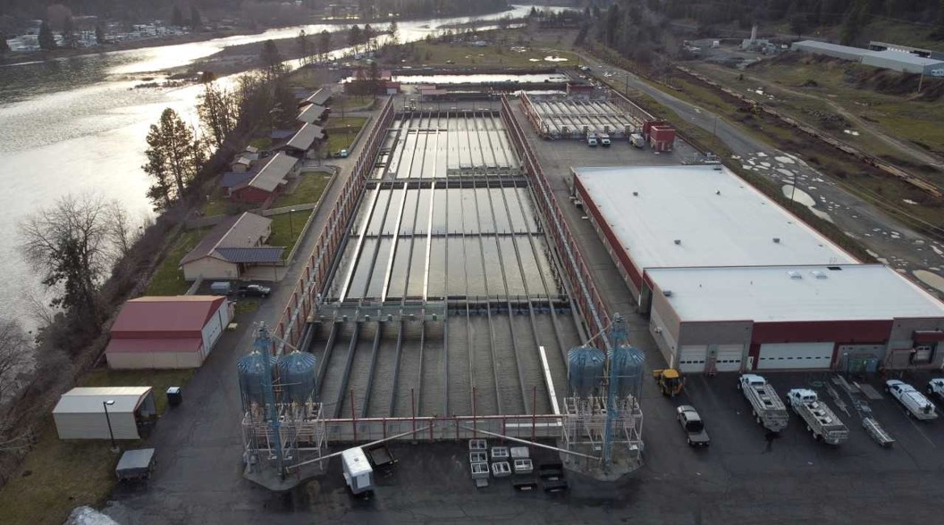
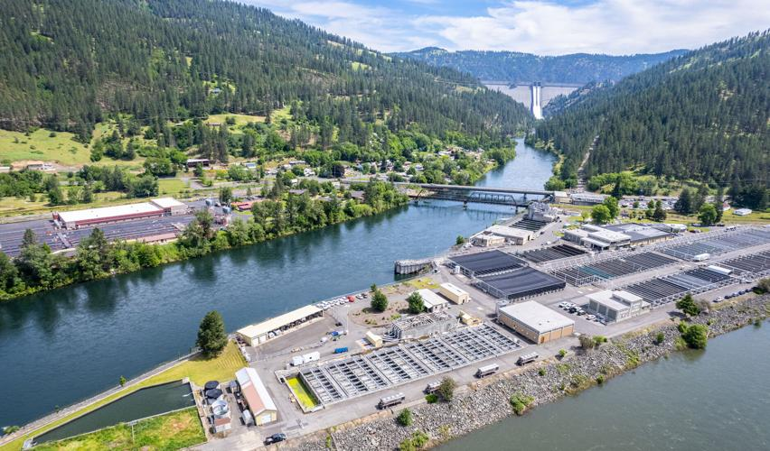





Clearwater Fish Hatchery
Dworshak Fish Hatchery

Slide 2
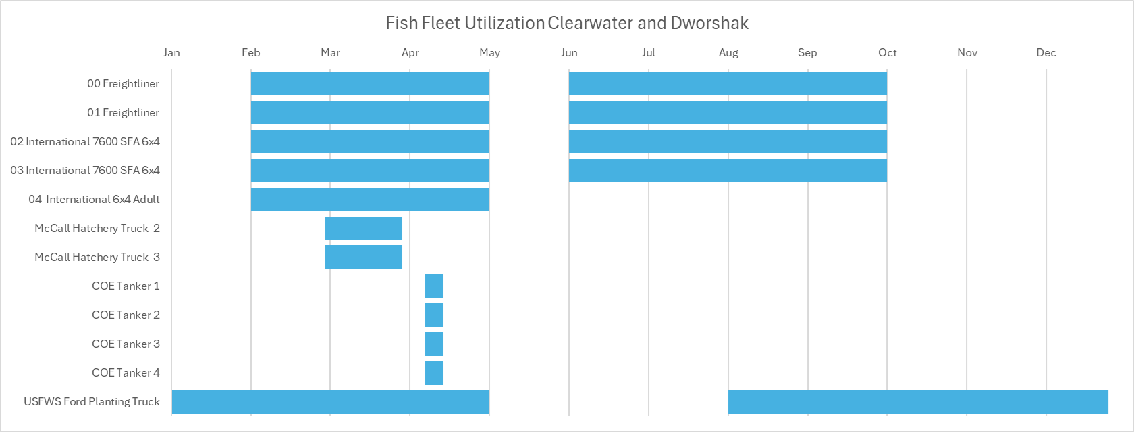
Smolt Trucks On the Road

Slide 3
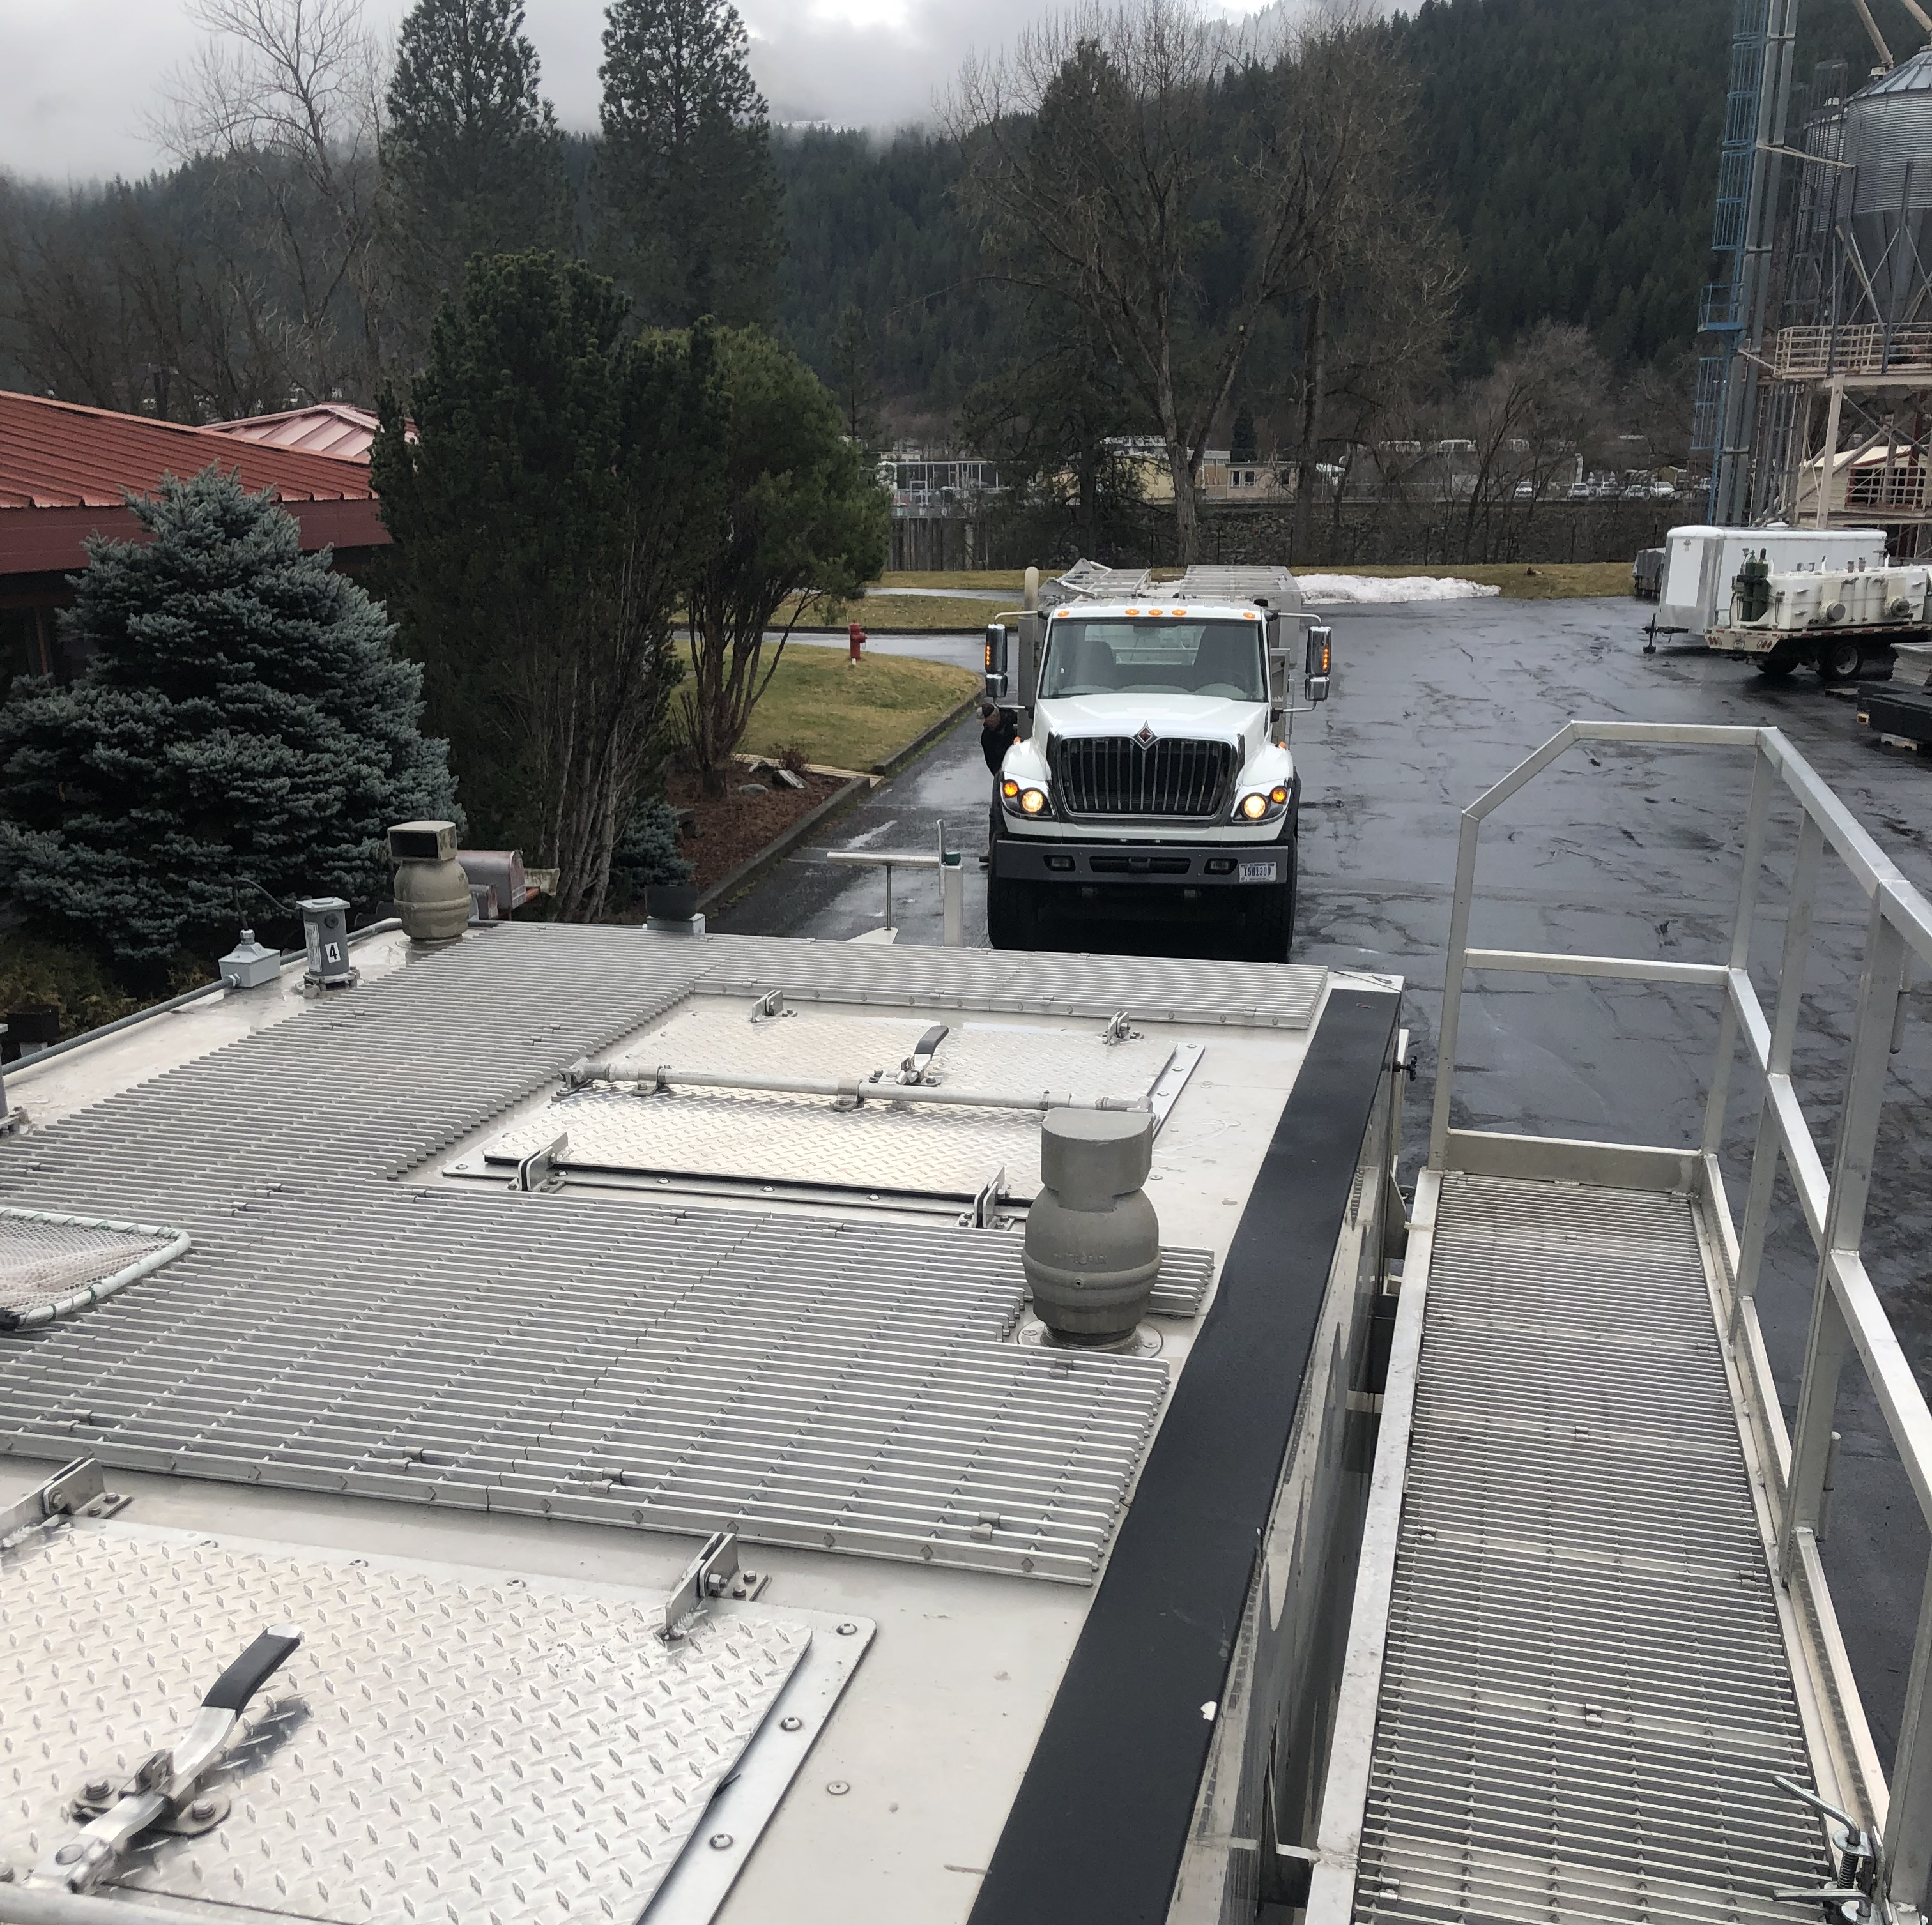
Difficulties with Hauling and Releasing Smolts
Short staffed for hauling, acclimation, and releases
Maintenance and keeping trucks on the road
Time it takes to replace trucks
Which release timings are the priority?
Does the AOP need to be updated?
Low water flows
Winter weather conditions
Short turn around times at hatcheries

Slide 4
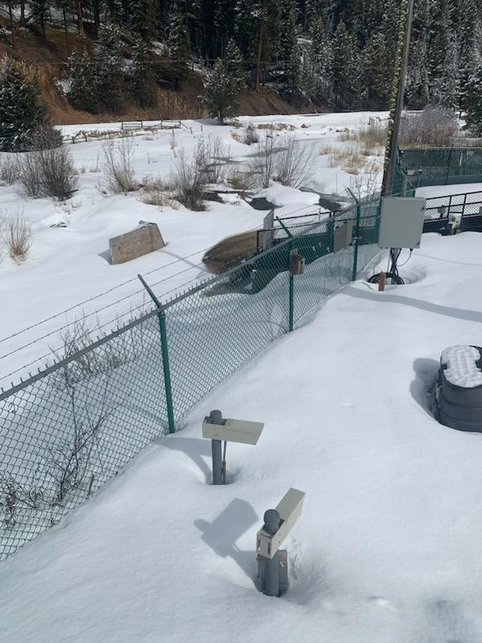
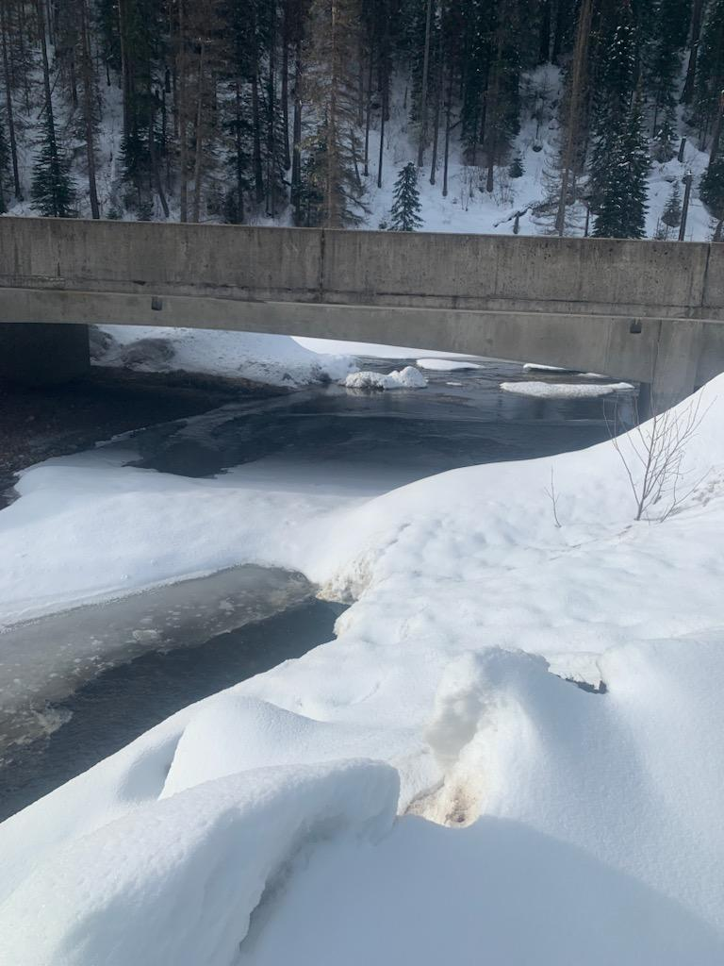
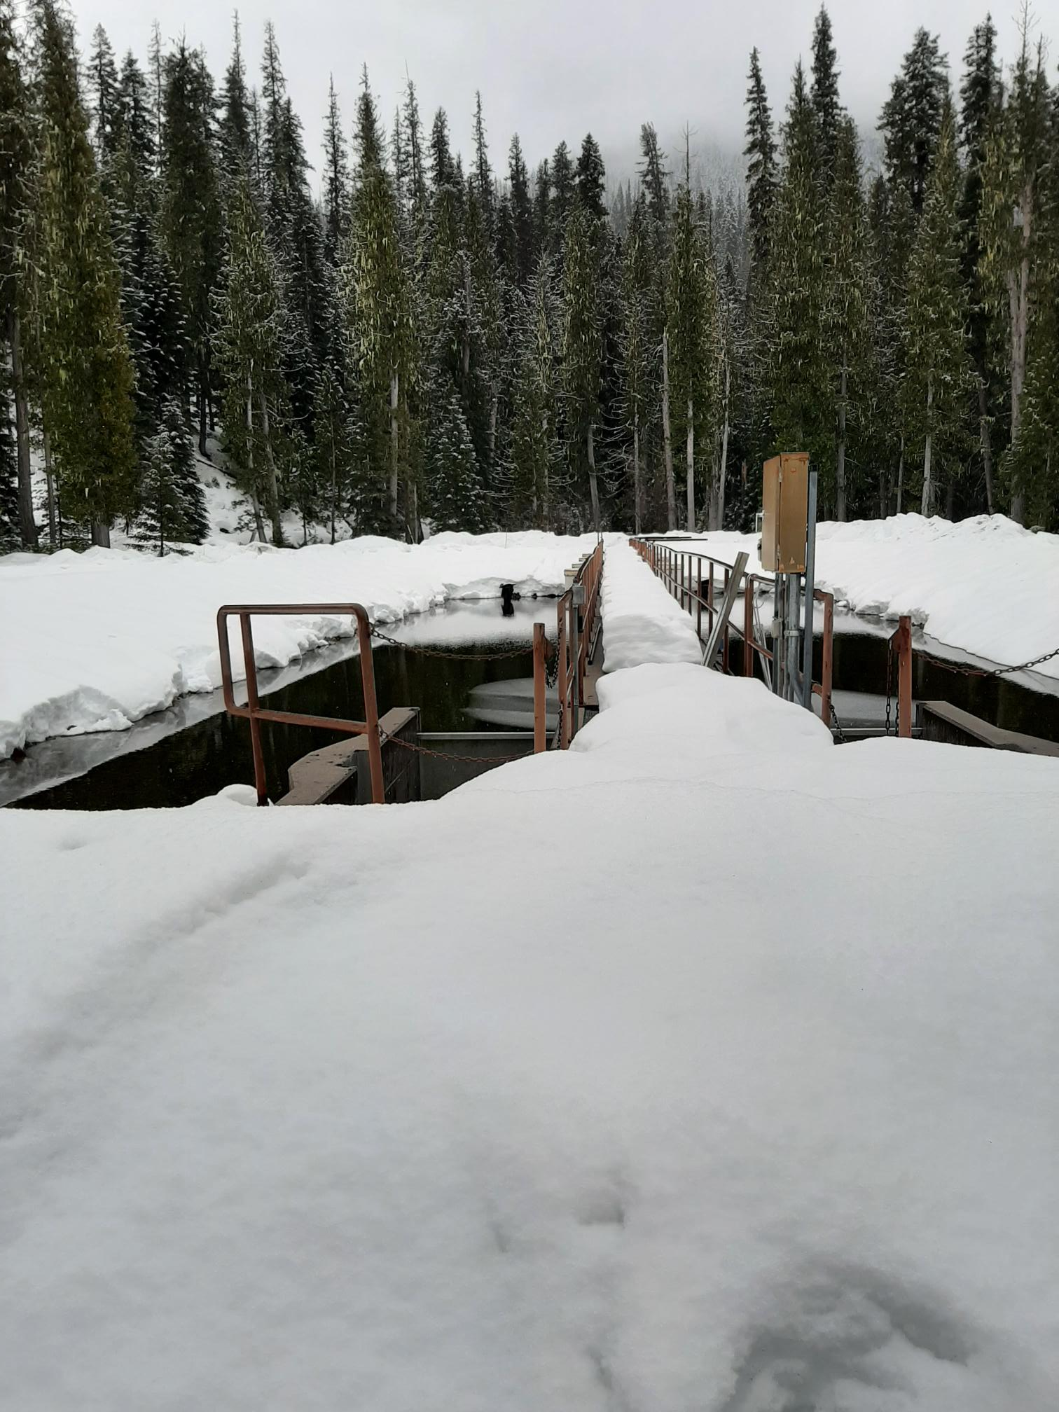
Acclimation and Release Sites

