Slide 1
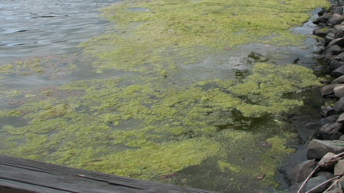

Low Phosphorus Diets
Ann Gannam
USFWS
Abernathy Fish Technology Center

Slide 2
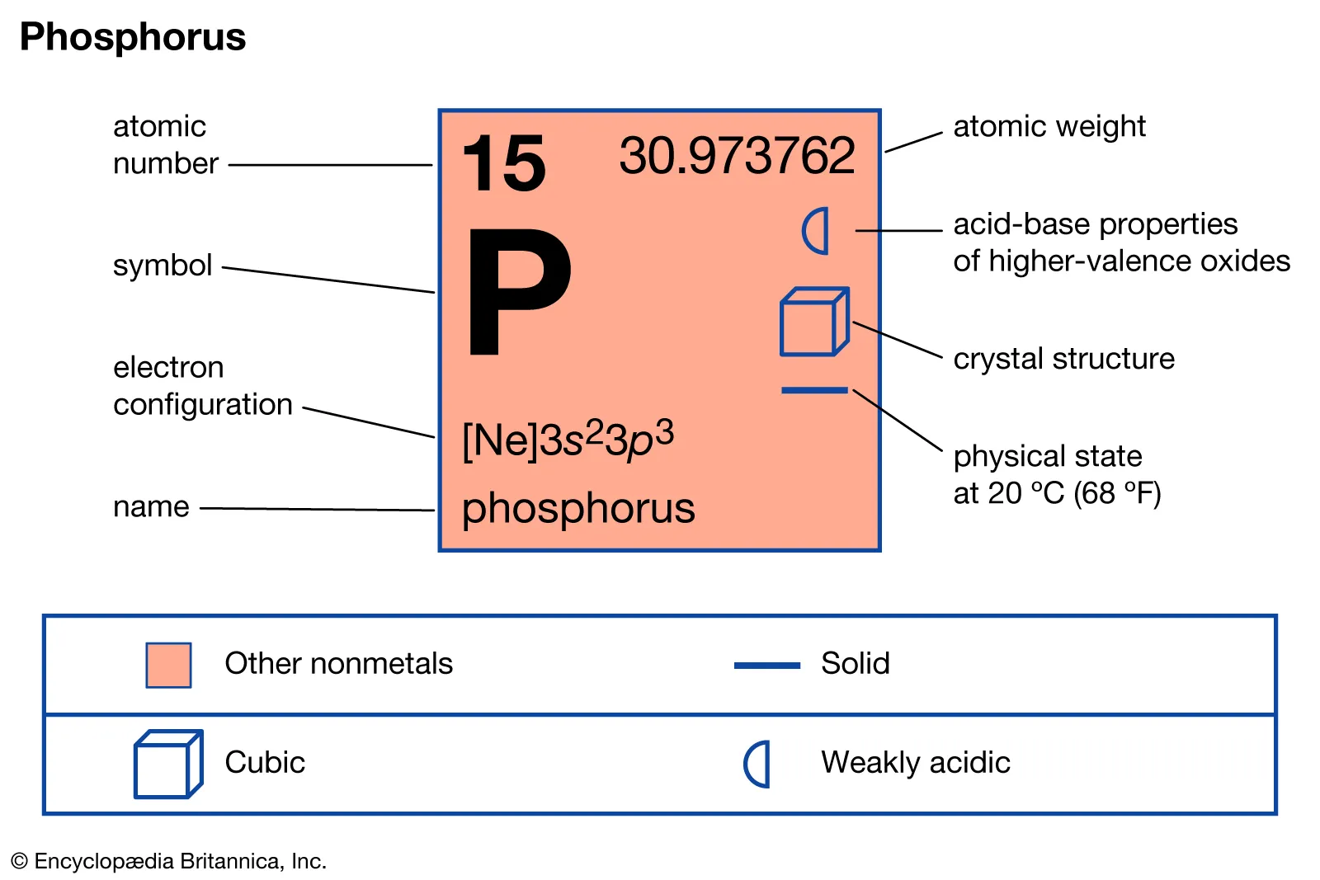
Phosphorus—the first limiting nutrient for aquatic plant growth in fresh water; the most available form is orthophosphate
Fish hatchery effluent is a point source of phosphorus derived from uneaten and undigested feed solids and metabolic
waste

Slide 3
Feed composition
Digestibility of the ingredients used in the feed
Approximately 19% organic carbon, 13% total nitrogen and 55% total phosphorus from the feed can be contained in the fecal material
30% or more of the phosphorus in the feces can leach out adding to 9% total phosphorus and 36% total nitrogen excreted as dissolved nutrients

Slide 4
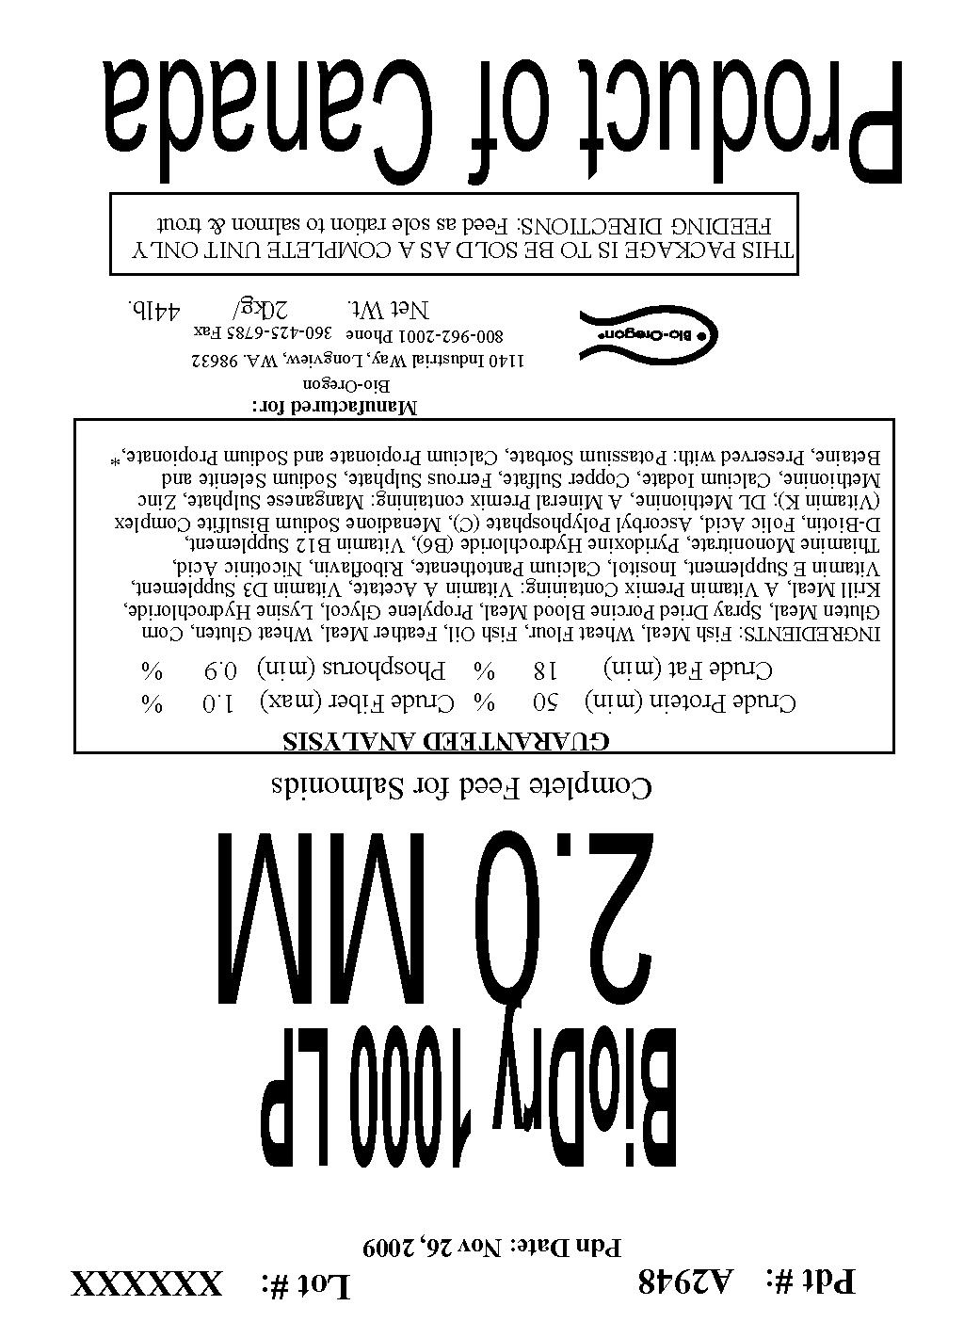
Low phosphorus feed
Low phosphorus diet achieved
through the formulation
BioVita Fry has phosphorus levels from 1.2% to 1.5%
Pacific salmon requirement is 0.6% available/digestible phosphorus
Notes:
To be safe feeds are not formulated much lower than 0.9% P, for certain salmonids the P requirement is 0.6% digestible P

Slide 5
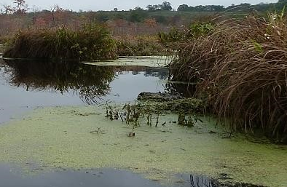
Benefit of low phosphorus feeds
Reduction of phosphorus contributed by the feed in the effluent
As the level of phosphorus in the feed is reduced it is used more efficiently by the fish
Notes:
But you can go too low.

Slide 6
Low phosphorus feeds tested
Formulated feeds to contain 0.6% P, 0.8% CaP and 0.8% NaP.
Fecal leaching of orthophosphate was significantly reduced using the experimental feeds, 0.6% P and 0.8% NaP, compared to both BioVita and BioDry LP.
Apparent digestibility of phosphorus was highest when 0.8% NaP was used.

Slide 7
In hatchery low P feed trial
Conducted at the WDFW Issaquah Hatchery by Jack Tipping (WDFW) and Dr. Karl Shearer (NOAA).
Used Coho (13 g, avg), fed a low phosphorus feed (0.82% P) or a standard diet (1.26% P) from October until April release.
Two raceways per treatment, study repeated for three years.

Slide 8
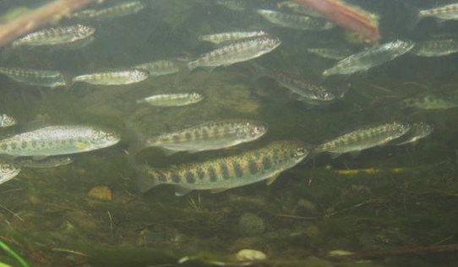
Low P feed trial, cont.
Phosphorus retention significantly greater in fish fed the low phosphorus feed.
Phosphorus discharges in hatchery effluent reduced by 55.3% on average with the low phosphorus feed.
Lengths and feed conversions were generally similar between the two treatments.

Slide 9
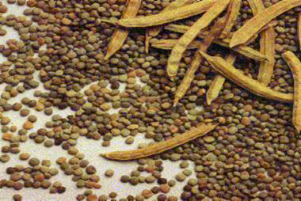
Feed with guar gum
Guar gum added to feed to stabilize the feces for efficient removal and reduced phosphorus leaching
Phosphorus levels don’t have to be extremely low
Notes:
Fecal material can contain 19% organic carbon, 13% total N, 55% total P; good to bind the fecal material to maintain a larger pellet to reduce surface area and therefore leaching. Dissolved nutrients 36% total N, 9% total P

Slide 10
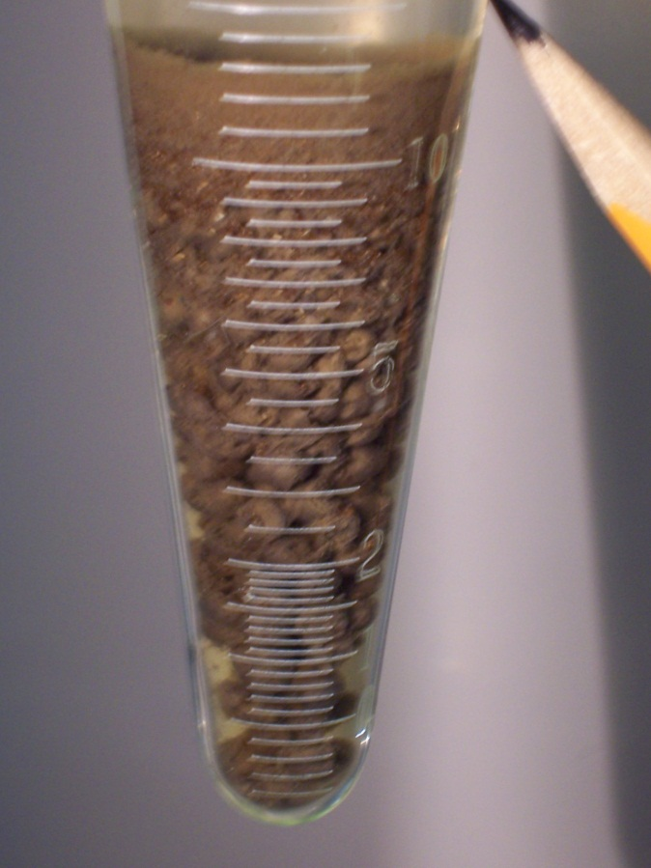
Benefits of guar gum
Fecal phosphorus leaching rate and fecal particle size distribution were significantly affected by dietary guar gum supplementation (added at 0.3% of the diet)
Notes:
BioClark’s Fry

Slide 11
Guar gum
Fecal particle size | 6 wks |  |  | 12 wks
 | %
Dietary treatment | Small | Medium | Large | Small | Medium | Large
Practical Diet w/o guar gum | 60.8 | 15.5 | 23.7b | 22.6a | 58.7 | 18.7
Practical Diet w/guar gum | 32.5 | 19.5 | 48.0a | 7.2b | 59.9 | 32.9
Commercial Diet | 33.9 | 20.5 | 45.6 | 32.8 | 27.0 | 40.1
P-value | 0.067 | 0.355 | 0.046 | 0.004 | 0.881 | 0.557
Commercial diet added for comparison, not included in the analysis. Significance at P<0.05

Slide 12
Guar Gum
 | Fecal settling |  | P leaching
 | 6 wk | 12 wk | 6 wk | 12 wk
 | cm/sec |  | ųg/ml/g feces
Dietary treatment
Practical Diet w/o guar | 2.1 | 2.9 | 4.2 | 0.09ª
Practical diet w/guar | 2.7 | 3.4 | 0.07 | 0.04^{b}
Commercial diet | 3.7 | 4.3 | 0.25 | 0.15
P-value | 0.212 | 0.315 | 0.056 | 0.0065
Commercial diet added for comparison, not included in the analysis. Significance at P<0.05

Slide 13
Phosphorus deficiency
Bone deformities (Roberts et al. 2001)
Low alkaline phosphatase (Skonberg et al. 1997)
A
B
C
Notes:
After feed a P replete diet the fish may not appear deficient but their bones show they were getting a deficient diet at one time. A normal RBT; B RBT fed deficient diet; C Atlantic salmon showing deficiency—fast growing young fish on a low P diet. Feed samples contained 0.7%-0.8% P Low alkaline phosphatase in guar fed fish, may bind P to make it less available.

Slide 14
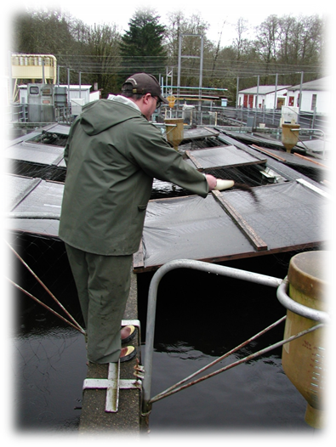
Feeding methods
Reduce feed waste, feed carefully
Alternate the low phosphorus feed with standard feed

Slide 15
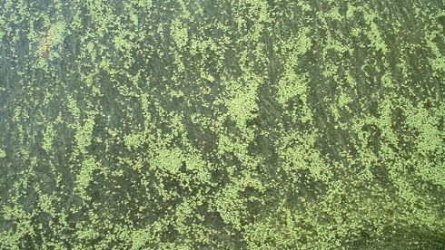
Thank you

