Slide 1
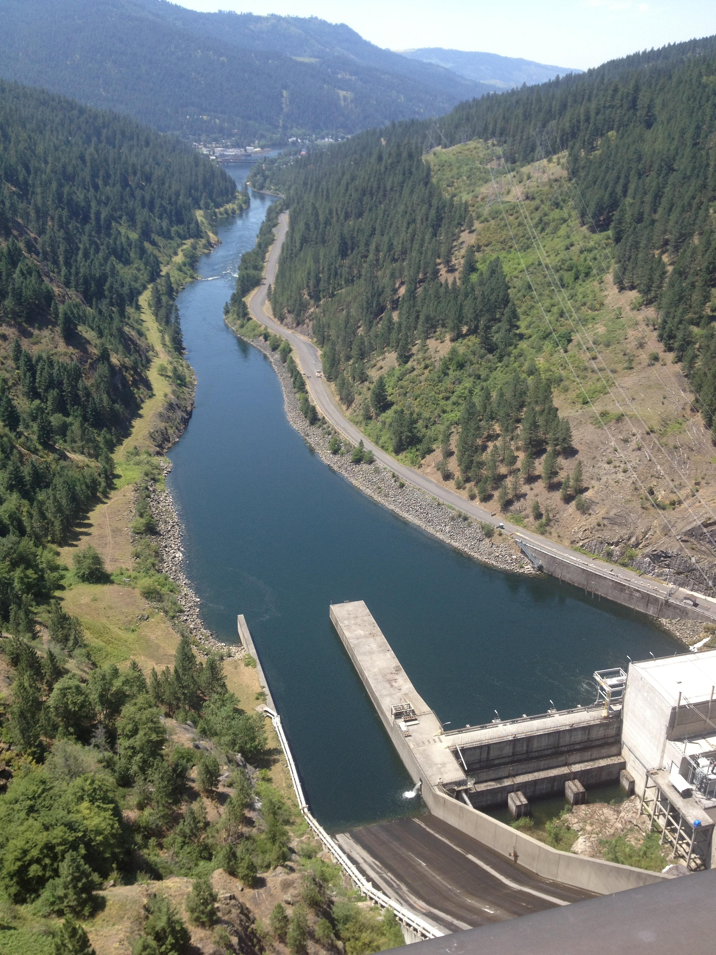
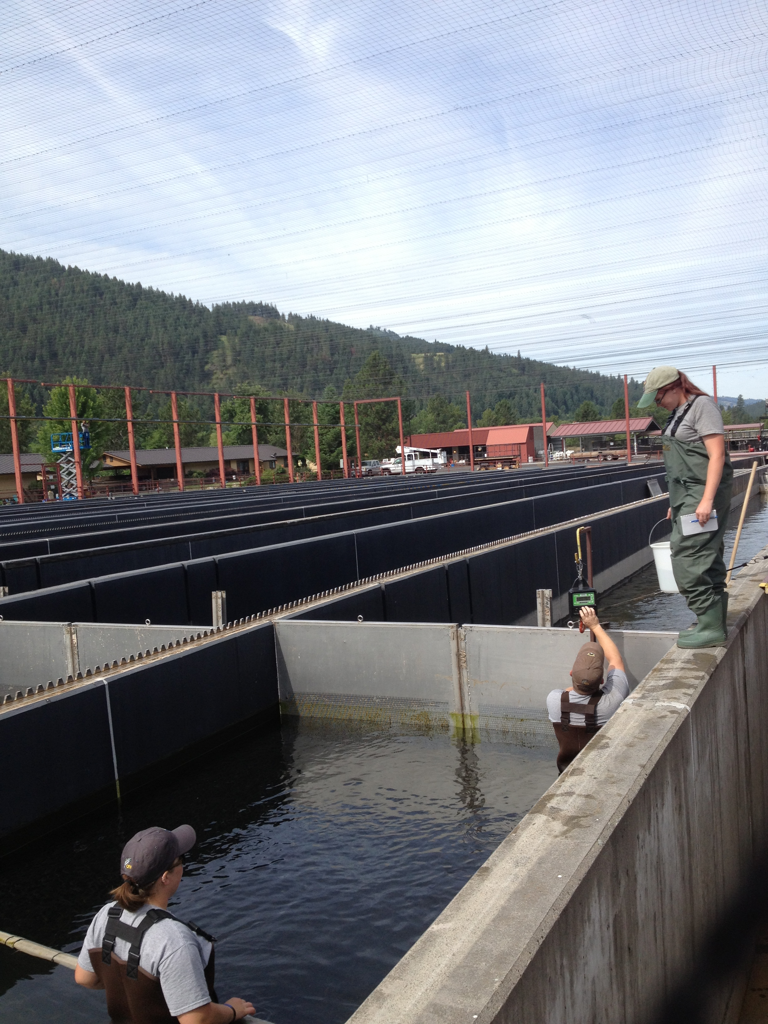
LSRCP Annual Meeting
Consideration of New Water Supply Lines to the Clearwater and Dworshak National Fish Hatcheries
April 26, 2023 Lewiston, Idaho

Slide 2
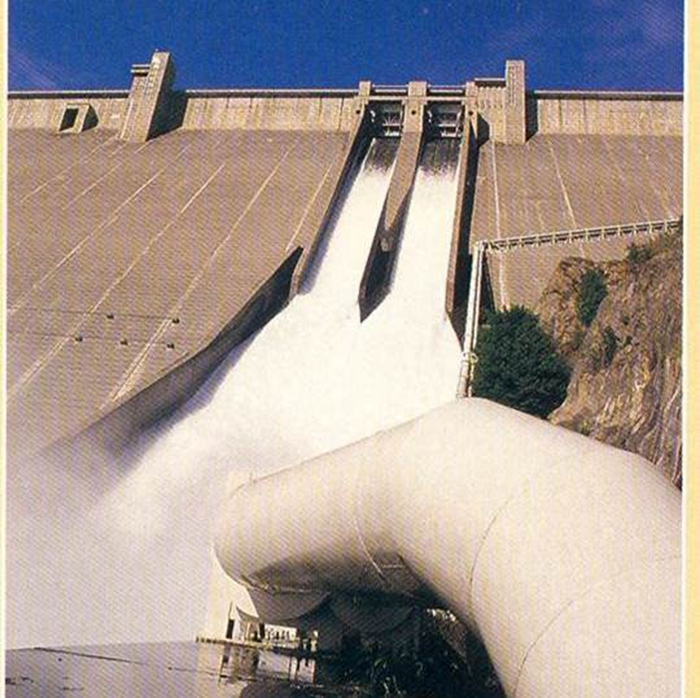
Clearwater Hatchery Water Supply Pipeline
Photo courtesy BPA 2012-08-07
Notes:
The hatchery has a water right for 89 cfs, and clean, disease-free water is supplied to the facility via two pipelines that run from the Dworshak Dam down the south bank of the North Fork Clearwater River. Unfortunately, the segment of the line that runs beneath the North Fork Clearwater River to the hatchery is improperly sized to convey the full water right. As a result, existing infrastructure on the station cannot be watered up and utilized for rearing.

Slide 3
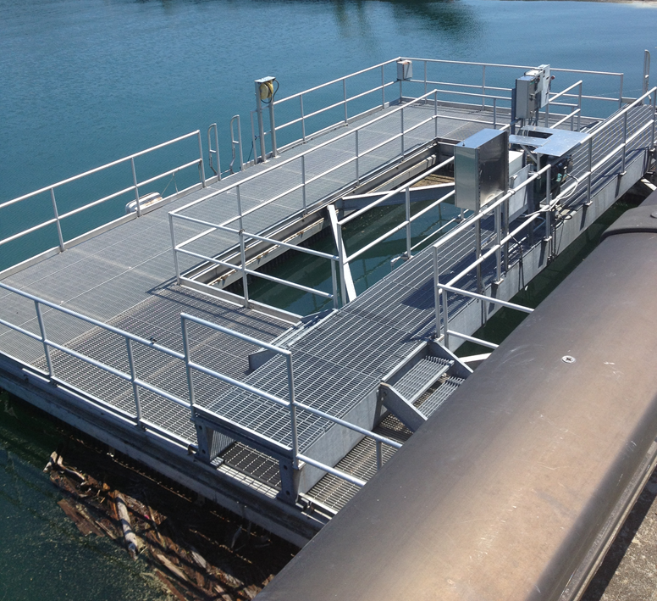
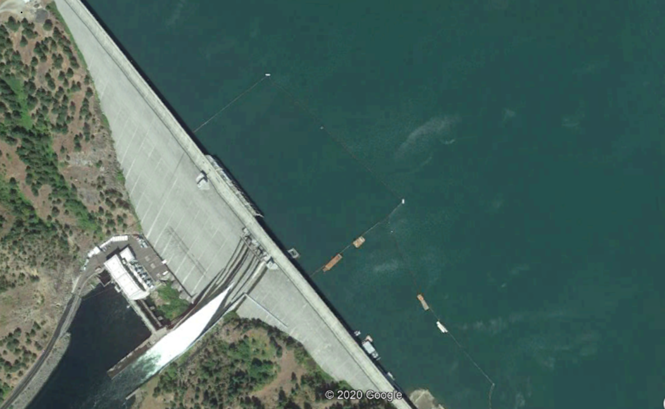
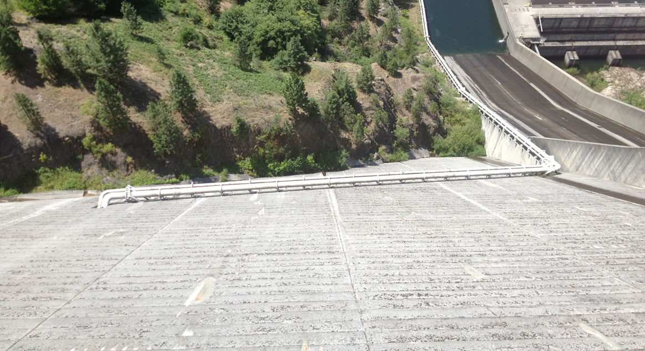
Water Conveyance
Platform supporting primary pipeline snorkel
Pipelines exiting downstream face of Dworshak dam
Notes:
Those who have considered a new pipeline system to convey water from the Dworshak Reservoir to Clearwater Fish Hatchery have envisioned an installation similar to the existing one.
Currently, the primary line provides a maximum flow of 71 cfs that is collected near the reservoir surface. That intake is outfitted with a moveable snorkel that can be adjusted to pull water in a range from 10’ to 60’ feet deep. This allows the facility to select from a range of available water temperatures to best suit fish feeding and growth plans.
The secondary pipeline provides a maximum of 18 cfs to the hatchery. The intake for this line is at a fixed depth much deeper in the reservoir, and provides water at a relatively stable (42ºF) temperature year round.

Slide 4
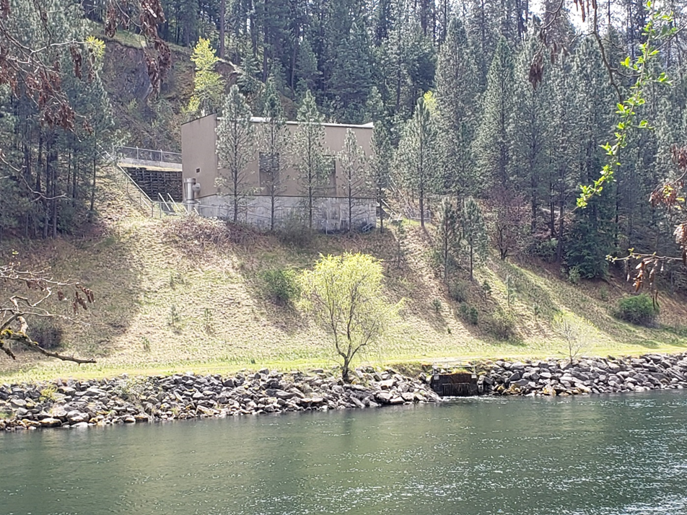
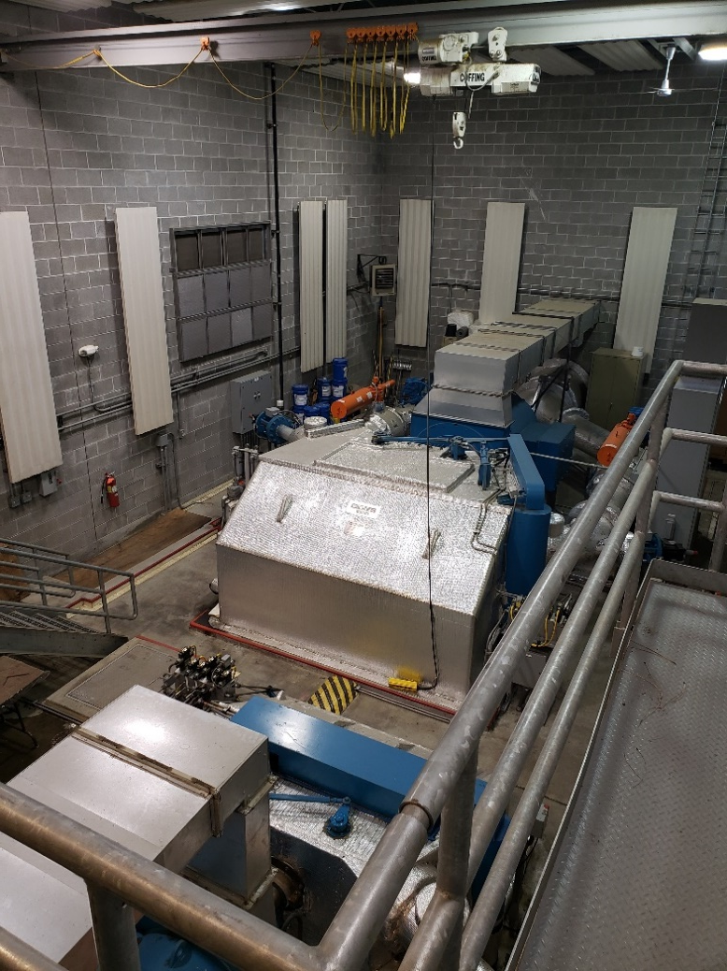
Power Generation
Notes:
The existing system also includes a turbine that decelerates the water prior to its reaching the hatchery and generates power that is sold to BPA.
The hatchery has been well served by the ability to select from a range of temperatures using the shallow intake, and to blend water from the shallow and deep lines. And the hydroplant provides benefits both to the hatchery and in power generation.

Slide 5
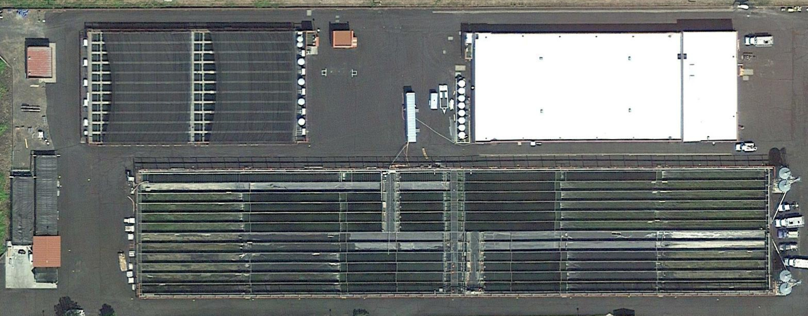
Clearwater Raceway Use
Blue = Steelhead Green = Chinook Salmon Red = Empty
Notes:
Here we have a google earth photo that gives a clear view of the Clearwater Fish Hatchery concrete raceways.

Slide 6
Clearwater Raceway Use
Blue = Steelhead Green = Chinook Salmon Red = Empty
Notes:
Adding a bit of color here, we’ll identify by the color blue those raceways in which steelhead are reared.

Slide 7
Clearwater Raceway Use
Blue = Steelhead Green = Chinook Salmon Red = Empty
Notes:
Here we have green representing raceways used for Chinook rearing.

Slide 8
Clearwater Raceway Use
Blue = Steelhead Green = Chinook Salmon Red = Empty
Notes:
And here is where we can see the extent of the problem. Those raceways colored red are not used for rearing any fish at all. It is estimated that to adequately operate these raceways would require the facility water supply to be increased to 125 cfs. This would allow an additional 1.6 million Chinook Salmon smolts to be produced using current rearing standards.

Slide 9
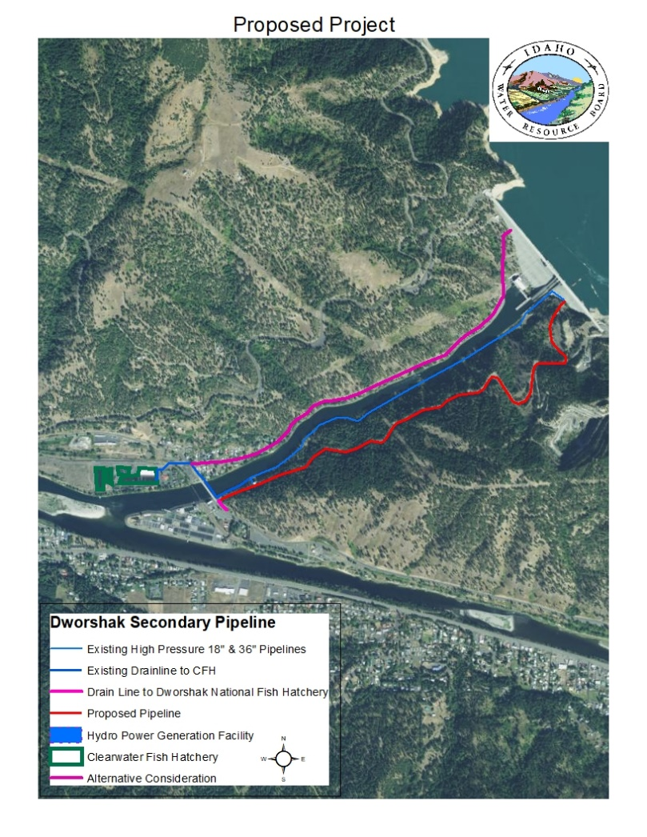
Idaho Department of Water Resources New Pipeline Assessment

Slide 10
2020 IDWR Project Cost Estimate
Construction Item | Cost
Pipeline & Intake | $46.6 Million
Distribution Box | $ 1.4 Million
3.0 MW Powerhouse | $ 8.8 Million
Total Construction Cost | $56.8 Million

Slide 11
2020 IDWR Power Generation Revenue Estimate
30 Year Power Generation Item | Value
Generation | $28.3 Million
Operations and Maintenance | -$ 4.3 Million
Capital Replacement | -$ 1.3 Million
30 Year Expected Net Revenue | $22.7 Million

Slide 12
2020 IDWR Comparison of Project Cost &
Generation Revenue
Comparison Item | Value
Project Cost | -$56.8 Million
Net Revenue from Power Generation | $22.7 Million
Project Net Value | -$34.1 Million

Slide 16
Pipeline Routing on the Left Bank with Approximate Length Noted

Slide 18
Captain John Rapids facility FCAP
Fall Chinook Acclimation Project

Slide 19
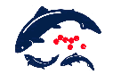





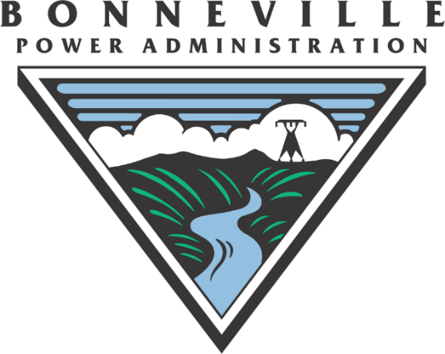
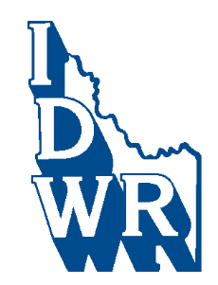



Potential Partners

Slide 20
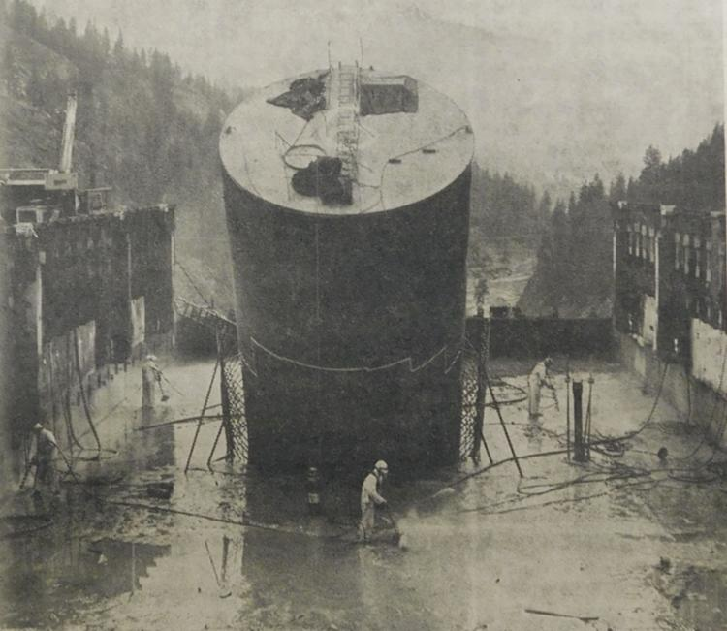
Questions?
Dworshak Dam construction, penstock tube, Clearwater Tribune, February 5, 1970

