Slide 1
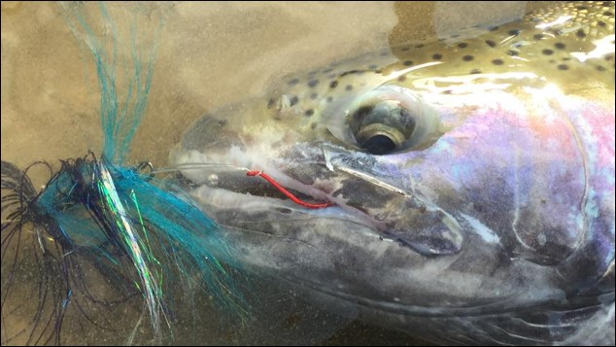

Wallowa Stock Steelhead
Novel Rearing Evaluation
Mike Greiner, Justin Herold, Keenan Schmidt and Joseph Feldhaus
2024 LSRCP Annual Meeting
May 8, 2024

Slide 2
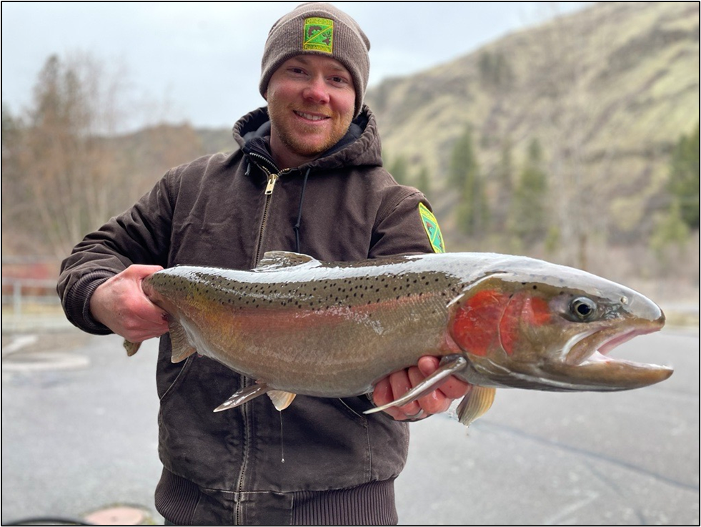
800,000 hatchery summer steelhead released Annually at 5 fish/lb.
Trapping, spawning, incubation: Wallowa
Hatching & rearing: Irrigon
Acclimation: Wallowa & Big Canyon

Slide 3
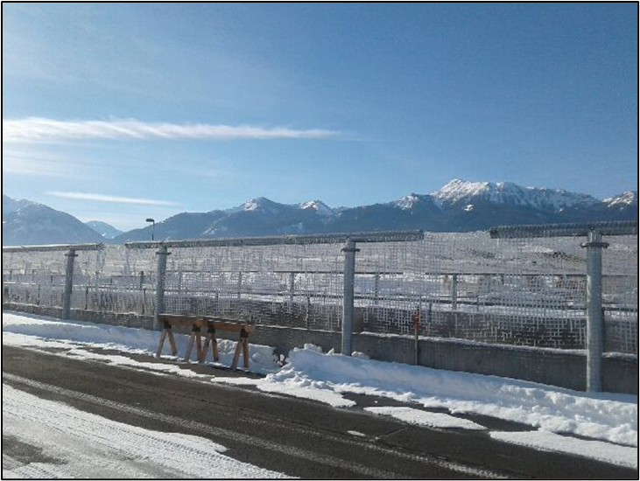
A novel approach to rearing and acclimation Began with by20
Release group | Transfer Date | Release Date | Time at Facility | # Smolts
Wallowa- early | 15-17 Nov | 1 April | 4.5 months | 400,000
Wallowa- late | 5-6 April | 16-26 April | 2-3 weeks | 160,000
Big Canyon | 16-17 March | 8-11 April | 1 month | 240,000
Necessitated by space, water issues
3 months early

Slide 4
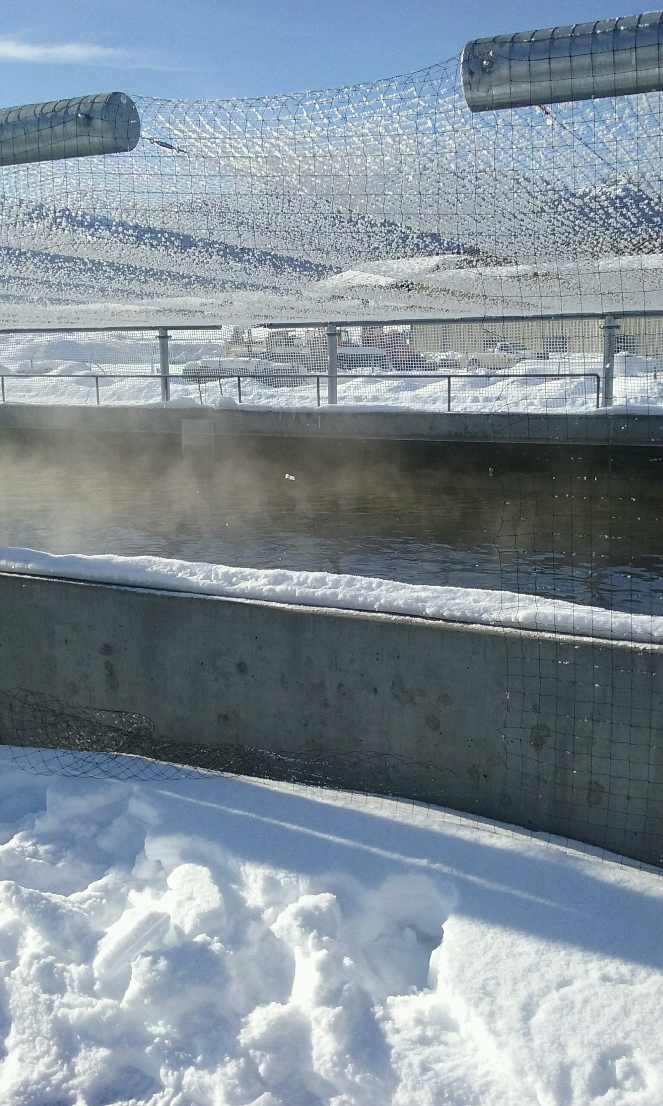
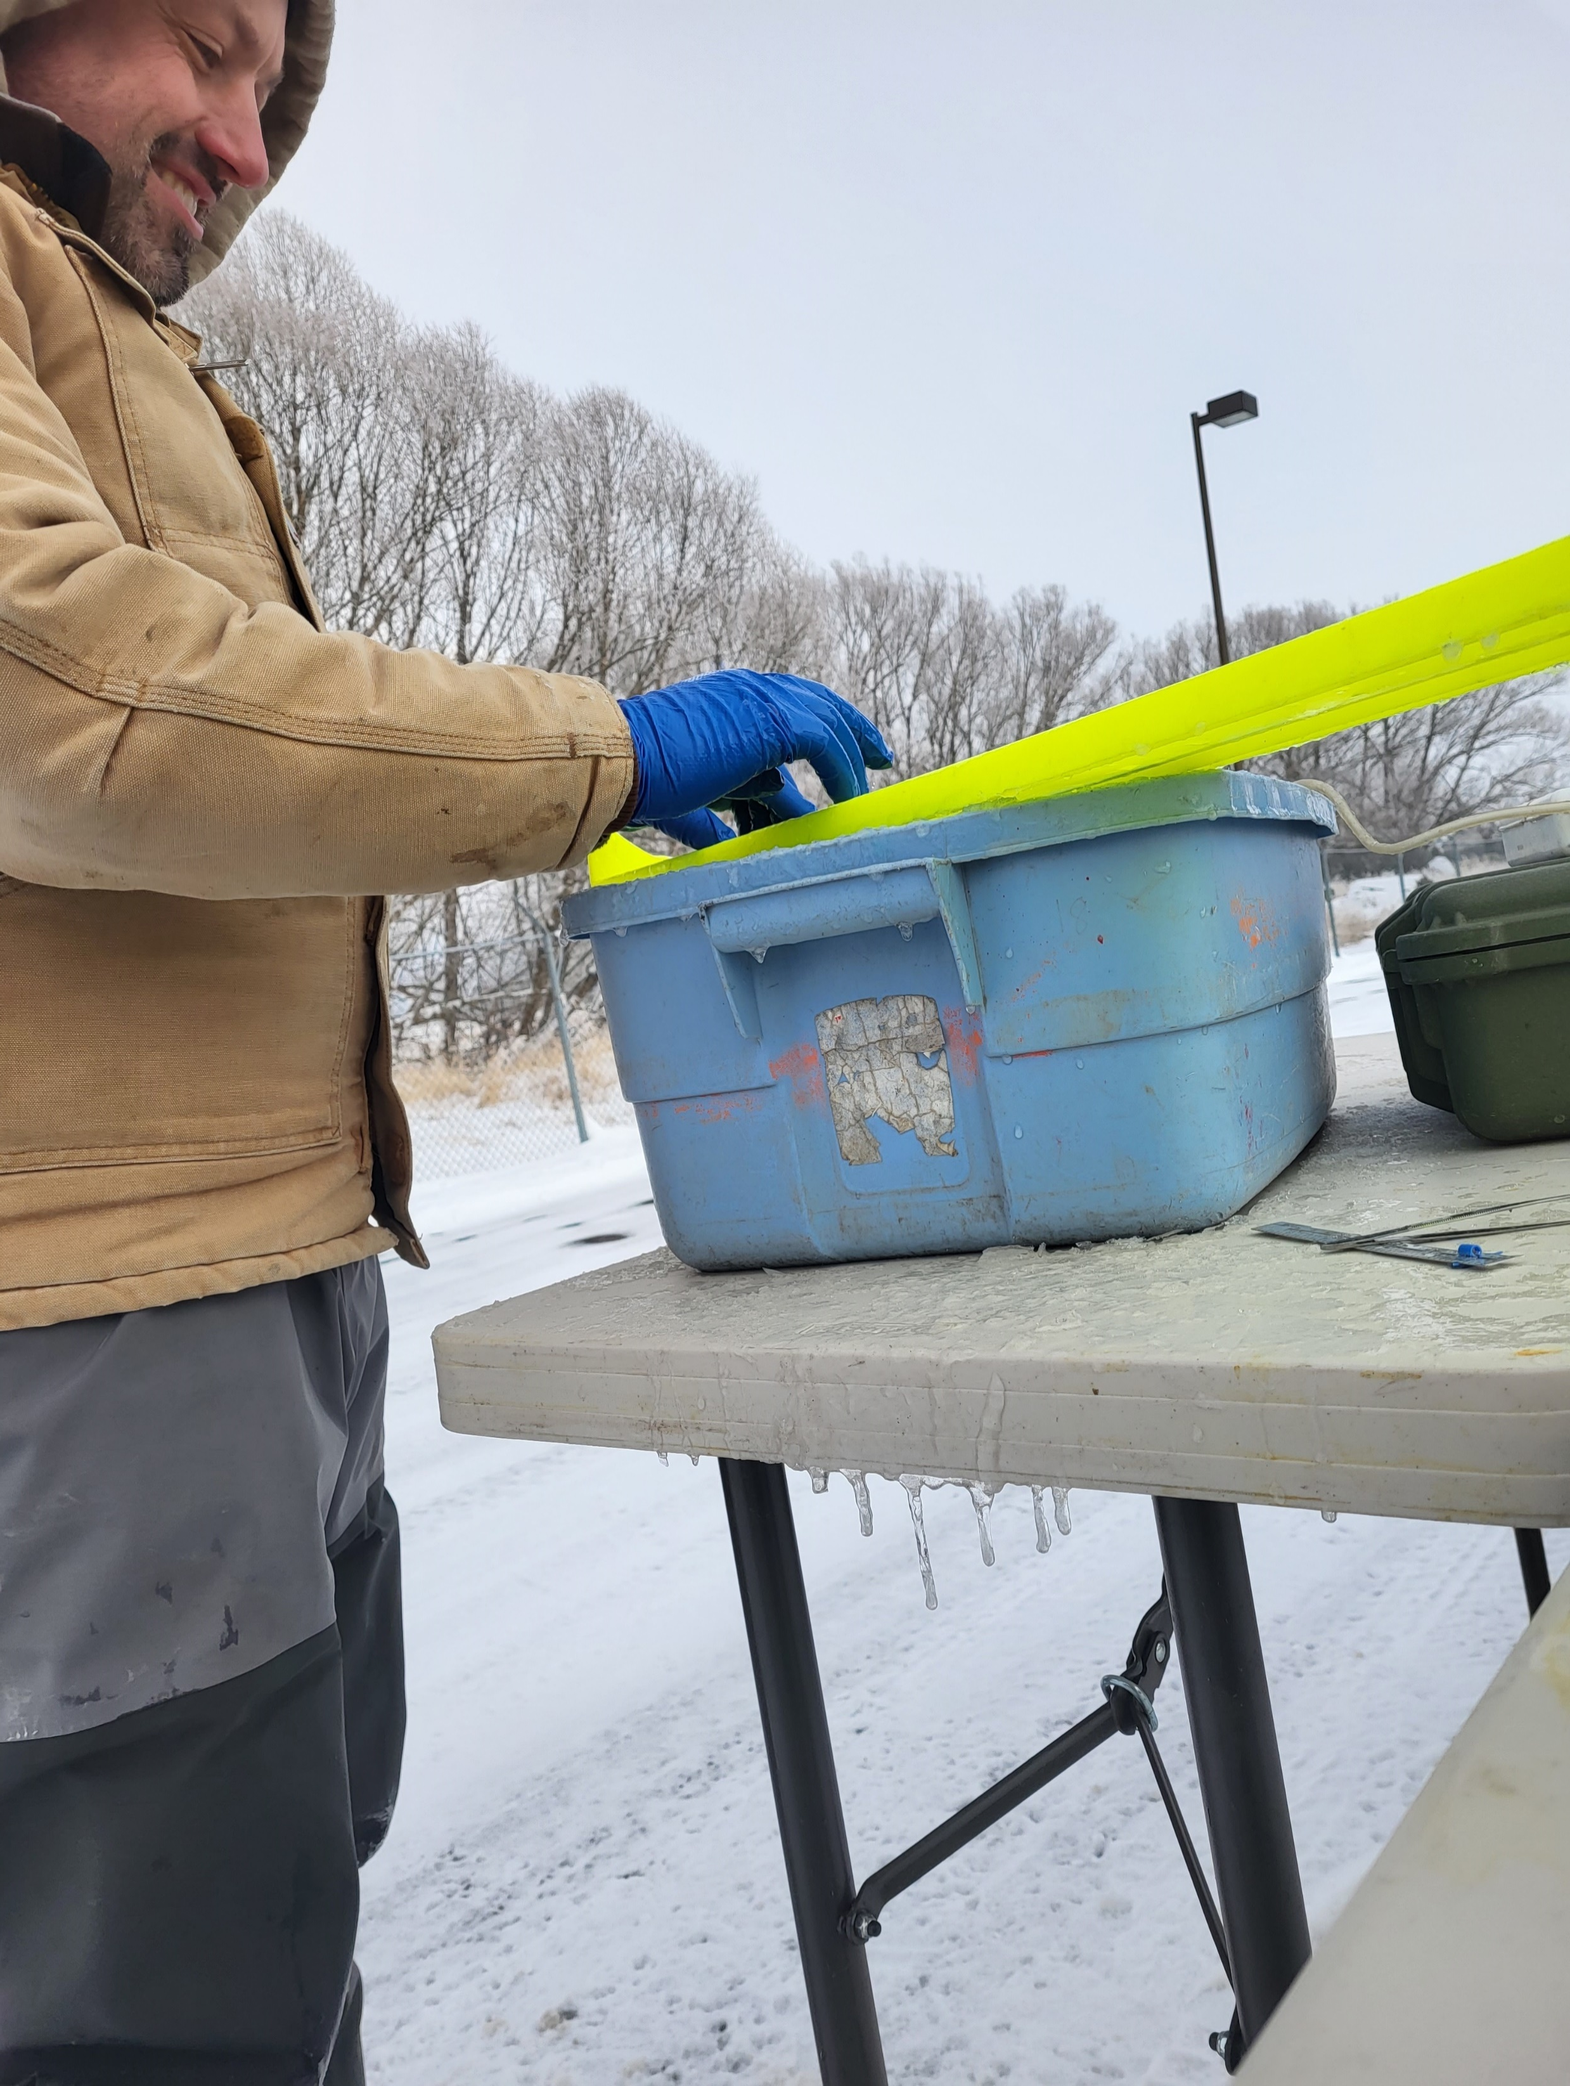
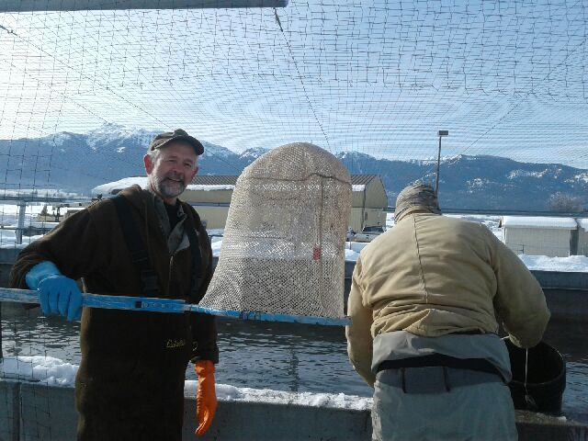
Differential Rearing & Acclimation
Irrigon- well water 10.5-13.9 °C
Wallowa- surface water 0-11.9 °C

Slide 5
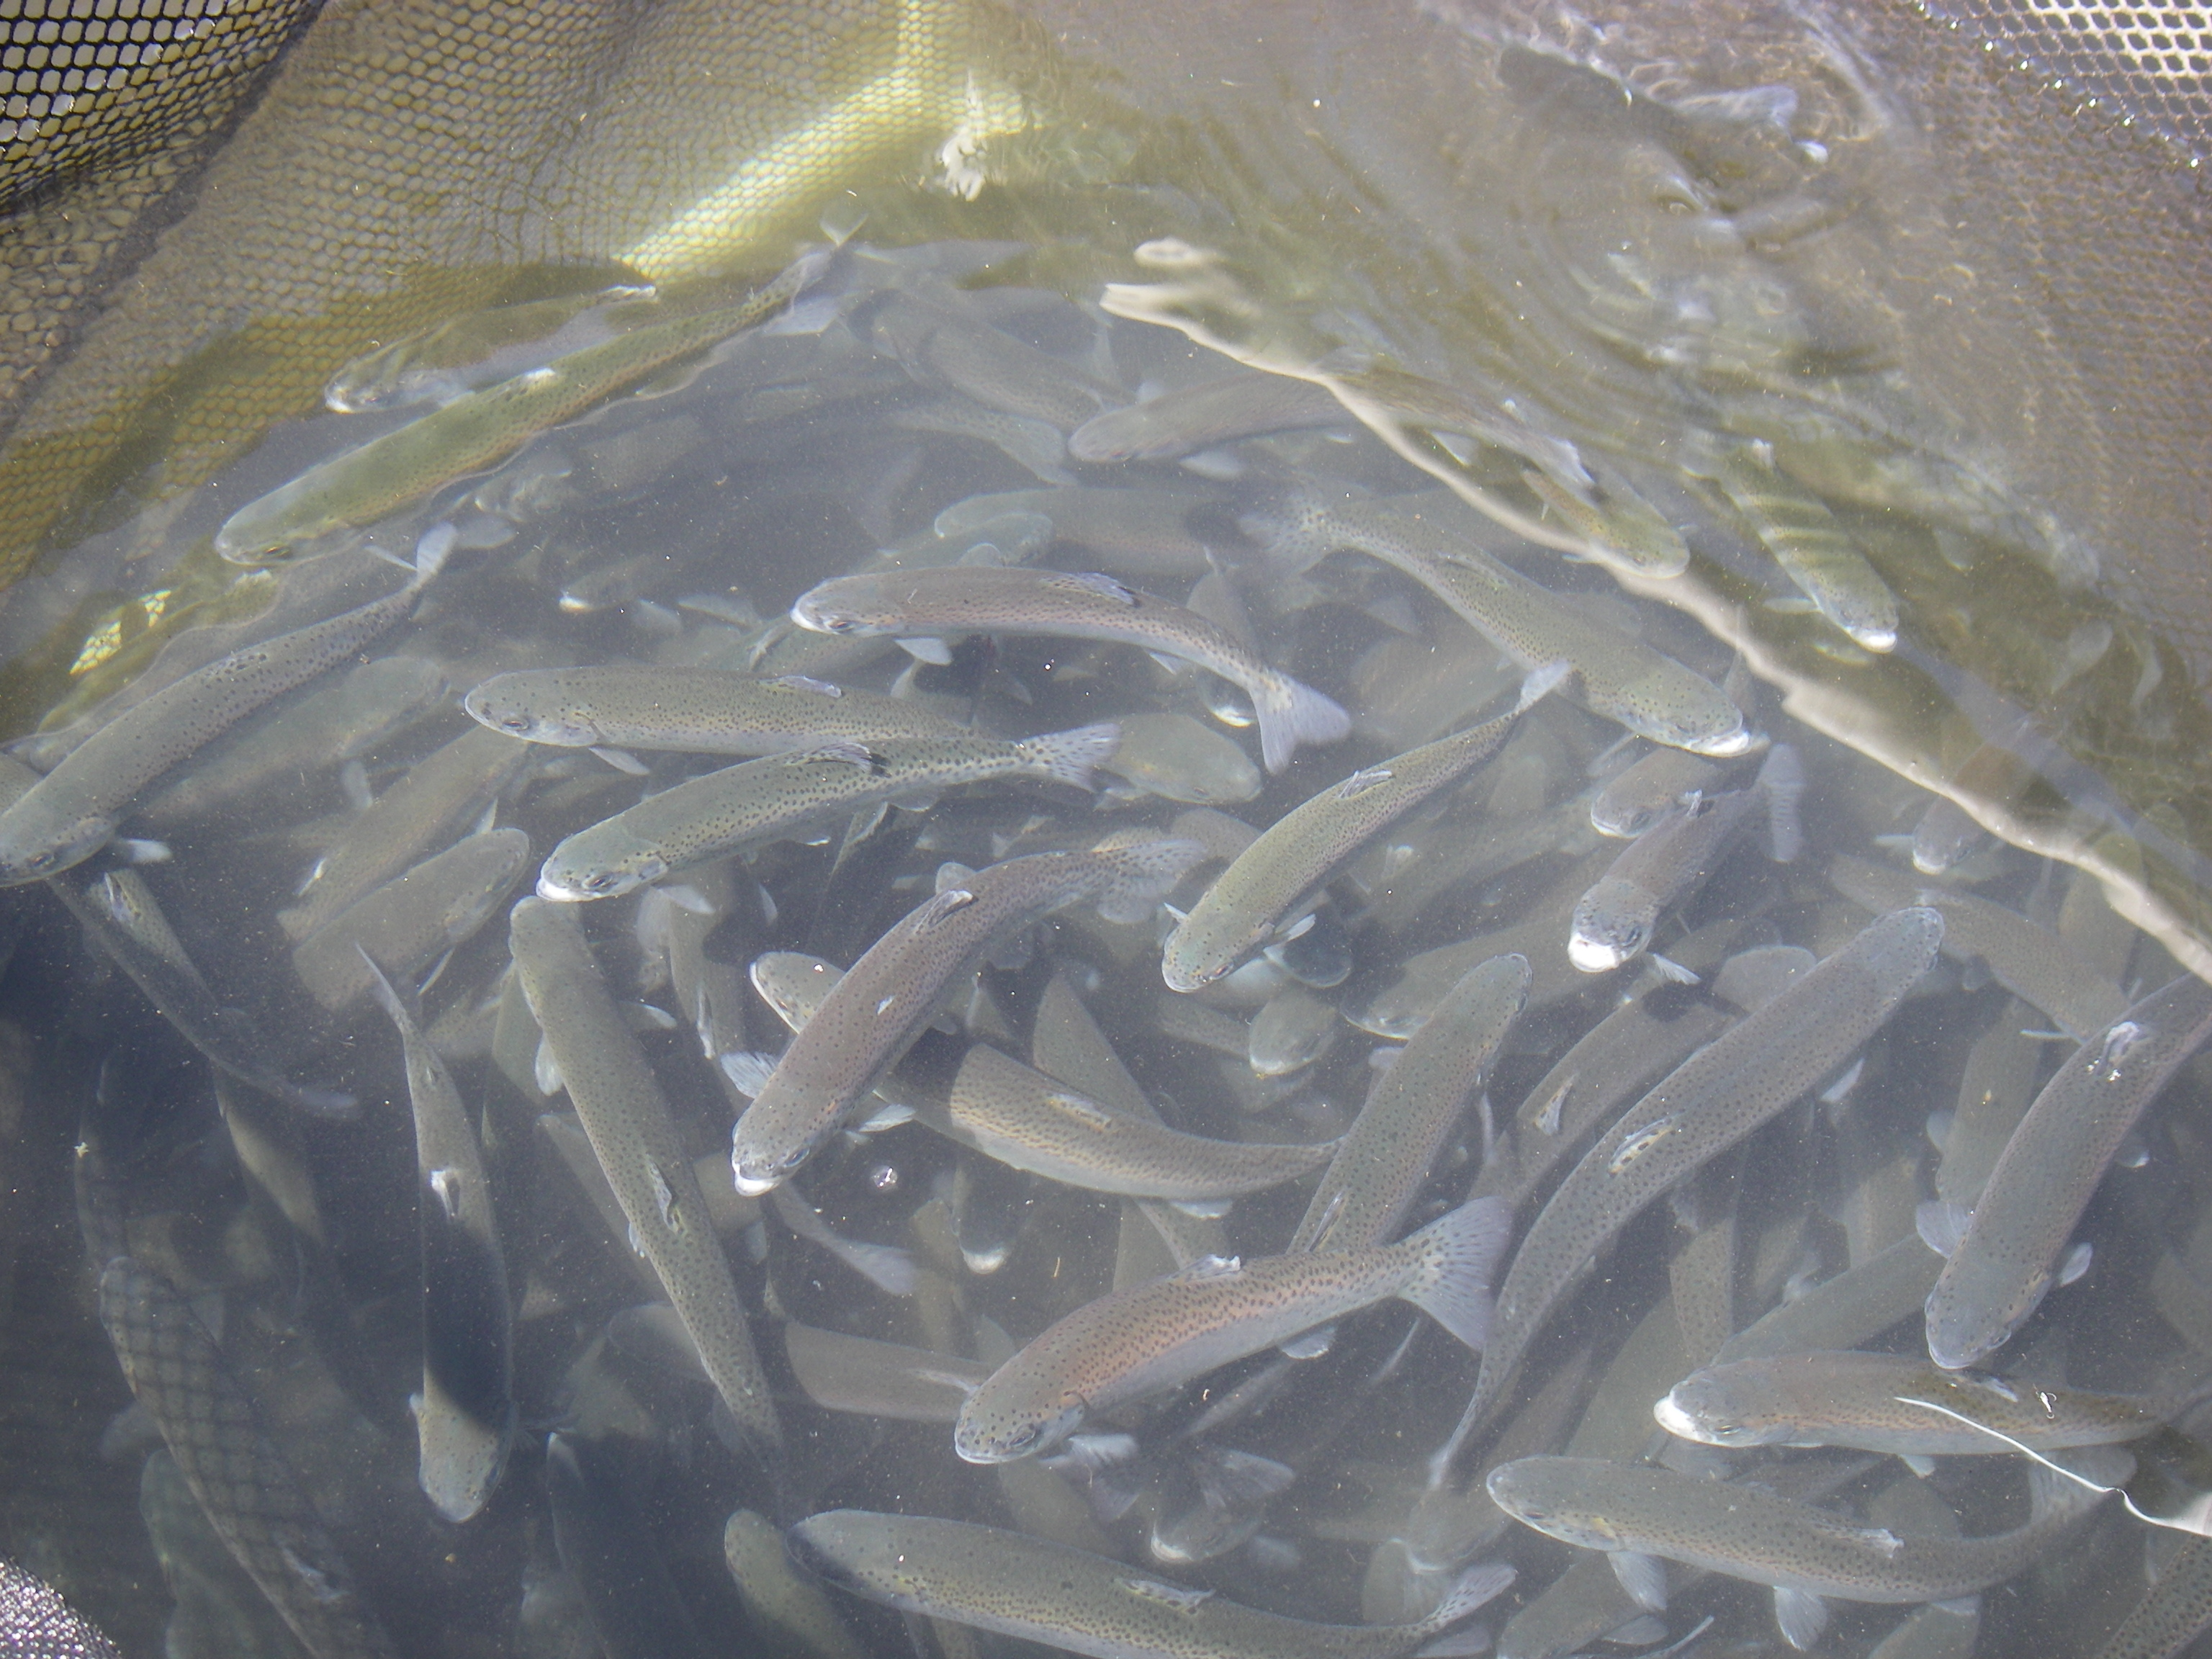
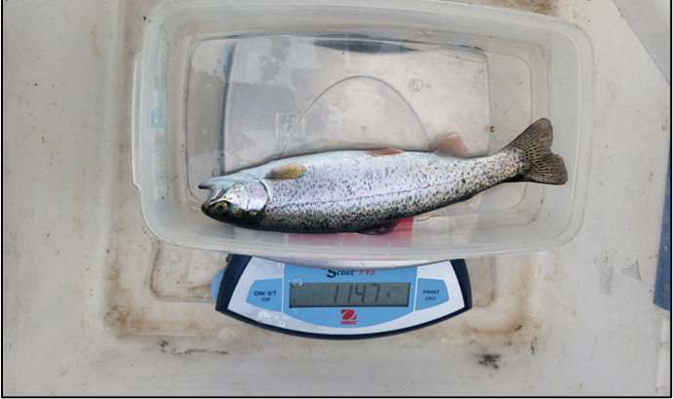
Effects on Growth, Juvenile survival, adult returns?
Pre-release growth metrics
Post-release survival, arrival timing
Adult returns

Slide 6
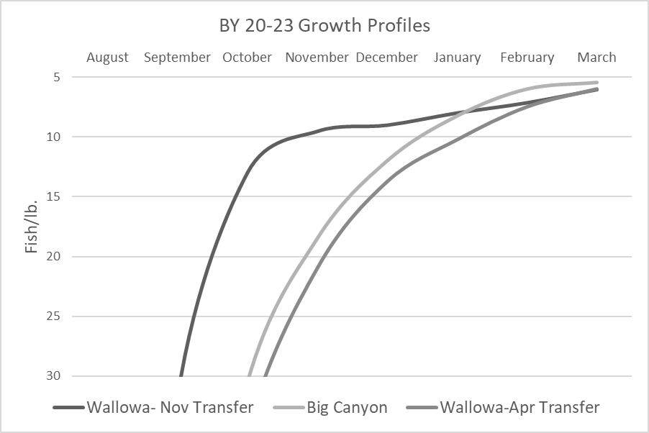
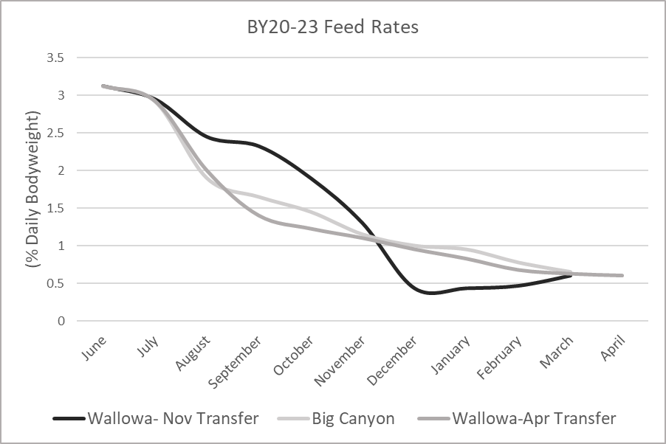
Growth & Feed Rates

Slide 7
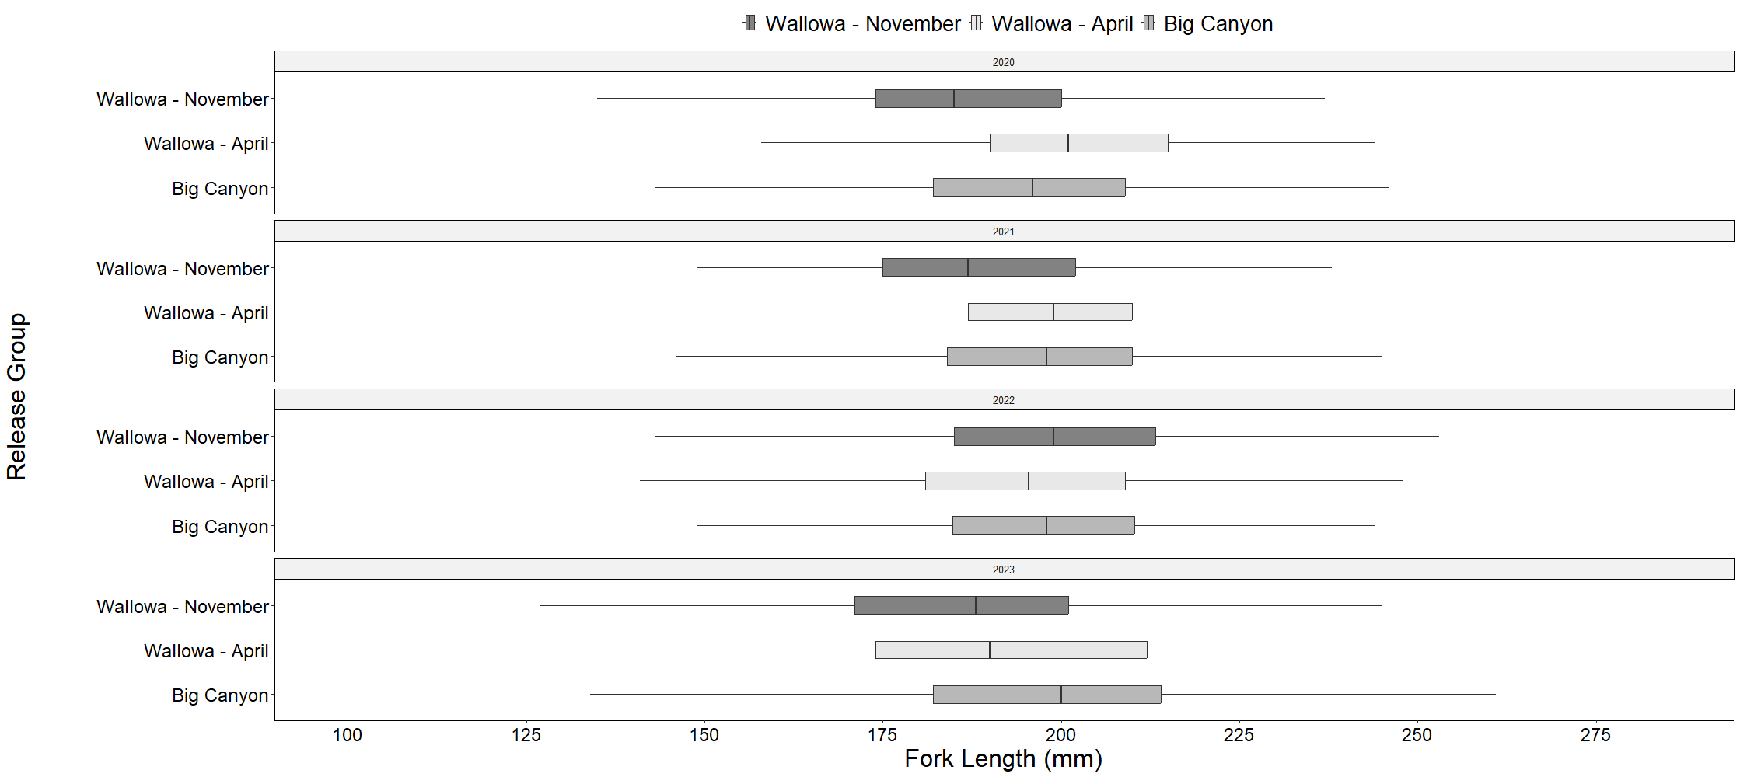
Notes:
Early-189.3, late-196.3, big canyon 196.7

Slide 8
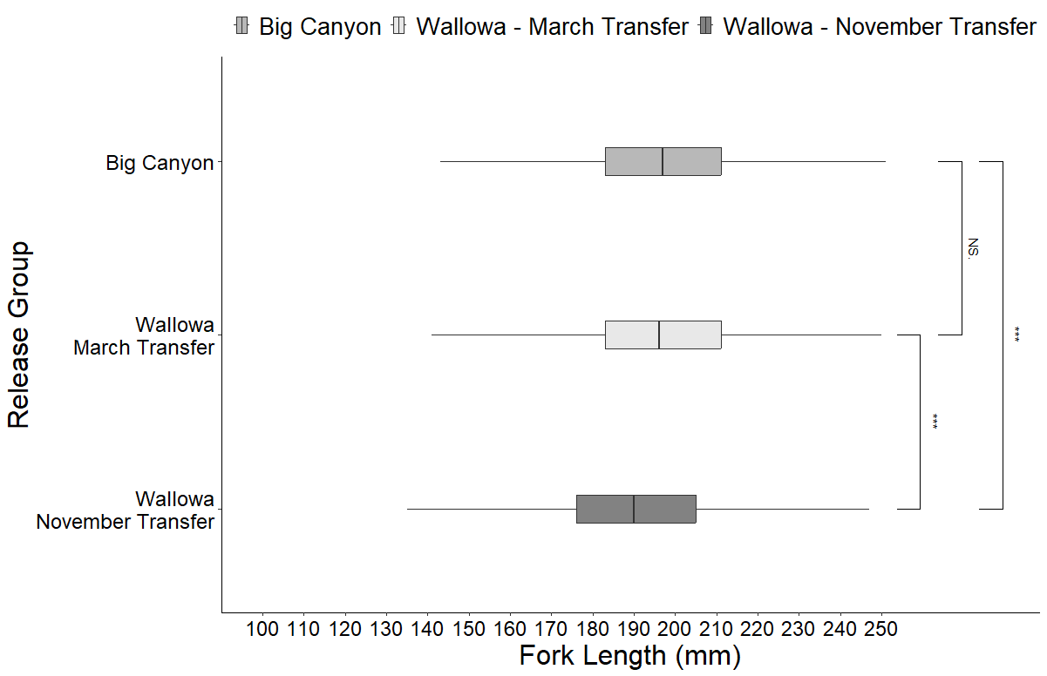
Notes:
Early-189.3, late-196.3, big canyon 196.7

Slide 9
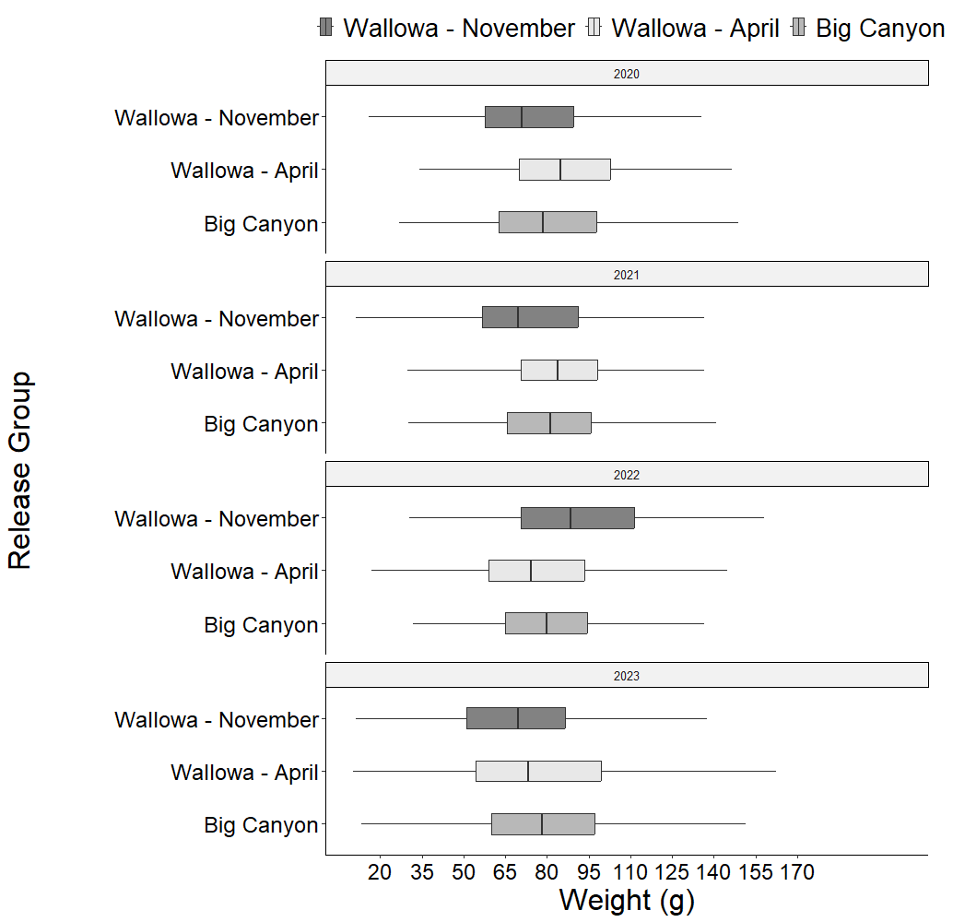
Notes:
Early-78.1,late-82.2,BC- 80.9

Slide 10
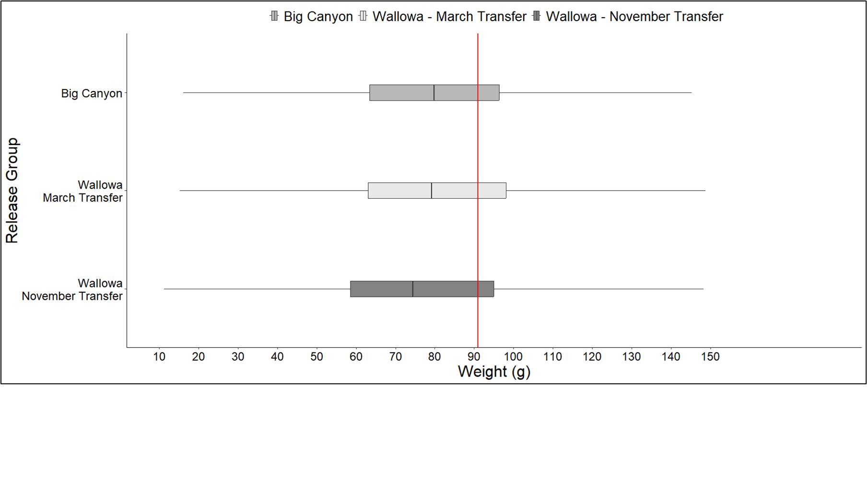
Notes:
Early-78.1,late-82.2,BC- 80.9

Slide 11
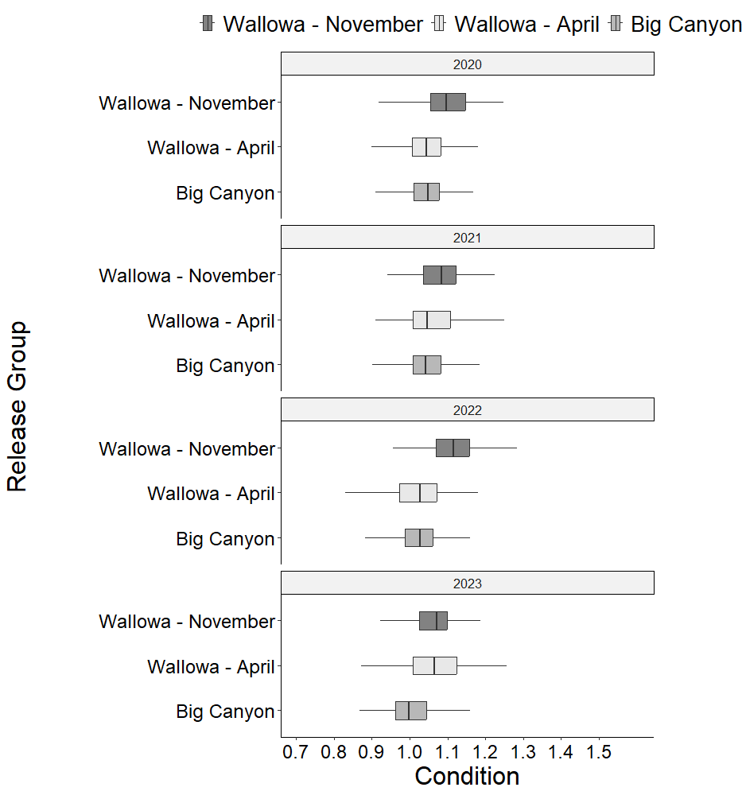
Notes:
EARLY-1.09, LATE-1.05, BC- 1.03

Slide 12
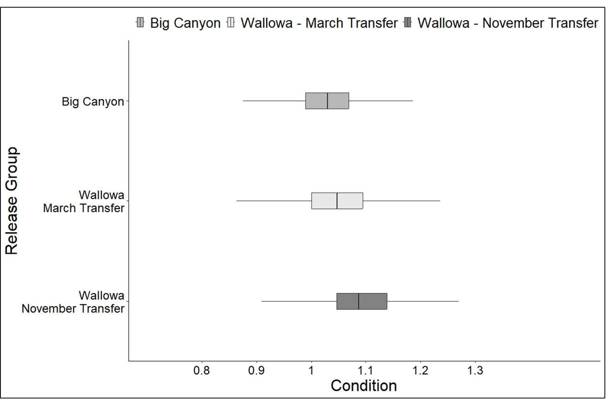
Notes:
EARLY-1.09, LATE-1.05, BC- 1.03

Slide 13
LGD travel days

Slide 14
LGD arrival date

Slide 15
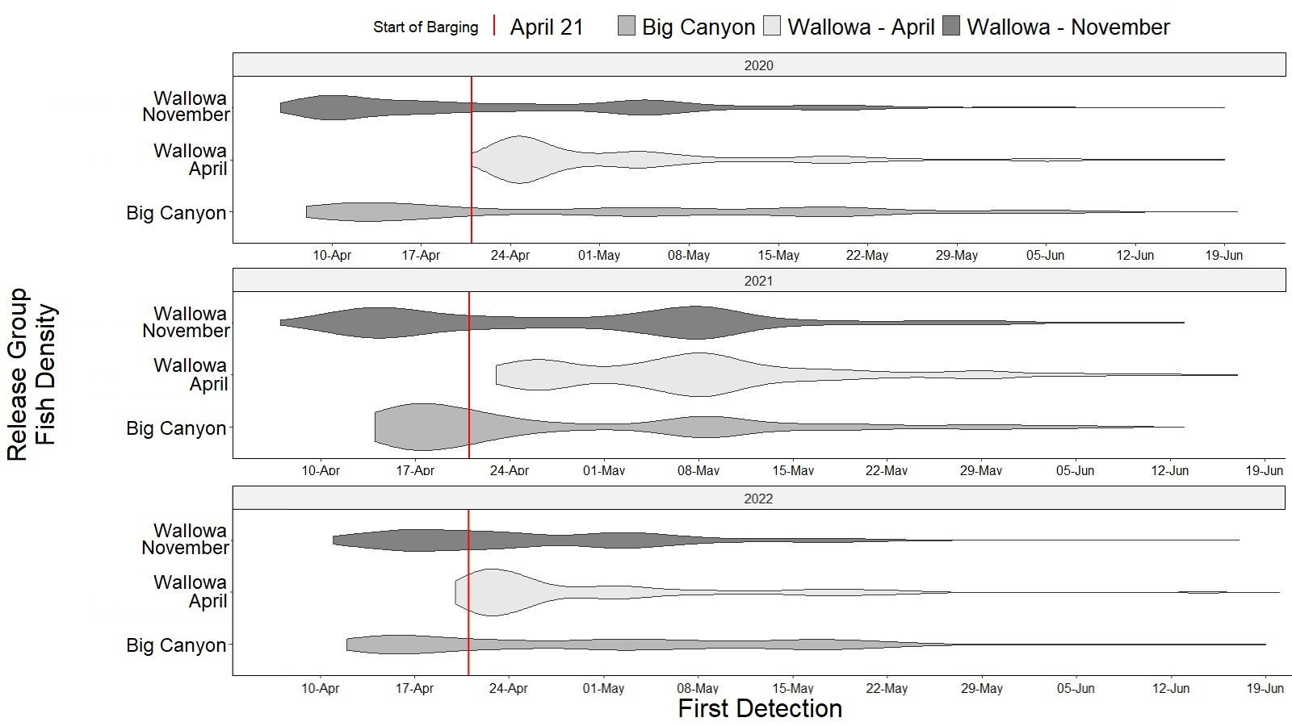

Slide 16
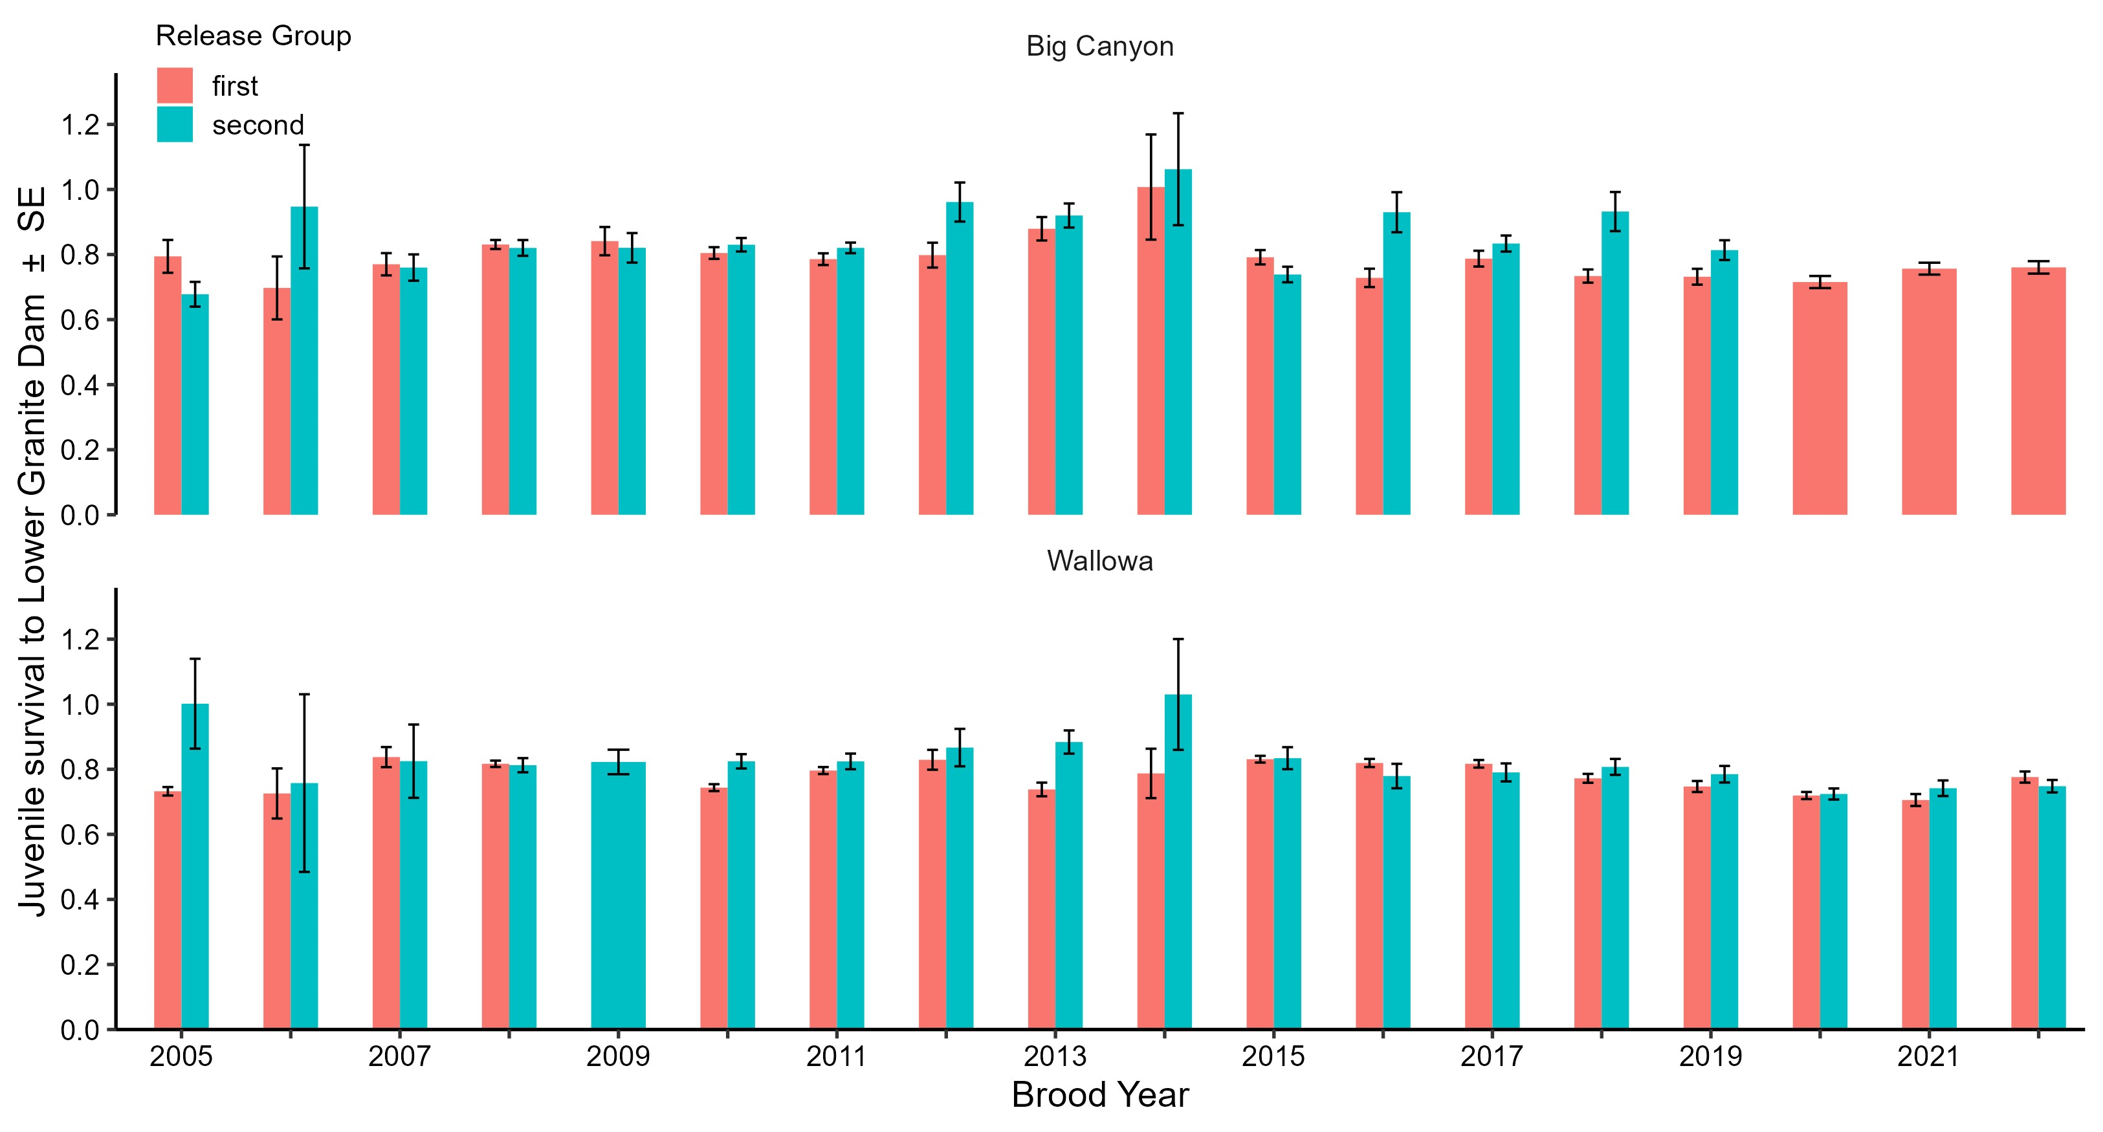
Annual survival

Slide 17
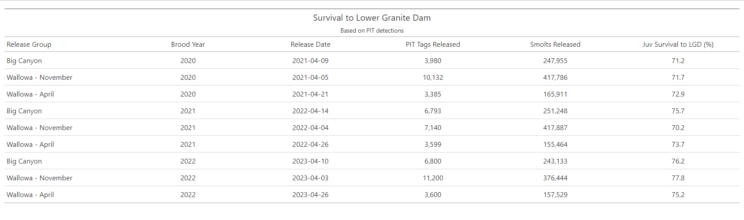
Survival BY20-22

Slide 18
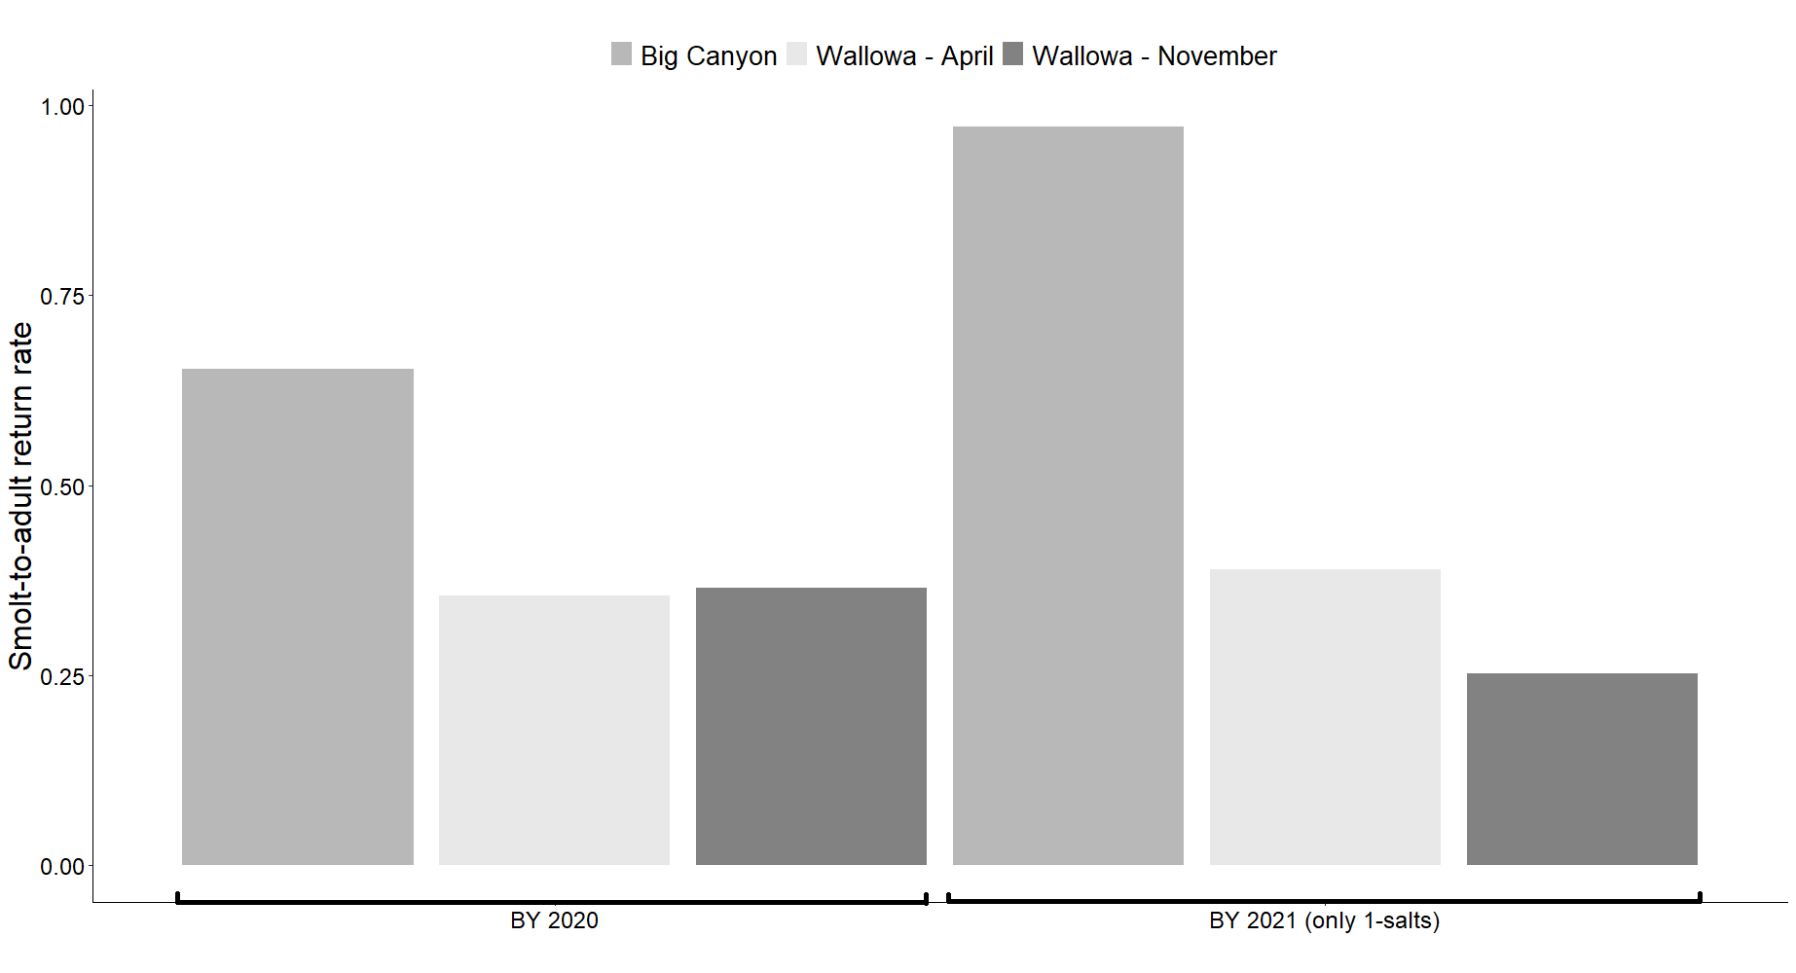
SAR
Notes:
2020: BC 65%, early 37%, late 35%
2021: BC 97%, early 39%, late 25%
WALH rkm63; BCANF rkm18. 45rkm diff., better water quality

Slide 19
tAKEAWAY
Different feed rates/ growth profiles
Nov Transfer smaller
Longer travel time/ earliest arrival at LGD
Similar survival & SARs
Big Canyon SARs?

Slide 20
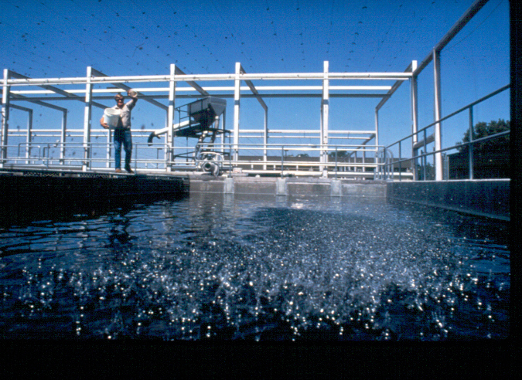
Questions

