Slide 1




An Evaluation of smolt release timing to Improve Adult Returns of Spring Chinook Salmon Adults
Chris Noyes, IDFG
Bill Young, NPT/IFWCO
LSRCP Annual Meeting – 2024
Boise, ID
Notes:
Salmon 0.481 (minus PahP)
Clearwater 0.388
From the Hesse dataset, it appears that Dworshak NFH smolts are released approximately 21-days earlier than optimal for a full complement of passage options. LSRCP supports a basin-wide review of all release timing. However, given the magnitude of effort required for a large-scale review, a prudent approach may be to examine a small component of the release timing. Reviewing Spring Chinook smolt release timing from the Clearwater basin and specifically the Dworshak National Fish Hatchery, represents an opportunity to review a significant portion of Spring Chinook smolt production (15%). In addition, since most Dworshak NFH smolt release occur onsite, significant opportunity is available to adjust release timing with minimal program costs.
Despite published benefits to transporting Hatchery yearling Chinook, facilities within the Clearwater basin now have some of the lowest transport rates across the LSRCP program. These differences can be partially explained by looking at the relationship between a shifting transport window (later in the season) and a static Hatchery release timing. As an example, using Comparative Smolt Survival (CSS) data comparing Rapid River and Dworshak smolt releases reveals a notable difference in both transport rate and correlated SAR’s. Rapid River has a 41% transport rate and 0.79% SAR while Dworshak has a 24% transport rate and 0.32% SAR from CSS data:

Slide 2
Objectives
Determine the affects of release timing on:
  Juvenile migration
  Fish health
  Adult returns
Notes:
Salmon 0.481 (minus PahP)
Clearwater 0.388
From the Hesse dataset, it appears that Dworshak NFH smolts are released approximately 21-days earlier than optimal for a full complement of passage options. LSRCP supports a basin-wide review of all release timing. However, given the magnitude of effort required for a large-scale review, a prudent approach may be to examine a small component of the release timing. Reviewing Spring Chinook smolt release timing from the Clearwater basin and specifically the Dworshak National Fish Hatchery, represents an opportunity to review a significant portion of Spring Chinook smolt production (15%). In addition, since most Dworshak NFH smolt release occur onsite, significant opportunity is available to adjust release timing with minimal program costs.
Despite published benefits to transporting Hatchery yearling Chinook, facilities within the Clearwater basin now have some of the lowest transport rates across the LSRCP program. These differences can be partially explained by looking at the relationship between a shifting transport window (later in the season) and a static Hatchery release timing. As an example, using Comparative Smolt Survival (CSS) data comparing Rapid River and Dworshak smolt releases reveals a notable difference in both transport rate and correlated SAR’s. Rapid River has a 41% transport rate and 0.79% SAR while Dworshak has a 24% transport rate and 0.32% SAR from CSS data:

Slide 3
Justification – Low SAR rates of Clearwater River releases relative to other basins
Notes:
Salmon 0.481 (minus PahP)
Clearwater 0.388
From the Hesse dataset, it appears that Dworshak NFH smolts are released approximately 21-days earlier than optimal for a full complement of passage options. LSRCP supports a basin-wide review of all release timing. However, given the magnitude of effort required for a large-scale review, a prudent approach may be to examine a small component of the release timing. Reviewing Spring Chinook smolt release timing from the Clearwater basin and specifically the Dworshak National Fish Hatchery, represents an opportunity to review a significant portion of Spring Chinook smolt production (15%). In addition, since most Dworshak NFH smolt release occur onsite, significant opportunity is available to adjust release timing with minimal program costs.
Despite published benefits to transporting Hatchery yearling Chinook, facilities within the Clearwater basin now have some of the lowest transport rates across the LSRCP program. These differences can be partially explained by looking at the relationship between a shifting transport window (later in the season) and a static Hatchery release timing. As an example, using Comparative Smolt Survival (CSS) data comparing Rapid River and Dworshak smolt releases reveals a notable difference in both transport rate and correlated SAR’s. Rapid River has a 41% transport rate and 0.79% SAR while Dworshak has a 24% transport rate and 0.32% SAR from CSS data:

Slide 4
Justification – Release timing history
Notes:
From the Hesse dataset, it appears that Dworshak NFH smolts are released approximately 21-days earlier than optimal for a full complement of passage options. LSRCP supports a basin-wide review of all release timing. However, given the magnitude of effort required for a large-scale review, a prudent approach may be to examine a small component of the release timing. Reviewing Spring Chinook smolt release timing from the Clearwater basin and specifically the Dworshak National Fish Hatchery, represents an opportunity to review a significant portion of Spring Chinook smolt production (15%). In addition, since most Dworshak NFH smolt release occur onsite, significant opportunity is available to adjust release timing with minimal program costs.
Despite published benefits to transporting Hatchery yearling Chinook, facilities within the Clearwater basin now have some of the lowest transport rates across the LSRCP program. These differences can be partially explained by looking at the relationship between a shifting transport window (later in the season) and a static Hatchery release timing. As an example, using Comparative Smolt Survival (CSS) data comparing Rapid River and Dworshak smolt releases reveals a notable difference in both transport rate and correlated SAR’s. Rapid River has a 41% transport rate and 0.79% SAR while Dworshak has a 24% transport rate and 0.32% SAR from CSS data:

Slide 5
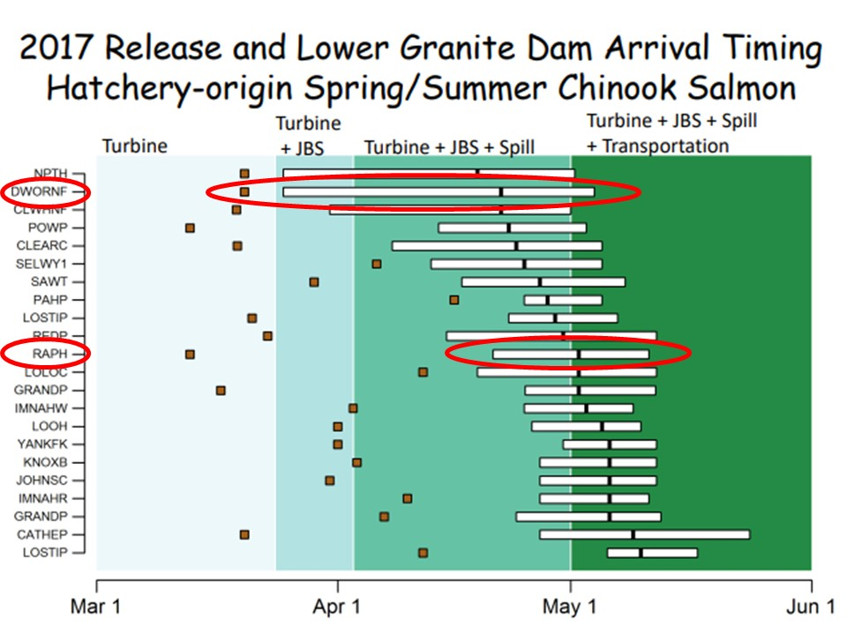
Justification – early arrival timing at LGR limited passage routes
Hesse, 2017 LSRCP meeting
Notes:
From the Hesse dataset, it appears that Dworshak NFH smolts are released approximately 21-days earlier than optimal for a full complement of passage options. LSRCP supports a basin-wide review of all release timing. However, given the magnitude of effort required for a large-scale review, a prudent approach may be to examine a small component of the release timing. Reviewing Spring Chinook smolt release timing from the Clearwater basin and specifically the Dworshak National Fish Hatchery, represents an opportunity to review a significant portion of Spring Chinook smolt production (15%). In addition, since most Dworshak NFH smolt release occur onsite, significant opportunity is available to adjust release timing with minimal program costs.
Despite published benefits to transporting Hatchery yearling Chinook, facilities within the Clearwater basin now have some of the lowest transport rates across the LSRCP program. These differences can be partially explained by looking at the relationship between a shifting transport window (later in the season) and a static Hatchery release timing. As an example, using Comparative Smolt Survival (CSS) data comparing Rapid River and Dworshak smolt releases reveals a notable difference in both transport rate and correlated SAR’s. Rapid River has a 41% transport rate and 0.79% SAR while Dworshak has a 24% transport rate and 0.32% SAR from CSS data:

Slide 6
Methods
Hatcheries
  Dworshak National Fish Hatchery
  Clearwater Fish Hatchery
  Nez Perce Tribal Hatchery
Two release times
  Early (“normal”) release in late March
  Late Release 2 weeks later
Metrics
  Juvenile size/condition at release – 20 fpp
  Juvenile survival and travel time to LGR – PIT tags
  Fish health evaluations
  Adult returns
    Evaluated by PBT

Slide 7
Historic release time evaluations
 | Release |  |  |  |  | CWT recoveries
Hatchery | Year | Date | Timing | CWT # | TT to LGR | I-Salts | II-Salts | III-Salts | Total rtns | Percent recovery
Kooskia | 1992 | 4/7 | Early | 111,879 | 16 | 4 | 17 | 1 | 22 | 0.020%
 |  | 4/22 | Mid | 113,423 | 13 | 0 | 4 | 1 | 5 | 0.004%
 |  | 5/5 | Late | 97,637 | 12 | 0 | 1 | 0 | 1 | 0.001%
Dworshak | 1993 | 4/8 | Early | 121,929 | 23 | 1 | 15 | 1 | 17 | 0.014%
 |  | 4/22 | Mid | 119,297 | 13 | 0 | 6 | 1 | 7 | 0.006%
 |  | 5/6 | Late | 105,988 | 10 | 1 | 3 | 0 | 4 | 0.004%
 | 1994 | 4/8 | Early | 66,014 | 25 | 11 | 37 |  | 48 | 0.073%
 |  | 4/22 | Mid | 61,840 | 18 | 4 | 24 |  | 28 | 0.045%
 |  | 5/6 | Late | 68,211 | 11 | 1 | 27 |  | 28 | 0.041%

Slide 8
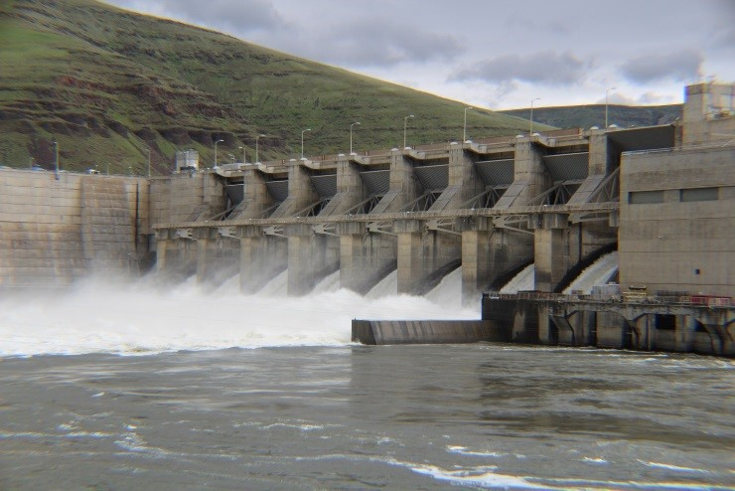
Results to Date
Travel Times
Arrival Times
Juvenile Survival to Lower Granite
Adult Returns
  Only one year of adult returns so far

Slide 9
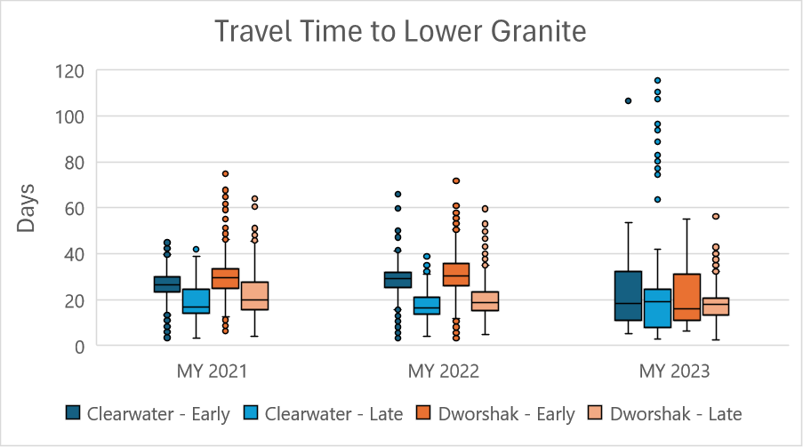
Travel Time to Lower Granite
Similar patterns between groups in 2021 and 2022
Earlier migrating fish tend to travel slower
Much more variability in 2023

Slide 10
Passage Timing at Lower Granite Dam
 |  | Passage Timing at Lower Granite
 |  | Clearwater |  |  | Dworshak
Migration Year | Release Date | 10% | 50% | 90% | 10% | 50% | 90%
2021 | 3/31/2021 | 4/16 | 4/26 | 5/17 | 4/19 | 4/29 | 5/11
 | 4/14/2021 | 4/25 | 4/29 | 5/09 | 4/26 | 5/03 | 5/15
2022 | 3/31/2022 | 4/16 | 4/29 | 5/05 | 4/20 | 4/30 | 5/08
 | 4/14/2022 | 4/21 | 4/29 | 5/05 | 4/27 | 5/02 | 5/09
2023 | 3/30/2023 | 4/08 | 4/17 | 5/03 | 4/08 | 4/15 | 5/05
 | 4/13/2023 | 4/17 | 4/29 | 5/04 | 4/23 | 5/02 | 5/12

Slide 11
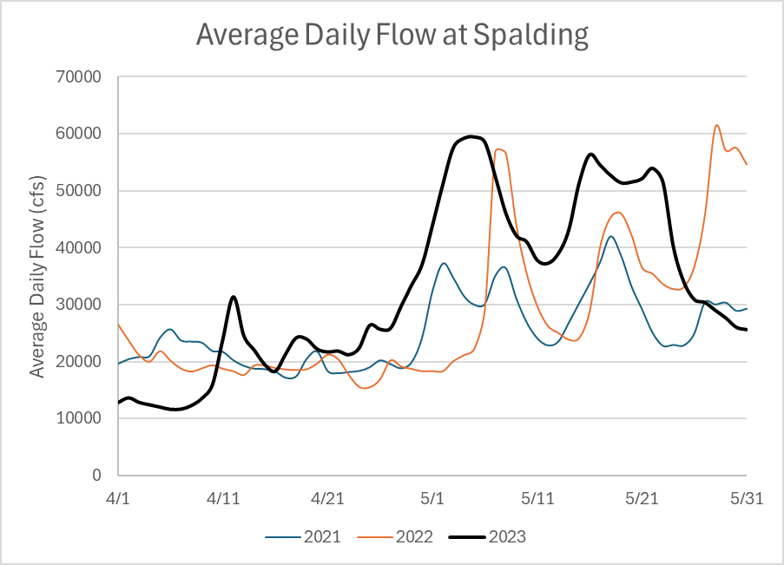
Travel Time to Lower Granite
Flows were generally higher in 2023 during passage period

Slide 12
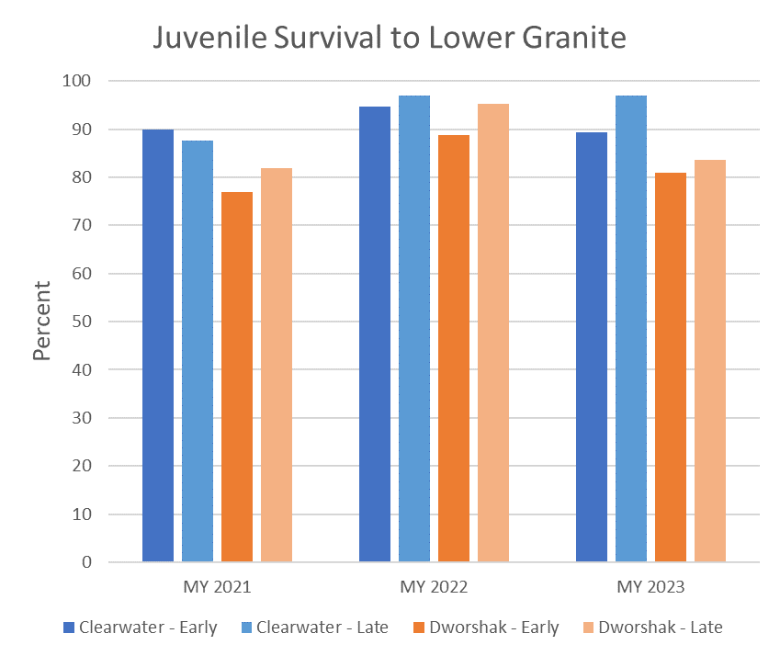
Survival to Lower Granite
Survival is generally high (>80%)
Late release groups had higher survival to Granite (except Clearwater in 2021)
  Differences not statistically significant

Slide 13
Adult Returns to Lower Granite
A few caveats…
PBT sampling at Lower Granite
  Individual samples
SAR’s can only be evaluated within the study
BY 2019 from Clearwater Hatchery confounded
BY 2020 represents very few fish
 | Clearwater |  | Dworshak
 | Number of Fish |  | Number of Fish
 | BY2019 | BY2020 | BY2019 | BY2020
Early | 72 | 1 | 98 | 3
Late | 37 | 4 | 75 | 12
 | Clearwater |  | Dworshak
 | SAR's |  | SAR's
 | BY2019 | BY2020 | BY2019 | BY2020
Early | 0.019% | 0.0004% | 0.010% | 0.0003%
Late | 0.019% | 0.0017% | 0.011% | 0.0010%

