Slide 1
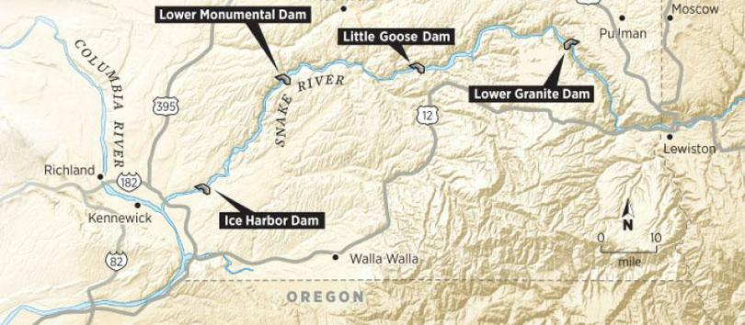
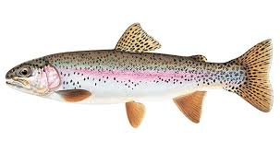
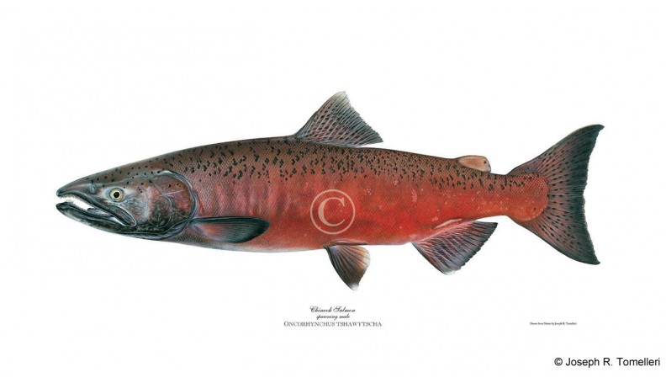
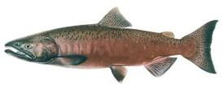
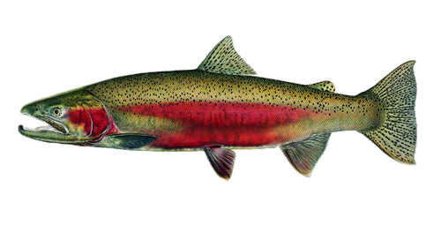
LSRCP Spring/Summer Chinook Monitoring and Evaluation Update and Priorties
Rod Engle USFWS-LSRCP

Slide 2
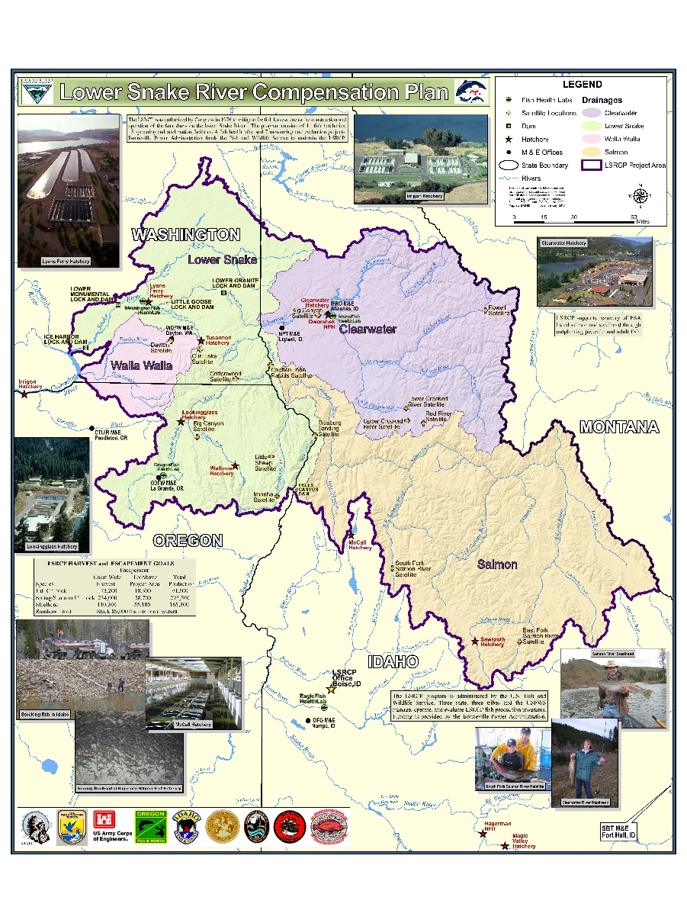
M&E Update
ISRP review highlights
Current performance and programmatic changes for improvement
AOP discussions on performance from ISRP
M&E Priority Project List
Future items

Slide 3
2010 ISRP Review
2022 ISRP Review
Reporting not complete for 2021

Slide 4
Table 3. Allocation of compensation (adults) by State as suggested by Columbia Basin Fisheries Technical Committee (reproduced from WDFW 1974). This allocation was not to be used as a specific indicator of release sites.
 | Washington |  |  | Oregon |  | Idaho
Area or Basin | Spring Chinook salmon | Fall Chinook salmon | Steelhead | Spring Chinook salmon | Steelhead | Spring-Summer Chinook | Steelhead
Snake River
Below Lewiston |  | 5,000
Lewiston – Hells Canyon |  | 9,728 | 2,208
Hells Canyon Dam |  | 3,648 |  |  | 1,368 | 1,200 | 1,368
Tucannon River | 1,152 |  | 1,632
Clearwater River |  | 68 |  |  |  | 288 | 20,736
Asotin Creek |  |  | 816
Grande Ronde River |  |  |  | 5,856 | 7,632
Salmon River |  |  |  |  |  | 46,656 | 16,896
Imnaha River |  | 68 |  | 3,216 | 1,920
Small Tributaries |  |  |  |  | 264 | 288 | 264
Totals | 1,152 | 18,512 | 4,656 | 9,072 | 11,184 | 48,432 | 39,264
Notes:
All numbered tables and figures are from the Draft LSRCP 2018 Biennial Report (Version February 2020).
The Clearwater and Salmon River breakdown of spring/summer Chinook and steelhead reflected where the committee thought salmon/steelhead production was coming from. As the table caption states, the committee was specific to say that these areas should not be used as specific indicator of release sites (ie. There’s flexibility).
The Hells Canyon

Slide 5
Large shift in production from Salmon to Clearwater basin.
Why?
Further refinements of programs to achieve cooperator desires, ESA.
Fishing, flexibility.
Since last review (2010), approximately 2.815 M smolt production has been added to address goals.
Clearwater Pipeline would increase additional 3.0 M to existing infrastructure.

Slide 6
Performance

Slide 7
Spring/Summer Chinook Example
Increased Performance
Low Densities
Better release sites
Good homing
Releases that are ready-to-migrate
Better in-river survival, hydrosystem survival.
Smolt programs over parr programs
Endemic or localized stock
0.87
0.42
Increasing Costs ($)
Increased Brood Need (and Reduced Fisheries)
Started program with 6.74 M with expected survival of 0.87% = 58,700
Current program is 10.4 M with measured, mean survival of 0.42% (BY07-16) = 43,783
Notes:
Change to total production of LSRCP and performance as a metric of meeting the goal
Started program with 6.74 M with expected survival of 0.87% = 58,700
Current program is 10.4 M with measured survival of 0.42% = 43,783 adults

Slide 8
Performance
Basin | Facility | Location | Current Production | BY07-16 Mean SAR | Expected adults | Basin Adult Goal | Balance Needed on in-place/in-kind
Clearwater | Clearwater | North Fork Clearwater* | 709,000 | 0.24% | 1,709 | 9,867
Clearwater | Clearwater | Clear Creek | 720,000 | 0.50% | 3,564
Clearwater | Clearwater | Lower Selway | 400,000 | 0.43% | 1,724
Clearwater | Clearwater | Red River | 1,280,000 | 0.26% | 3,328
Clearwater | Clearwater | Lochsa | 640,000 | 0.26% | 1,664 | 2,033
Clearwater | Dworshak | North Fork Clearwater | 1,650,000 | 0.57% | 9,405 | 9,135
Clearwater | Dworshak/NPTH | Lapwai* | 180,000 | 0.57% | 1,026
 |  | Basin Total | 5,579,000 | 0.38% | 22,420 | 21,035 | 1,385

Slide 9
Performance
 | Location | Juvenile Production Release | BY-07-16 SAR | Expected Adults
 | Clear Creek | 720,000 | 0.50% | 3,564
Status Quo | Red River | 1,280,000 | 0.26% | 3,328
 | Total | 2,000,000 |  | 6,892
Alternative 1 | Clear Creek | 1,000,000 | 0.50% | 4,950
 | Red River | 1,000,000 | 0.26% | 2,600
 | Total | 2,000,000 |  | 7,550 | 658
Alternative 2 | Clear Creek | 1,400,000 | 0.50% | 6,930
 | Red River | 600,000 | 0.26% | 1,560
 | Total | 2,000,000 |  | 8,490 | 1,598
What can we do to make this better?
What are we doing to make the current situation improve?

Slide 10
Performance
Basin | Facility | Location | Current Production | BY07-16 Mean SAR | Expected adults | Basin Adult Goal | Balance Needed on in-place/in-kind
Clearwater | Clearwater | North Fork Clearwater* | 709,000 | 0.24% | 1,709 | 9,867
Clearwater | Clearwater | Clear Creek | 720,000 | 0.50% | 3,564
Clearwater | Clearwater | Lower Selway | 400,000 | 0.43% | 1,724
Clearwater | Clearwater | Red River | 1,280,000 | 0.26% | 3,328
Clearwater | Clearwater | Lochsa | 640,000 | 0.26% | 1,664 | 2,033
Clearwater | Dworshak | North Fork Clearwater | 1,650,000 | 0.57% | 9,405 | 9,135
Clearwater | Dworshak/NPTH | Lapwai* | 180,000 | 0.57% | 1,026
 |  | Basin Total | 5,579,000 | 0.38% | 22,420 | 21,035 | 1,385

Slide 11
Performance
 | Location | Juvenile Production Release | BY-07-16 SAR | Expected Adults
Status Quo | Lochsa (Summer) | 640,000 | 0.26% | 1,664
Alternative 1 | North Fork (Spring) | 640,000 | 0.57% | 3,648 | 1,984
Alternative 2 | Lochsa (Spring*) | 640,000 | 0.43% | 2,758 | 1,094
 | Total
Are we doing what we can to make this better?

Slide 12
RM&E Prioritization List
Objective: Identify research needs for the program and prioritize the top 10 research needs and costs to address shortfalls in meeting adult mitigation
Solicited ideas, concepts and projects, have initial list (40), need further revision/development and prioritization.
 | Main | Alternate
IDFG | Brian Leth | Chris Sullivan
ODFW | Joseph Feldhaus | Ian Tattam
NPT | Bill Young | Jason Vogel
CTUIR | Gene Shippentower | Les Naylor
WDFW | Joe Bumgarner | -
SBT | Lytle Denny | Sammy Matsaw
LSRCP | Rod Engle | Nathan Wiese

Slide 13
RM&E Prioritization List
Reviewing and comparing growth profiles across programs
Thiamine injections and egg/juvenile survival evaluations
Marking/tagging review
Climate change vulnerability assessments
Upper Grand Ronde Aggregated Projects
Carcass additions, subyearling releases, alternative brood, mortality investigations
Yankee Fork
Genetic analyses needed for existing work and egg box efficacy.
Mechanism – internal/external engagement

Slide 14
Prioritization List - Needs
LSRCP Spring/Summer Chinook Program Performance for ISRP Reviews - In Place/In Kind Mitigation Performance
Basin | Facility | Location | Current Production | BY07-16 Mean SAR | Expected adults | Basin Adult Goal | Balance Needed on in-place/in-kind
Upper Salmon | McCall | South Fork Salmon | 1,000,000 | 0.50% | 5,000 | 8,000
Upper Salmon | Sawtooth | Sawtooth Weir | 1,700,000 | 0.30% | 6,000 | 19,445
Upper Salmon | Sawtooth | Yankee Fork | 300,000
 |  | Basin Total | 3,000,000 | 0.91% | 11,000 | 27,445 | (16,445)
How do we improve what we have now?... For planning into the future?

Slide 18
Outcome
Agreement on the following….
Discontinuing backfilling of USAL B programs with DNFH B stock.
If future brood shortages occur with the USAL B returns for Yankee Fork, production will be made up with backfilling shortfalls with A stock and releases at existing A stock release sites (ie. Sawtooth weir). These will be coordinated through the Tuesday coordination calls and the AOP process
Change - Little Salmon program release of 217,000 B-steelhead to A-steelhead.
Shift of 87,000 B-production from Yankee Fork to Pahsimeroi Hatchery.
The following will be the prioritization of USAL-B smolt production groups
428,000 production at Pahsimeroi Hatchery
440,000 production of USAL B at Yankee Fork.
As available and funded, egg box production of USAL B in Yankee Fork.
The overall marking of USAL B should remain the same but there will be an increase in the number of coded wire tags from 341,000 to 428,000. Releases at Pahsimeroi Fish Hatchery will be entirely coded wire tagged and unclipped.
These changes and actions will be additionally coordinated by LSRCP, IDFG and SBT with NOAA-Fisheries for ESA permitting compliance.

Slide 19
Future Efforts
Fall Chinook
Implementation of yearling to subyearling conversion
Proposed action to NOAA-Fisheries
Reciprocal Study Discussion
Steelhead in NE Oregon, SE Washington
Spring/Summer Chinook in NE Oregon
Annual Report FY 2019-2021
Structured Decision Making Course
Budget Discussion and Statements of Work

Slide 20
Questions?

