Slide 1
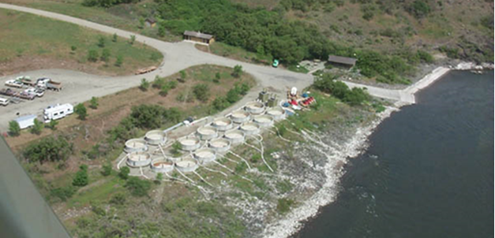
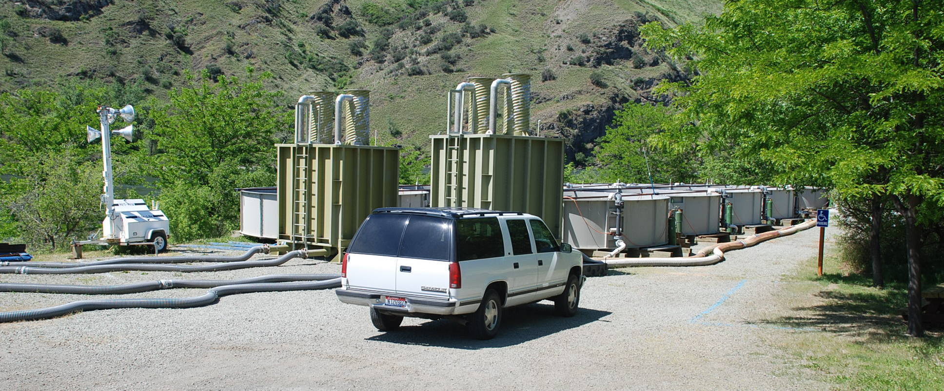
FCAP - Pittsburg Landing Acclimation Facility Move to the Salmon River at Russell Bar

Slide 2
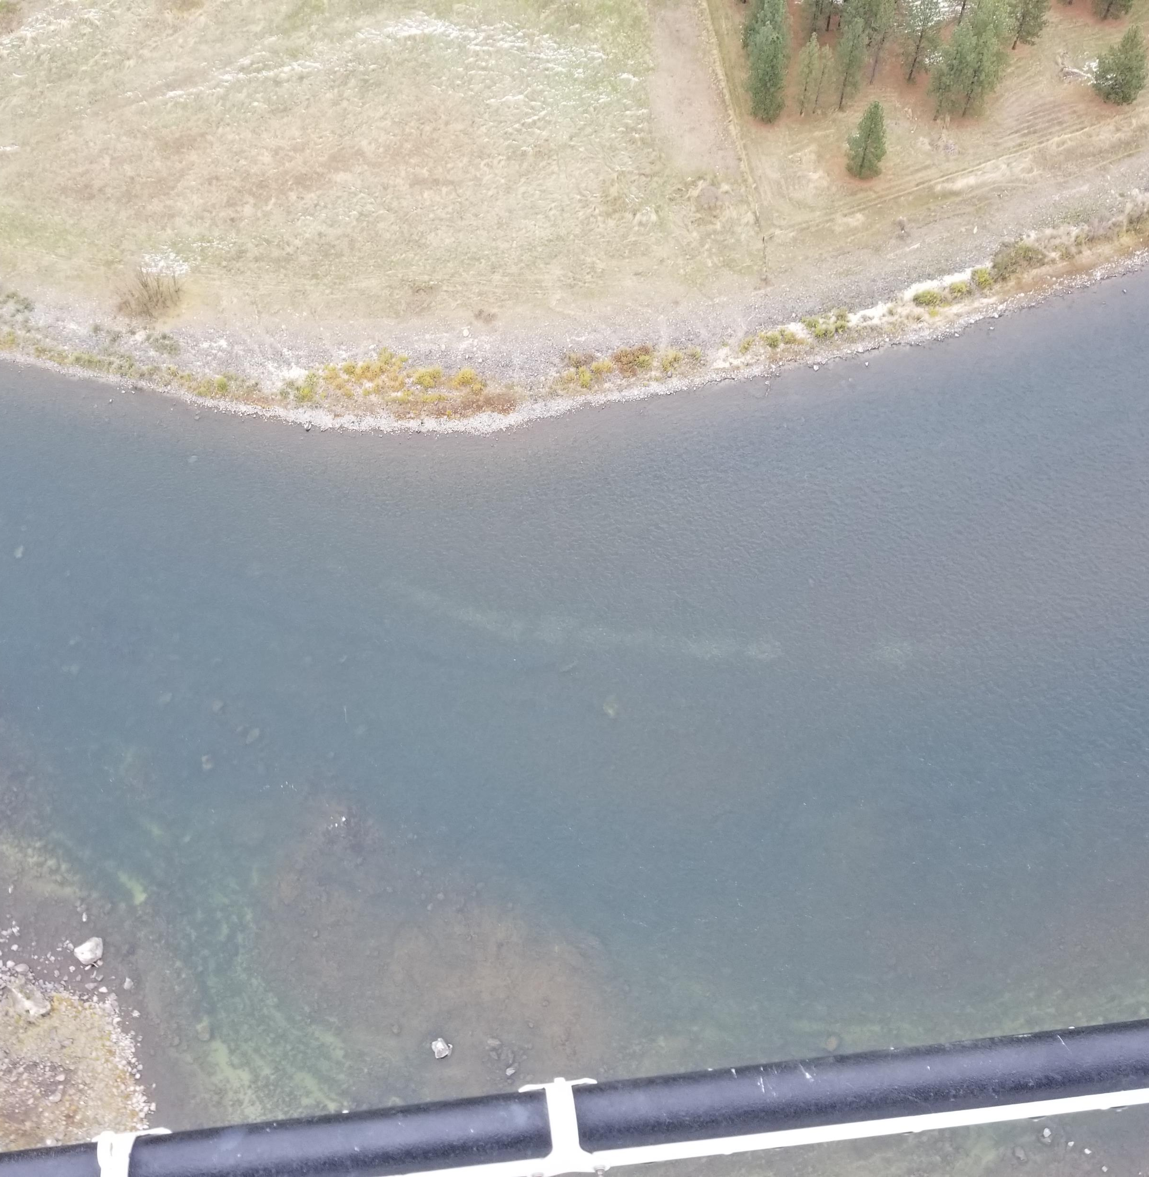
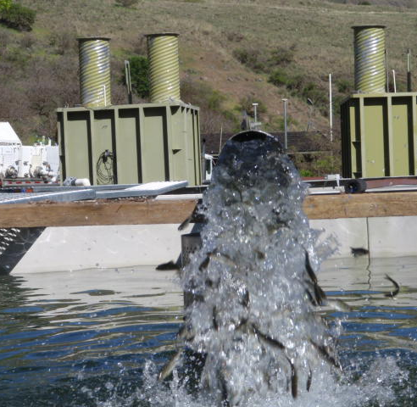
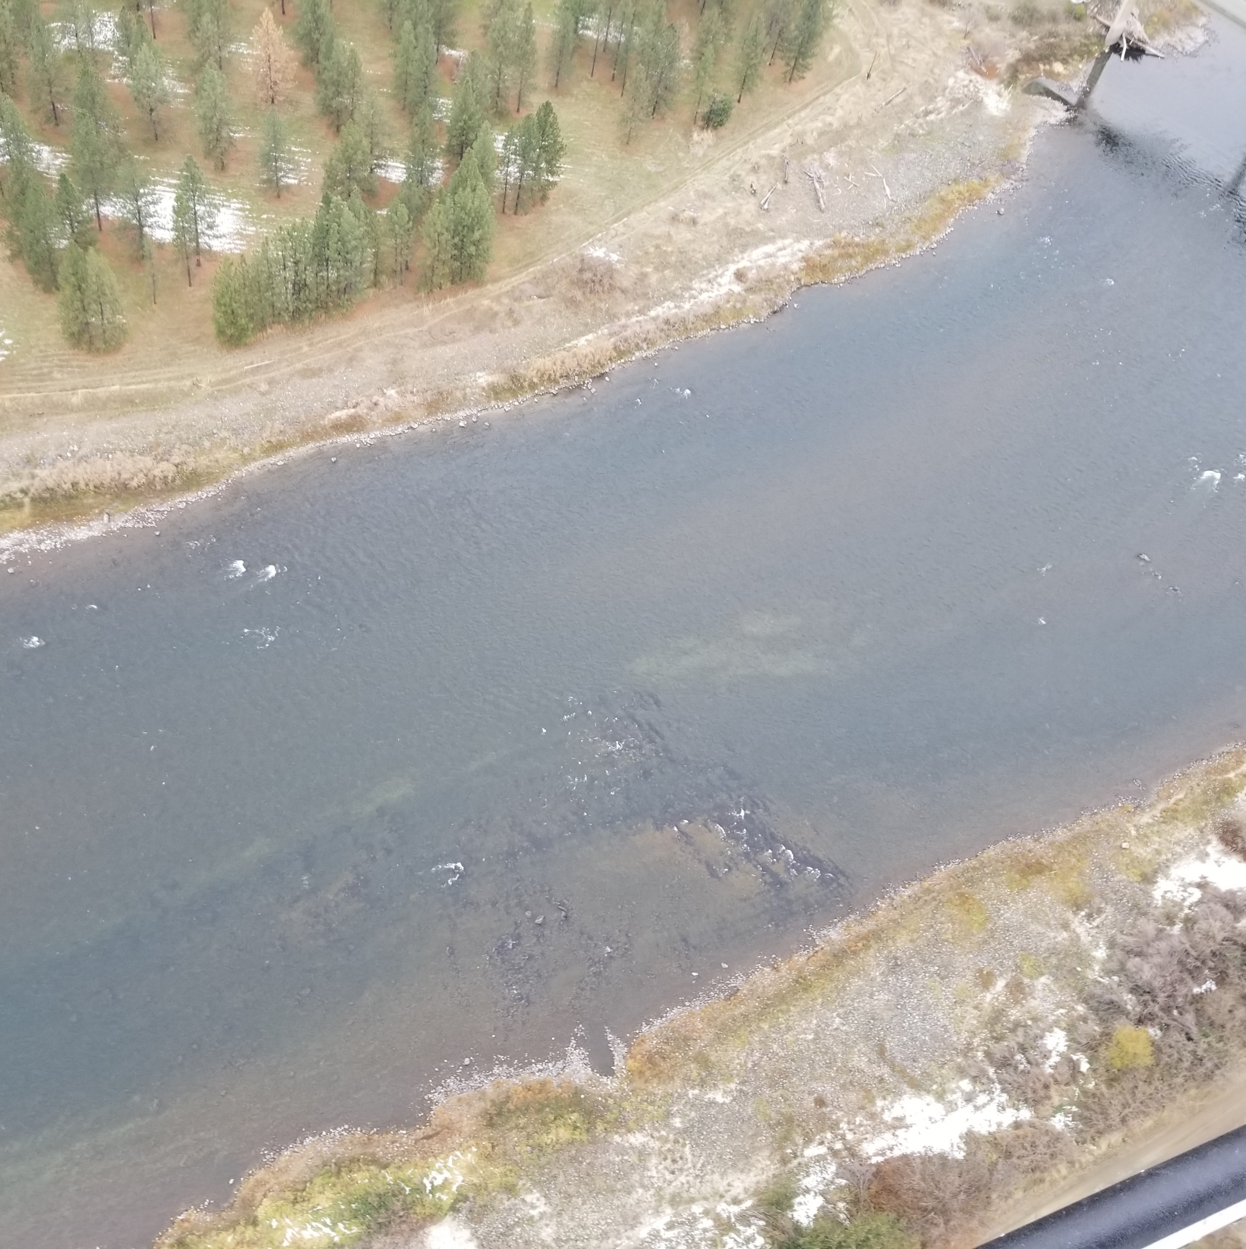
Why Move the Acclimation Site
Snake above Salmon as Natural Production Emphasis Area
USFS would like to have all of Pittsburg parking lot back
Acclimation still in Snake at Captain John
New site can be set up and left in place
Easier access for trucks to delivery fish

Slide 3
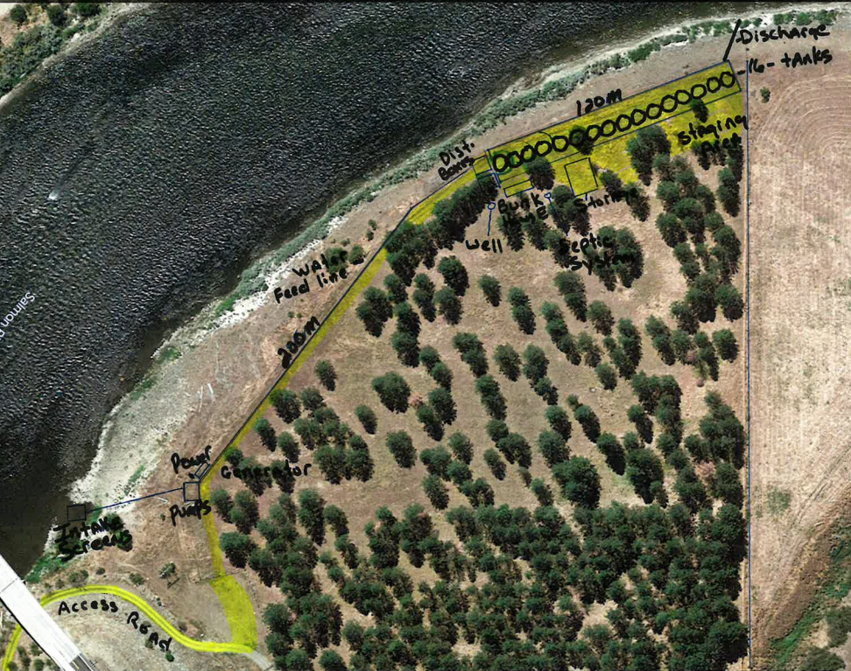
Russell Bar
Russell Bar (BLM site DS of the Twin Bridges along Hwy 95)
Site has 3 Phase power for electric pumps (generator for backup)
16 Tanks and associated equipment would be set up and left in place
Would be in use from March – June annually (Set up, testing and 2 acclimation periods of 3+ weeks for each group of sub yearlings, and winterization)

Slide 4
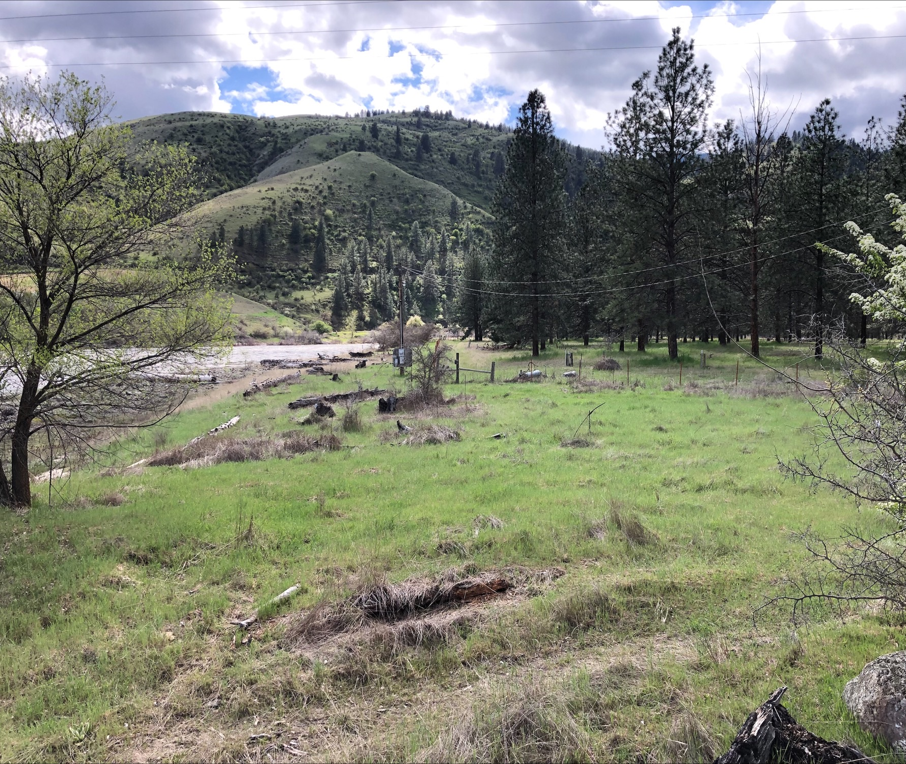
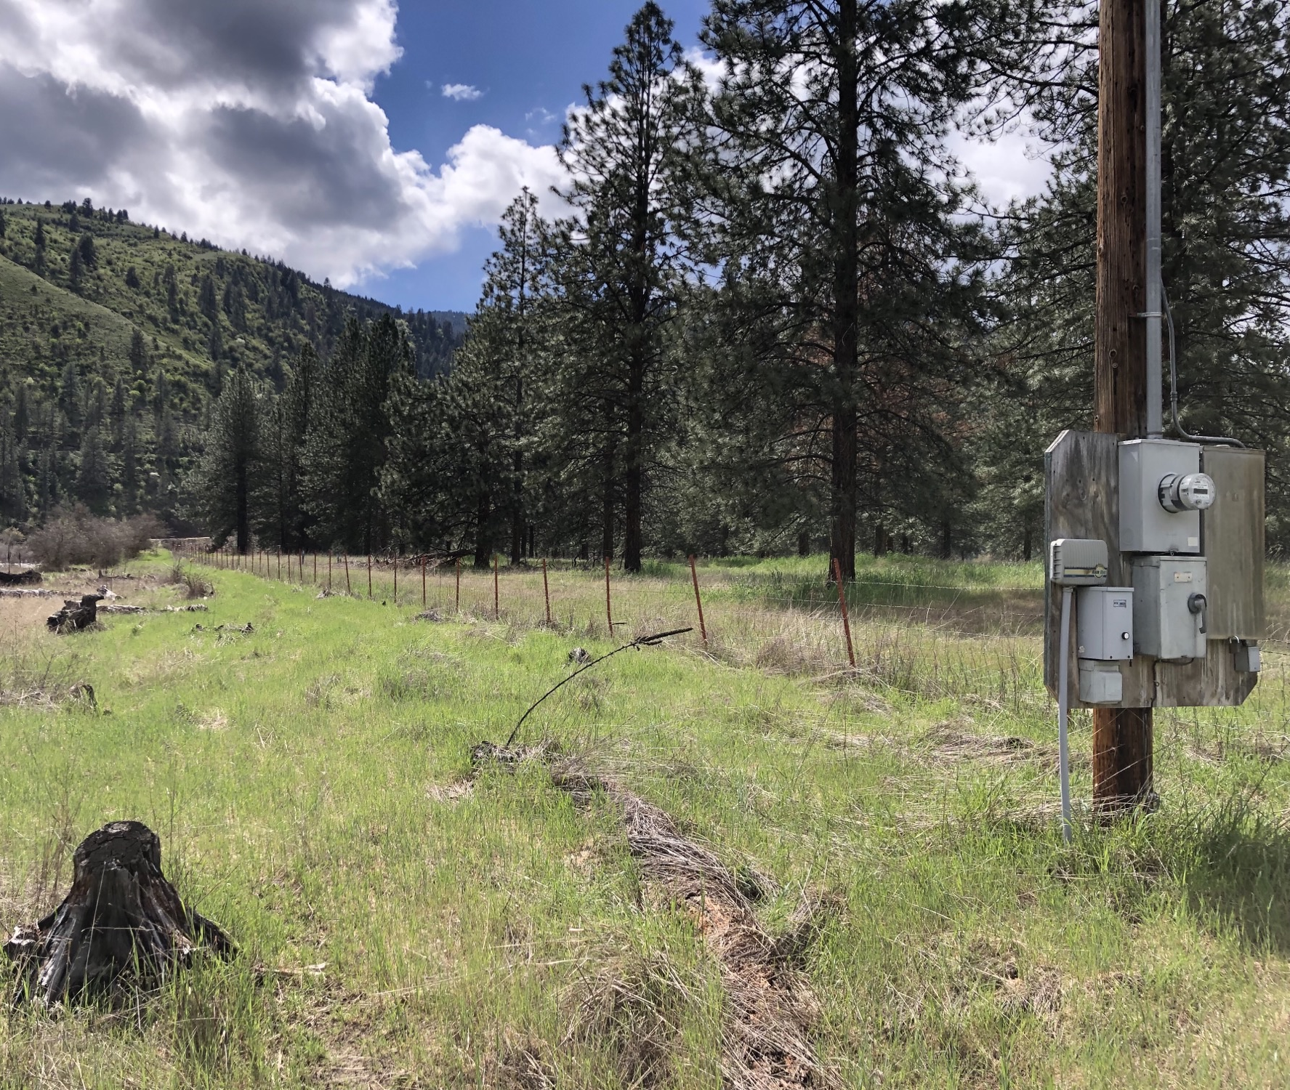
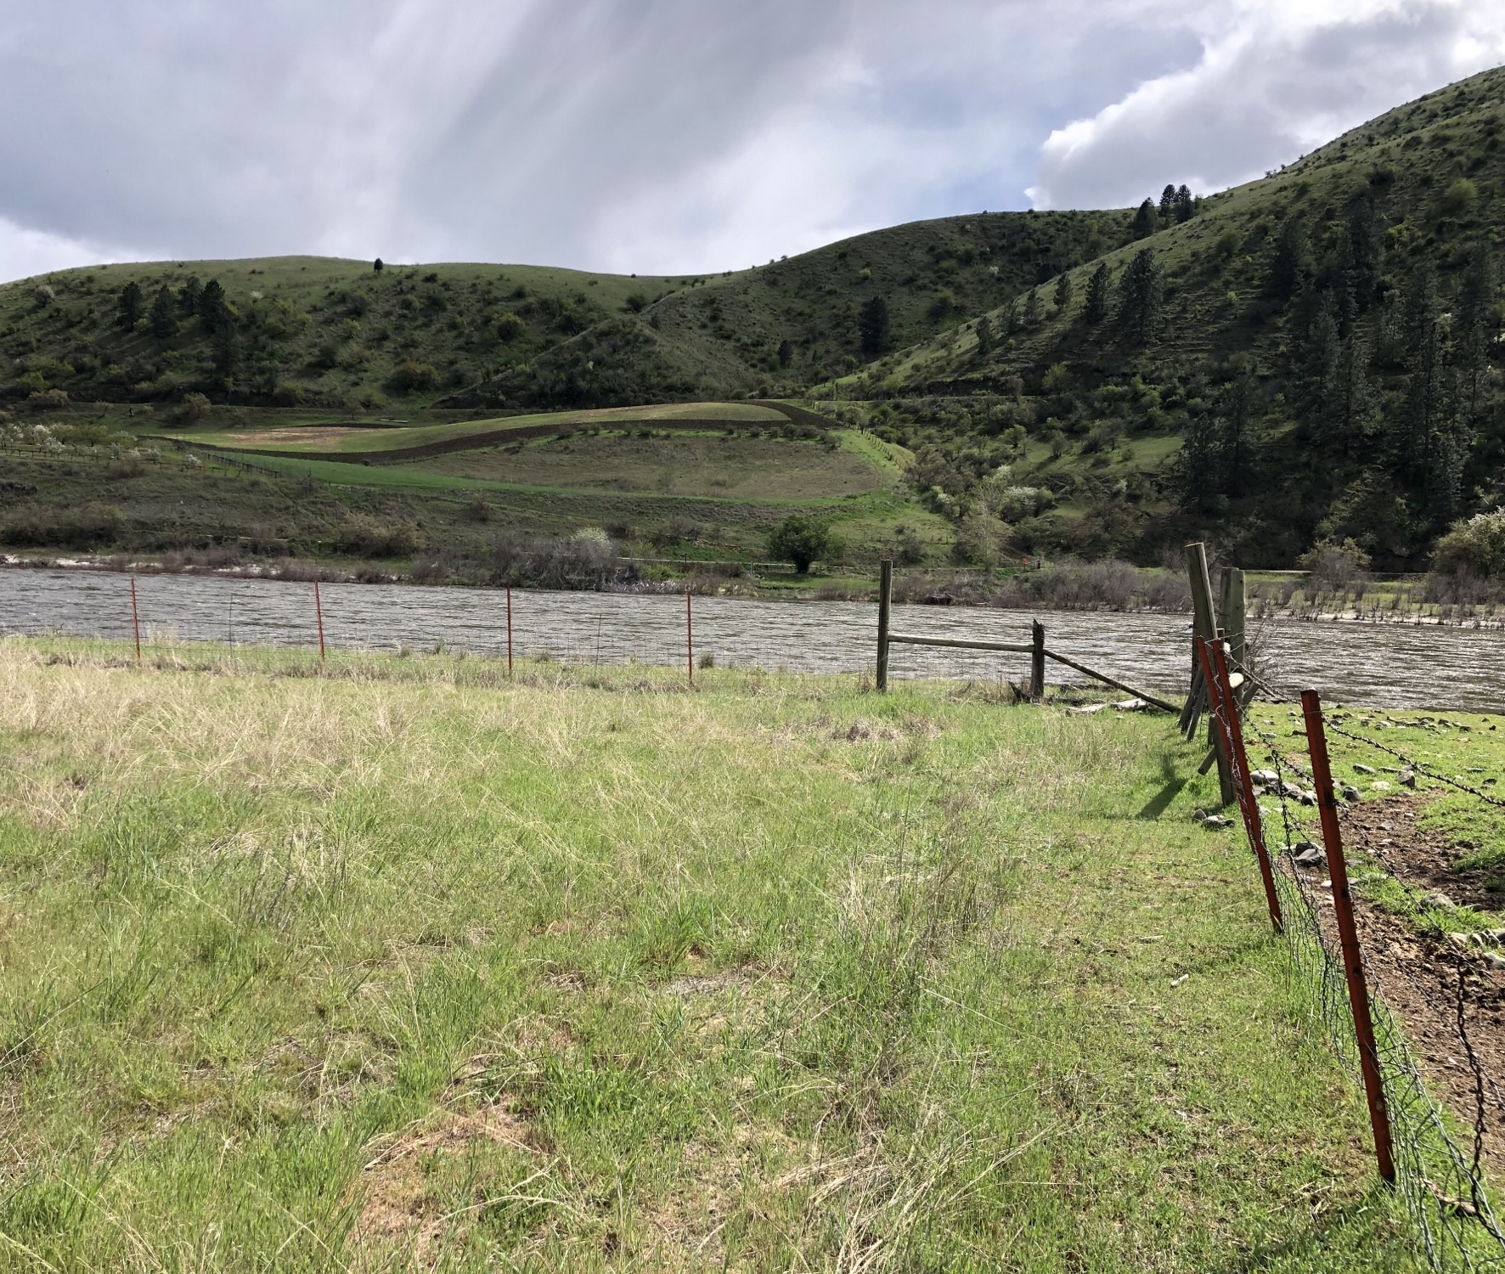
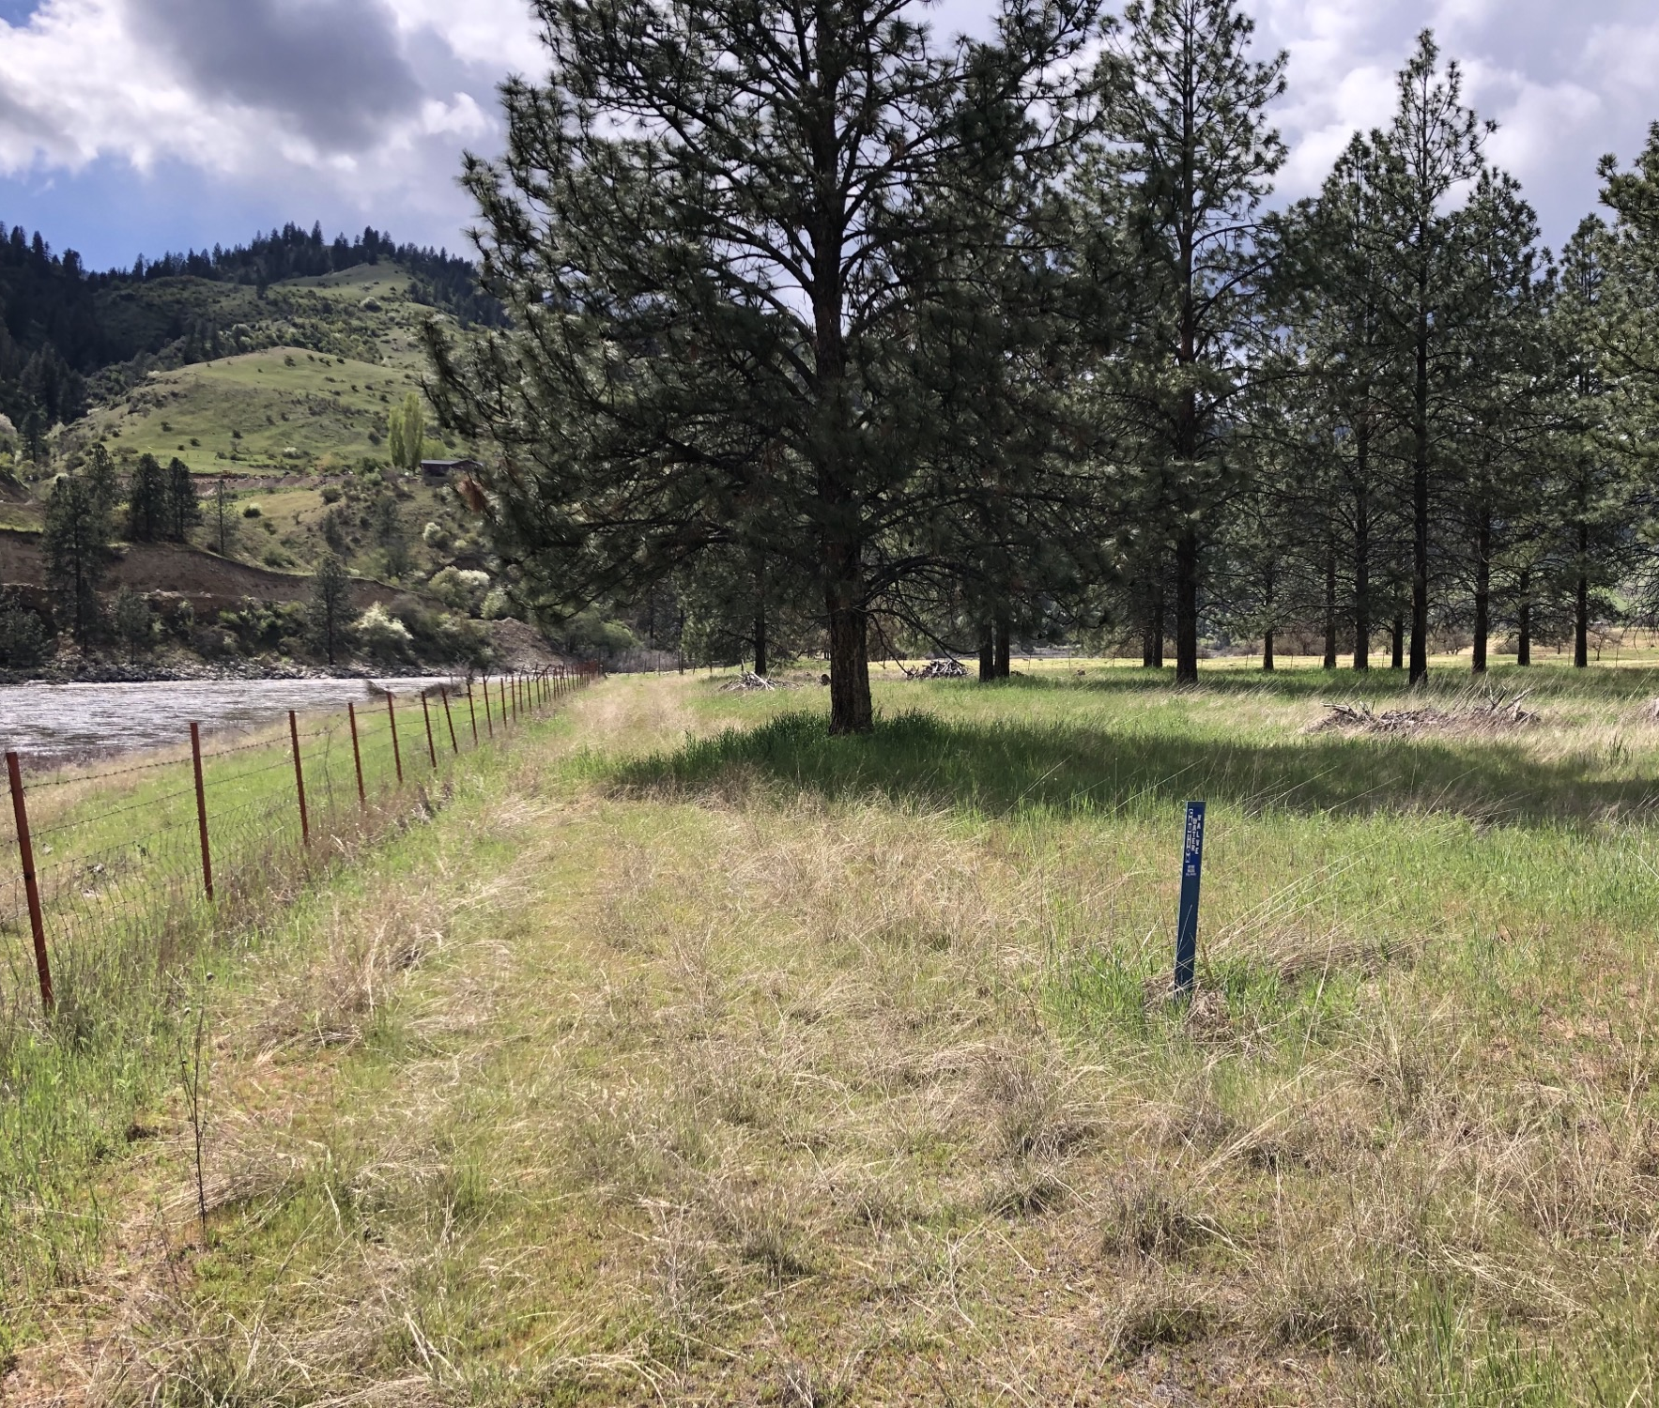
Access Road from Rodeo Grounds under Highway Bridge
Upstream corner of site where pumps would be located
Power panel looking downstream where pipes would run
Southwest corner of site where tanks will discharge into river
Looking upstream where tanks and staging would be located
Tanks start in this location and go downstream

Slide 5
Timeline
BLM
Currently completing draft action and staff reviews.
Started NEPA and Sec 7 consultation (completed by end of 2024)
Site Prep
Once approval received from BLM, begin site prep. Hopefully begin in spring/summer of 2025
Prep includes laying gravel for access road, tank pads, and staging area
No ground disturbing activities and minimized tree removal for now.
Equipment Move and Set up
Moving of equipment from Pittsburg Landing and set up at Russell Bar would occur in summer/fall of 2025
Potential Pitfalls
Not sure what restrictions BLM/NOAA Fisheries will have
Availability of contractors/materials for site improvements
Access Road under Highway Bridge may need improvement
Operational for 2026 Acclimation

Slide 6
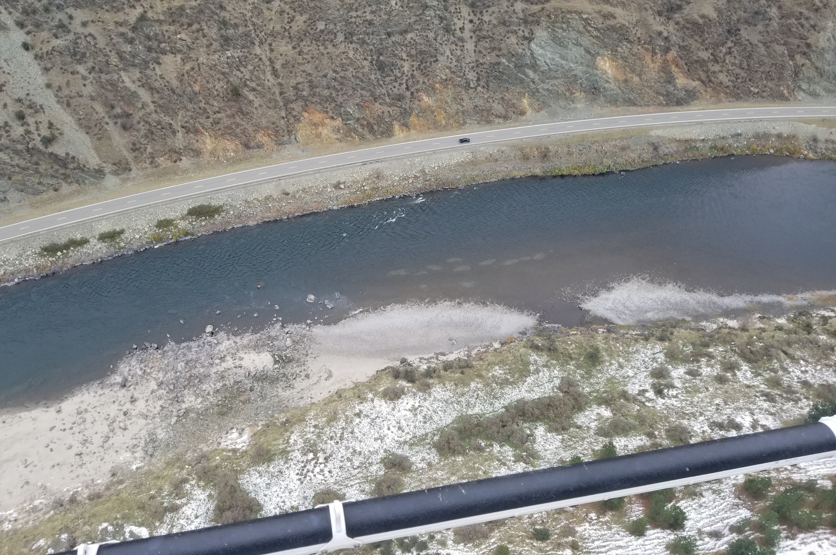
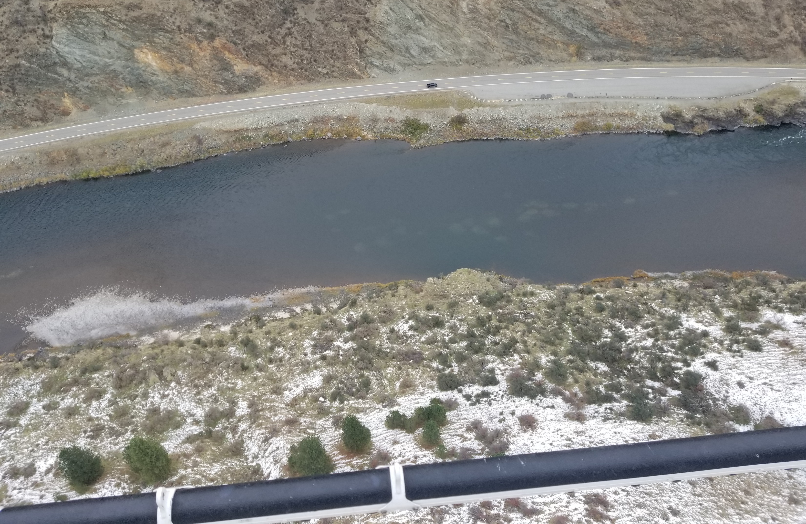
Questions

