Slide 1
LSRCP Annual Meeting Funding and Agreements Update
Andy Traylor
May 8, 2024

Slide 2
Budget Landscape
OM&ME Annual Funding
3 years into 7-year OM&ME MOA
Opportunity to extend additional 6 years in 2028
Integrated Program Review (IPR) for BP-26 (FY 26-28) in June
Unique 3-year rate period to sync with long-term power sales contracts set to expire in Sep 2028
LSRCP proposed to receive inflationary increase, commensurate with agency-wide cost management benchmarks
Notes:
Covers seven total FY’s (2022-2028)
3 year rate period is preferred over another 2 year rate period followed by a 1 year rate period.
Cost management benchmarks are using GDP Price Deflator and Employment Cost Index

Slide 3
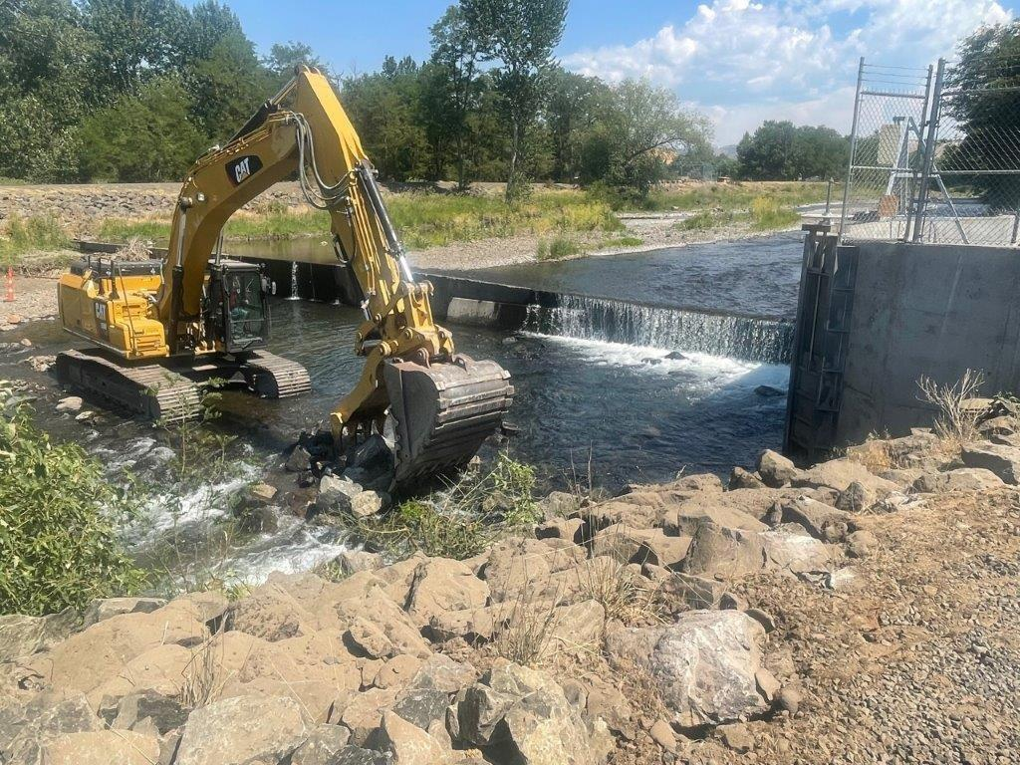
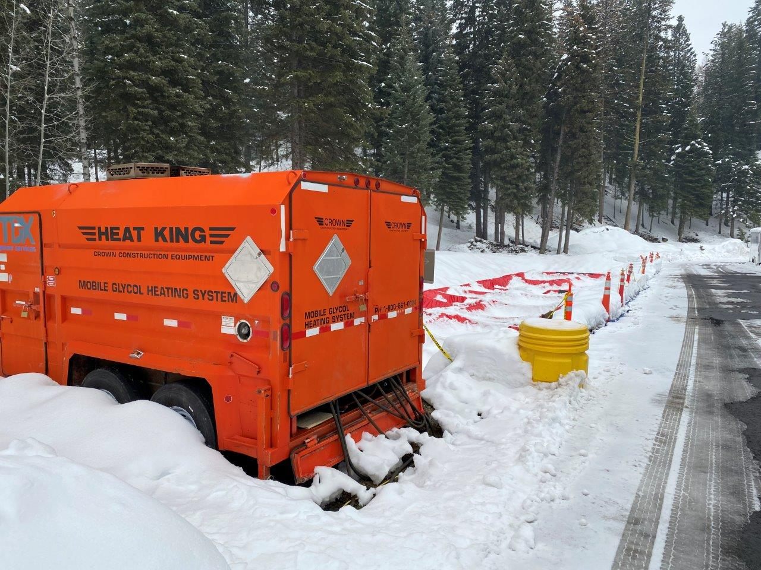
Budget Landscape
Reserves Distribution Clause (RDC)
$25M for non-routine, deferred maintenance
Funding available FY23 through end of FY27
Full amount available to USFWS as of Aug 2023 via IAA
Notes:
Dayton Dam repairs, McCall holding ponds

Slide 4
Budget Landscape
Resilient Columbia Basin Agreement
Contains various USG commitments, some of which will be implemented by BPA
Relevant to LSRCP: $200M over 10 years in capital funding will be available for hatchery modernization, upgrades, and non-recurring maintenance, as guided by the priorities of other fishery managers including the Six Sovereigns.
Capital funding MOA in development

