Slide 1
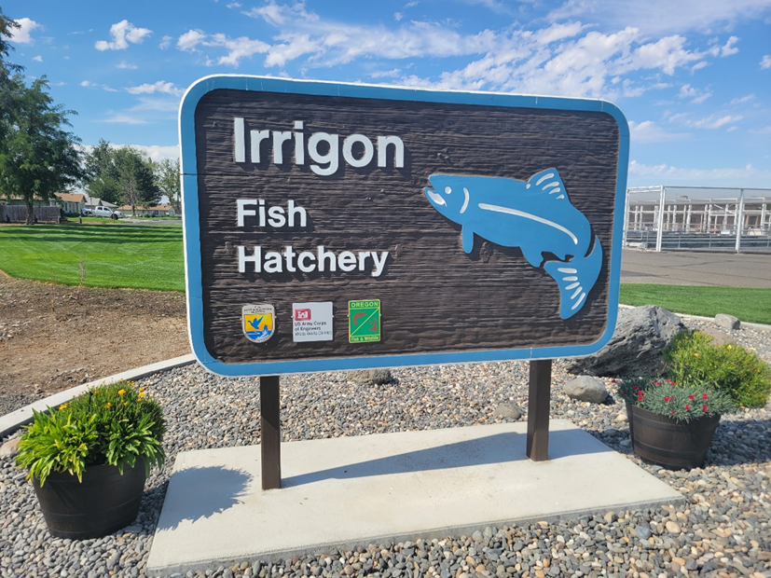
Lower Snake River Compensation Plan Infrastructure Audits
Irrigon Hatchery

Slide 2
Mitigation Goal
9,184 Wallowa River stock summer steelhead adults above Lower Granite Dam.
2,000 Little Sheep Creek stock summer steelhead adults above Ice Harbor Dam.

Slide 3
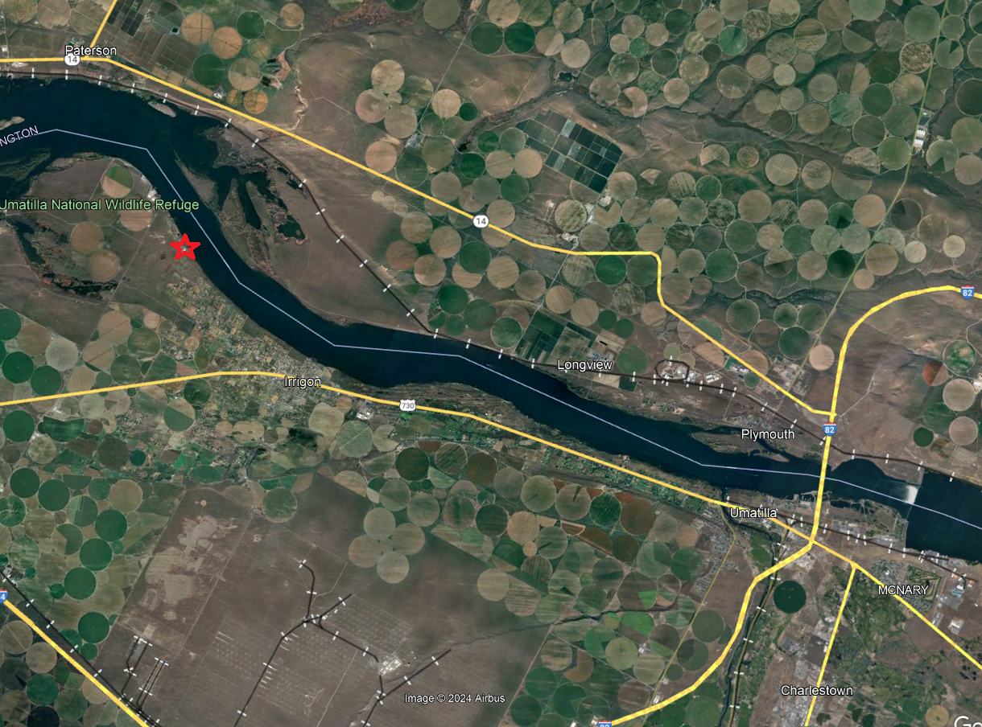
Facility Location
Located on the Columbia River near Irrigon, OR

Slide 4
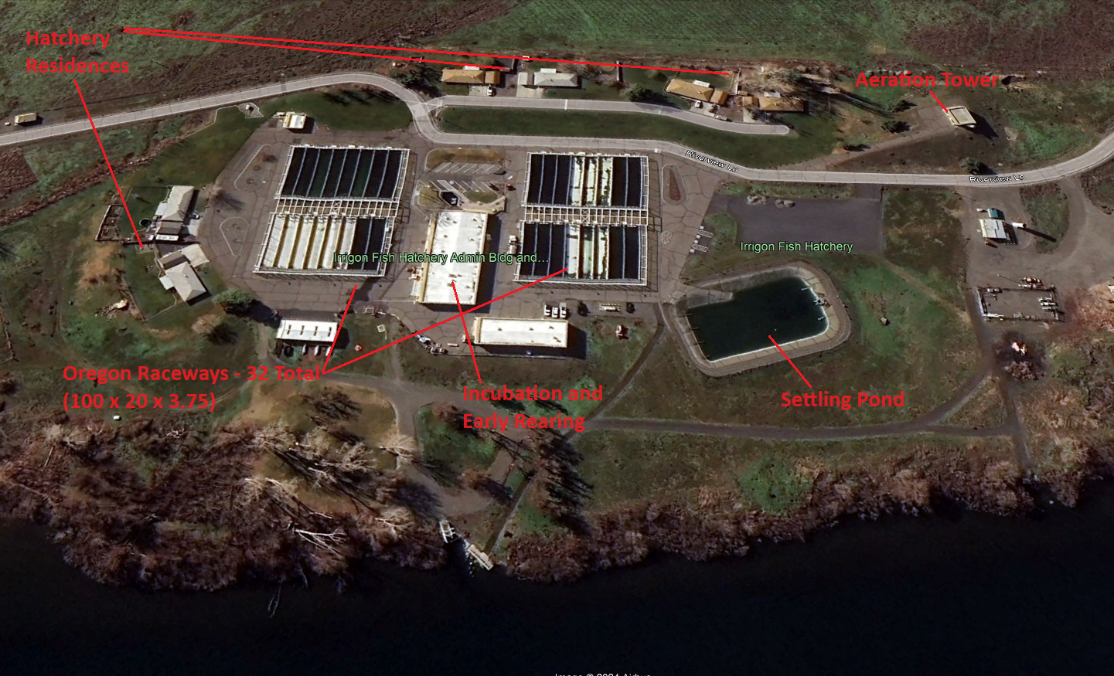
Facility Layout

Slide 5
Water Supply

Slide 6
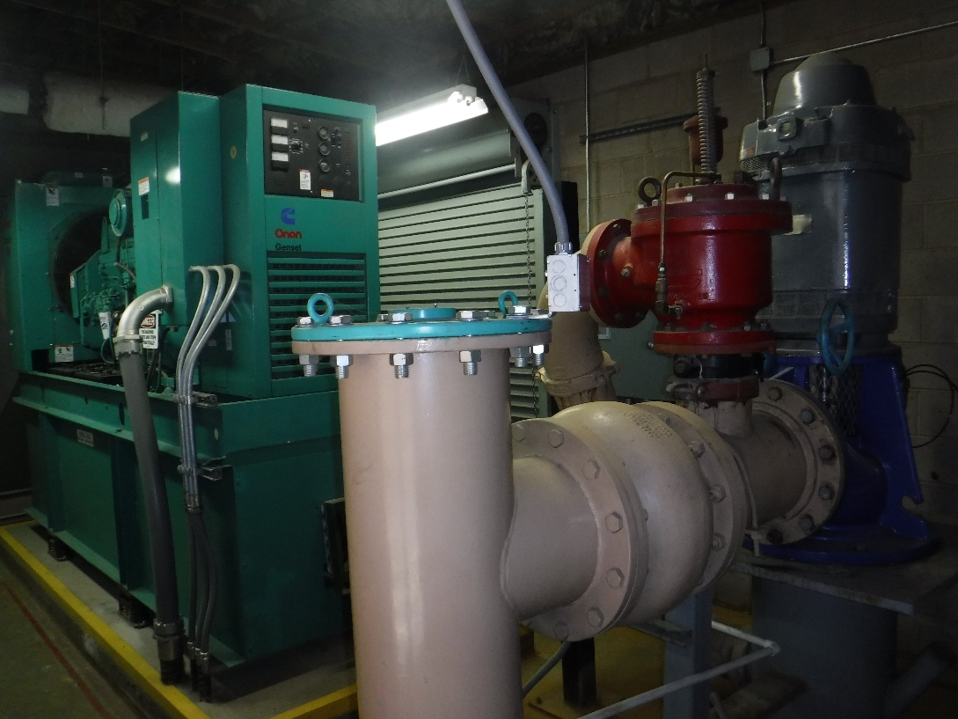
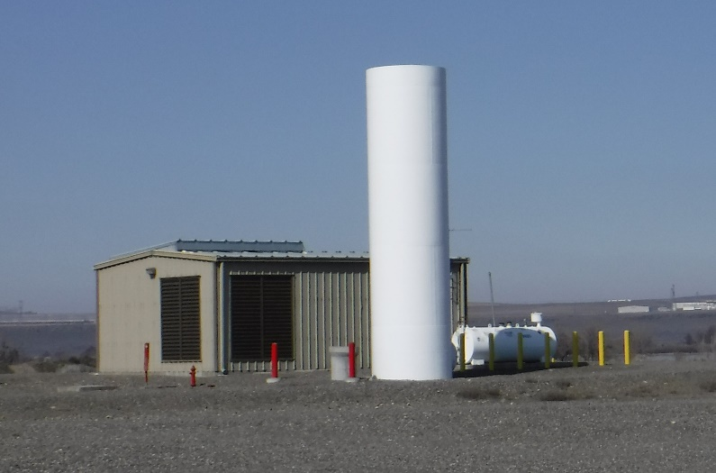
Well Stations

Slide 7
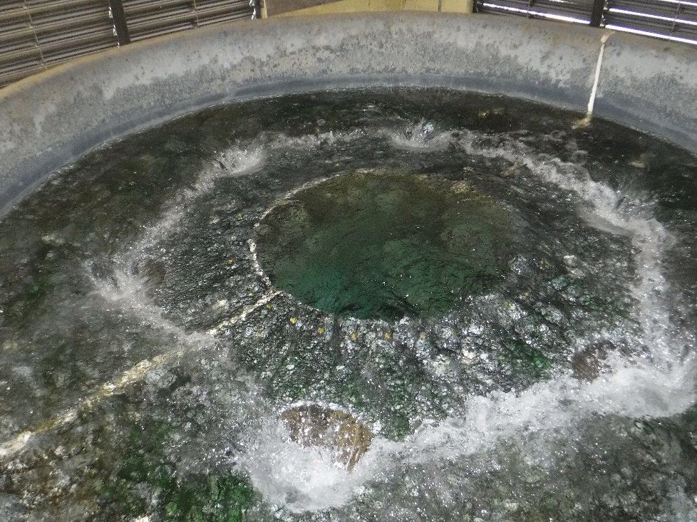
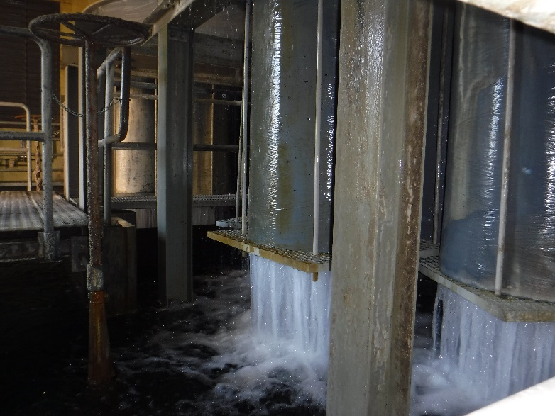
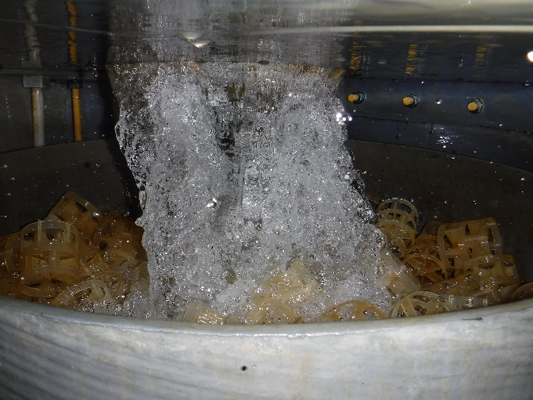
Aeration Tower

Slide 8
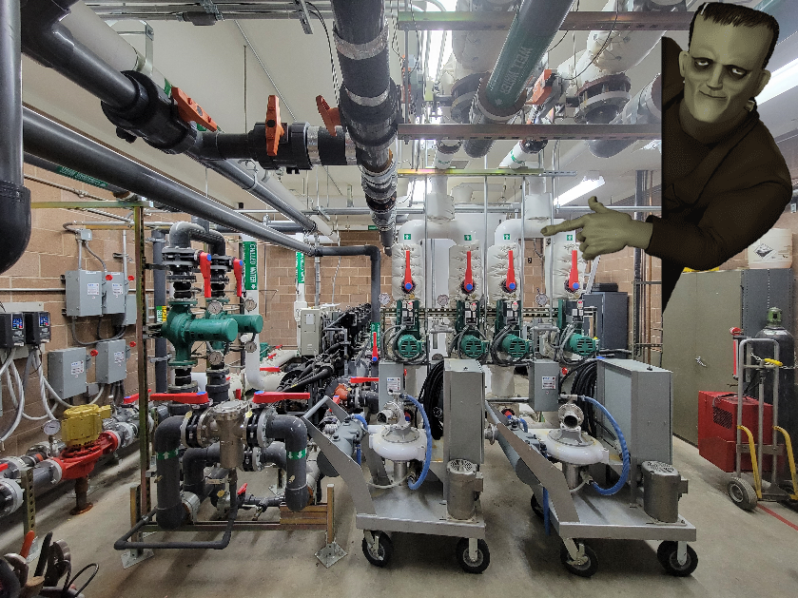
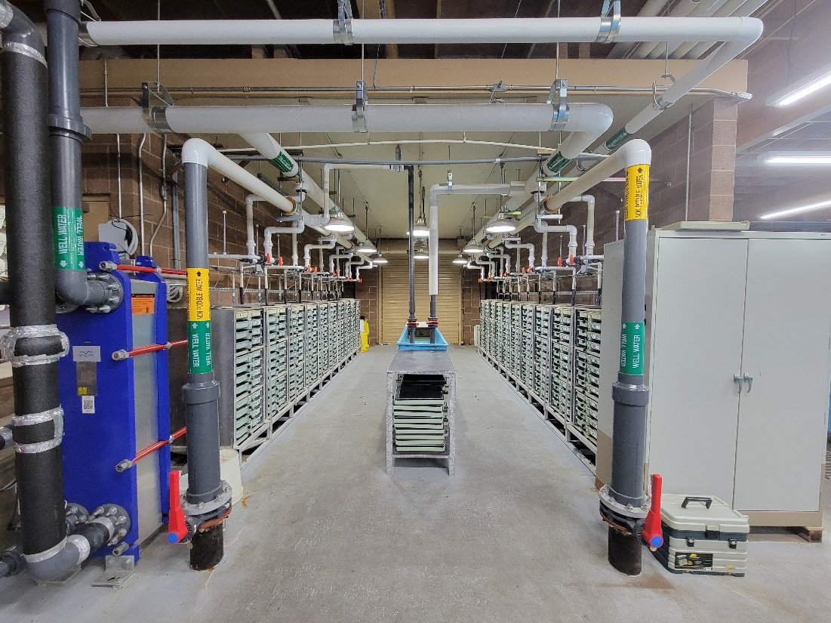
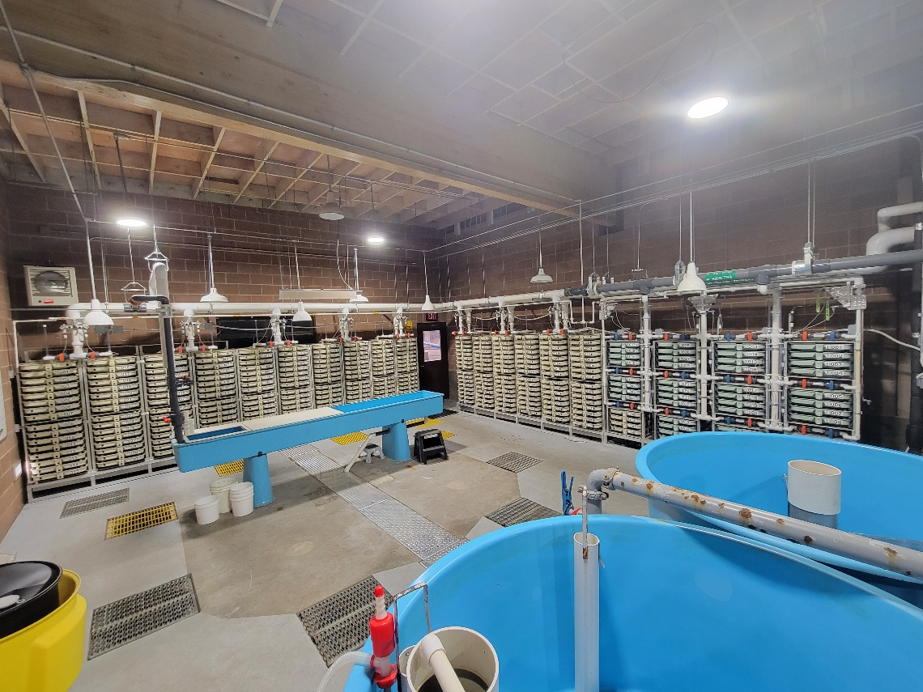
Incubation
508 Total Trays

Slide 9
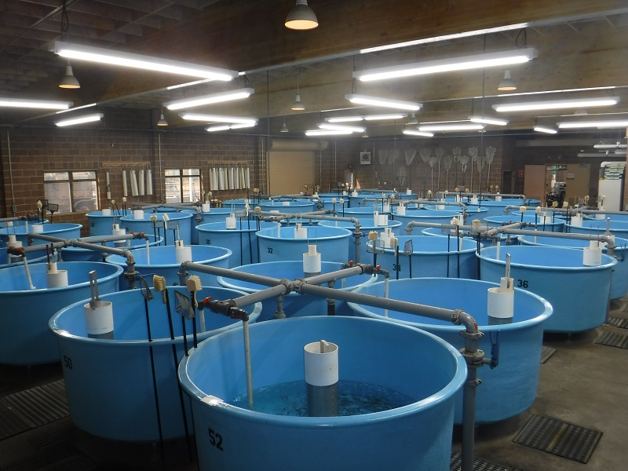
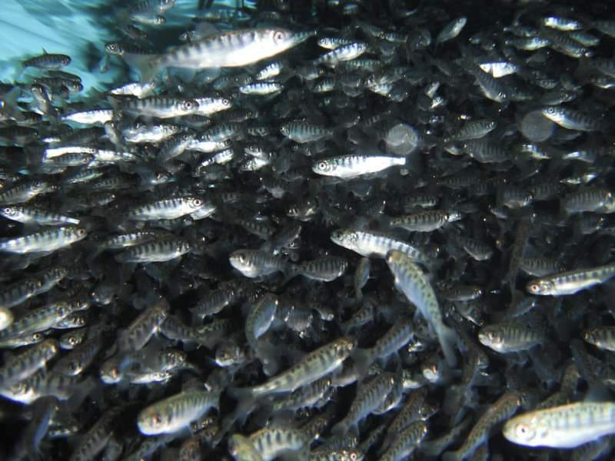
Nursery Rearing
54 6ft Circulars (68 ft3)
Max DI <0.79
Max FI <1.54

Slide 10
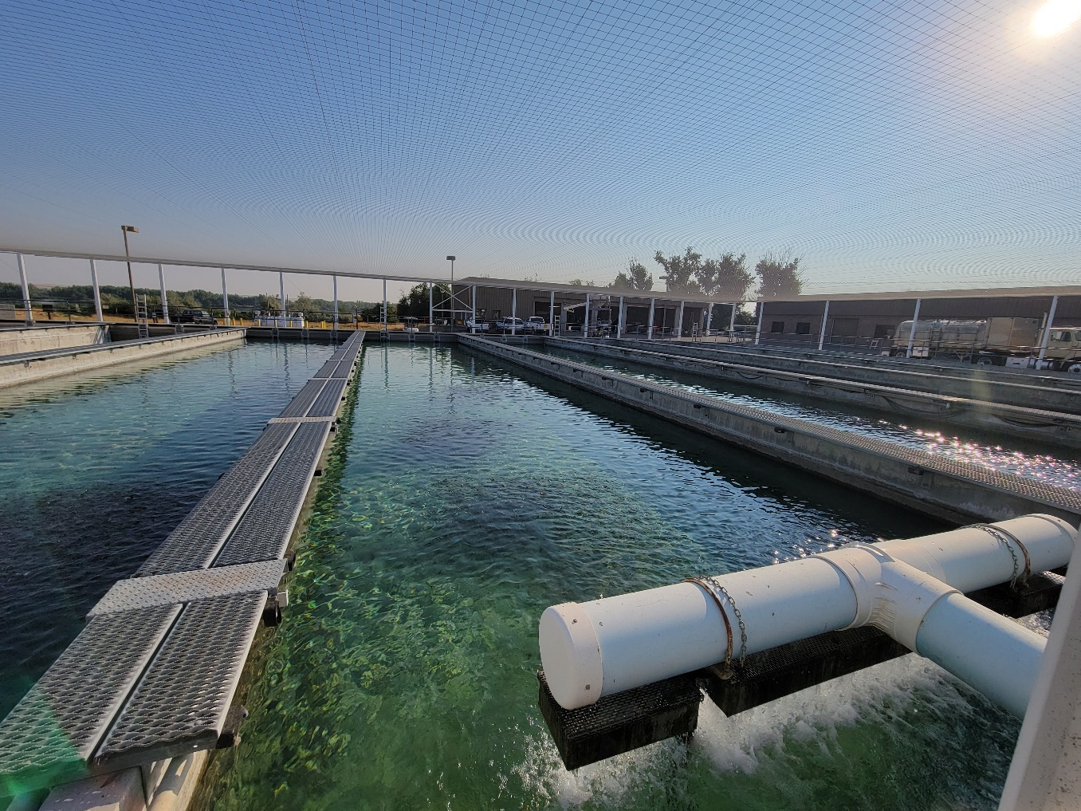
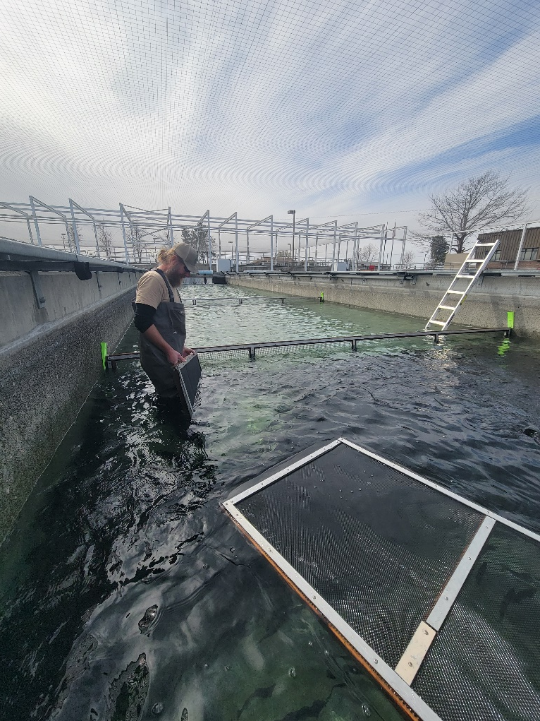
Outdoor Rearing
32 Raceways 100 x 20 x 3.75 (7,500 ft3)

Slide 11
Raceway Rearing Densities
Species | Fish/RW | Size | Lbs. | Density Index | Flow Index | Lbs./gpm
StS Wallowa | 40,000 | 5.5 | 7,273 | 0.12 | 0.75 | 6.06
StS Imnaha | 35,883 | 5.0 | 7,167 | 0.12 | 0.72 | 5.97
ChF | 200,000 | 50.0 | 4,000 | 0.13 | 0.82 | 3.33
Rb Legal | 24,320 | 2.7 | 9,007 | 0.12 | 0.77 | 7.51

Slide 12
Release
No smolts released directly from hatchery.
Summer steelhead transported by ODFW East Region Liberation and IFH drivers. Wallowa Acclimation, Big Canyon Acclimation, Little Sheep Acclimation.
Fall Chinook transported by IPC and ODFW drivers. Direct stream releases in the lower Grande Ronde River and Salmon River at Hammer Creek.

Slide 13
Release

Slide 14
Marking
Species | Release Site | Stock | Rearing Goals by Mark Type |  |  |  | PIT Tags
 |  |  | Total | Mark Type |  |  | Total
 |  |  |  | AD | AD CWT | NO MARK
StS | Wallowa Acc. 1st Release | Wallowa | 400,000 | 300,000 | 100,000 | 0 | 7,200
StS | Wallowa Acc. 2nd Release | Wallowa | 160,000 | 110,000 | 50,000 | 0 | 3,600
StS | Big Canyon Acc. Release | Wallowa | 240,000 | 140,000 | 100,000 | 0 | 6,800
StS | Little Sheep Acc. Release | Imnaha | 215,000 | 190,000 | 25,000 | 0 | 15,000
ChF | Salmon River Direct | Snake R. | 1,000,000 | 800,000 | 200,000 | 800,000 | 4,500
ChF | Grande Ronde River Direct | Snake R. | *500,000 | 0 | 200,000 | 300,000 | 4,500
ChF | Couse Creek Direct | Snake R. | *600,000 | 0 | 200,000 | 400,000 | 4,500

Slide 15
Operational Changes
Low Head Oxygen Supplementation
Reduce pumping cost
Eliminate insufficient system already in place (treats entire water supply at aeration tower)
Allows us to deliver oxygen to individual raceways

Slide 16
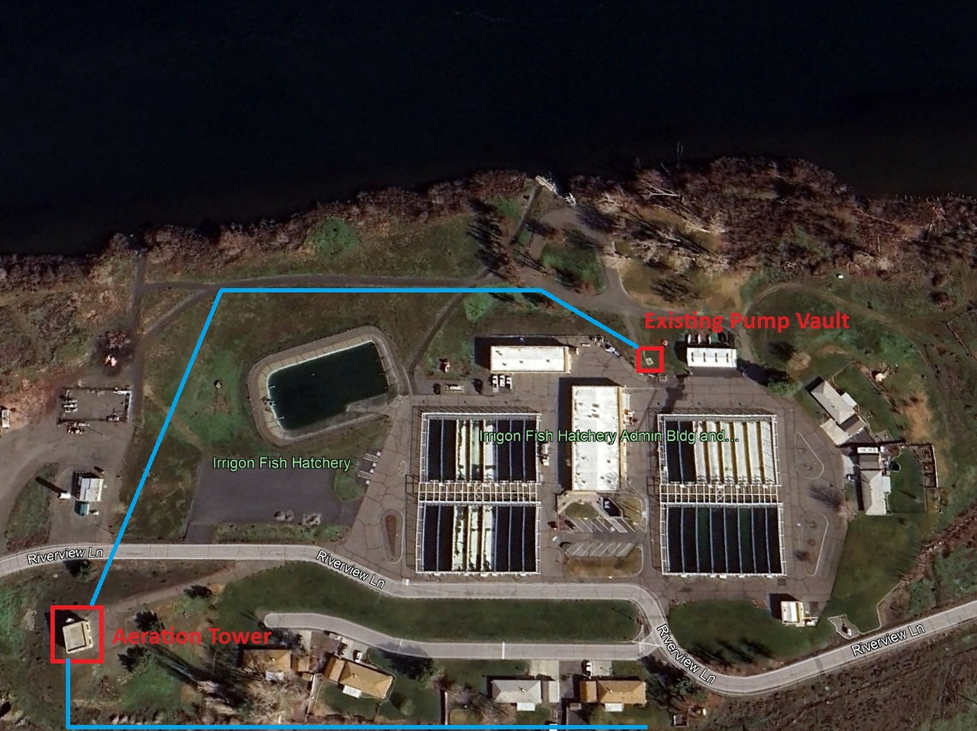
Operational Changes
Partial Reuse
Install pipeline and pump back system

Slide 17
Operational Changes
Production Modification
Reduce/Trade Summer Steelhead Production
Reduce/Eliminate Resident Trout Production
Chinook production gained for every Rb or StS RW removed
 | # Fish | Size | Lbs. | D.I. | Lbs/ft3
ChF +0 | 200,000 | 50 | 4,000 | 0.13 | 0.53
ChS +1 | 80,000 | 14 | 5,714 | 0.12 | 0.76

Slide 18
Current Infrastructure Concerns
Isolation valves
Raceway fresh water valves and head pipes
Incubation chiller
Fill tower chiller
Raceway seams
Aeration tower maintenance
Potable water system at facility
Backup generator that will run the chiller

