Slide 1
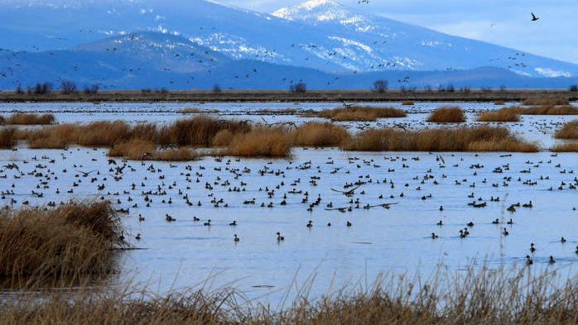
FWS 2025 Budget Request

Slide 2
FWS 2025 Budget Submission
Budget Authority | 2023 Actual | 2024 Enacted | 2025 President’s Budget | Change from 2024 (+/-)
($000)
Current Authority without Supplementals | 1,773,292 | 1,722,665 | 1,886,091 | 163,426
Bipartisan Infrastructure Law* | 98,044 | 90,545 | 90,545 | 0
Supplemental Construction | 247,000 |  |  | 0
Current Authority with Supplementals | 2,118,336 | 1,813,210 | 1,976,636 | 163,426
Permanent Authority** | 2,118,762 | 1,921,632 | 2,022,745 | 101,113
Total – with supplementals | 4,237,098 | 3,734,842 | 3,999,381 | 264,539
Discretionary | 6,652 | 6,663 | 7,082 | 419
Mandatory | 373 | 444 | 444 | 0
Transfers/Alloc. | 1,617 | 1,652 | 1,657 | 5
TOTAL FTEs | 8,642 | 8,759 | 9,183 | 424
Note: 2024 Enacted column shows the Annualized CR amount for FTE due to timing of passage.

Slide 3
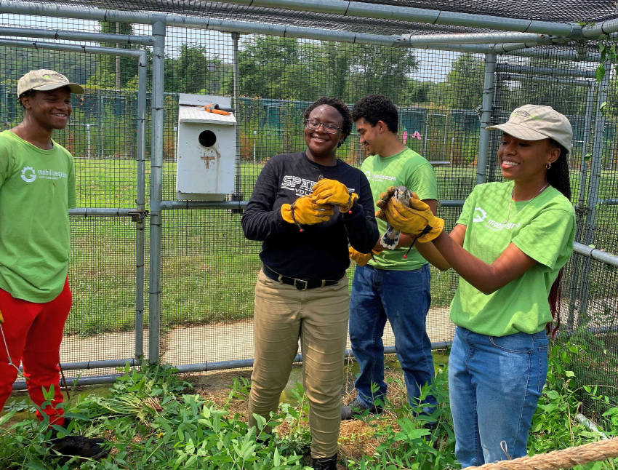
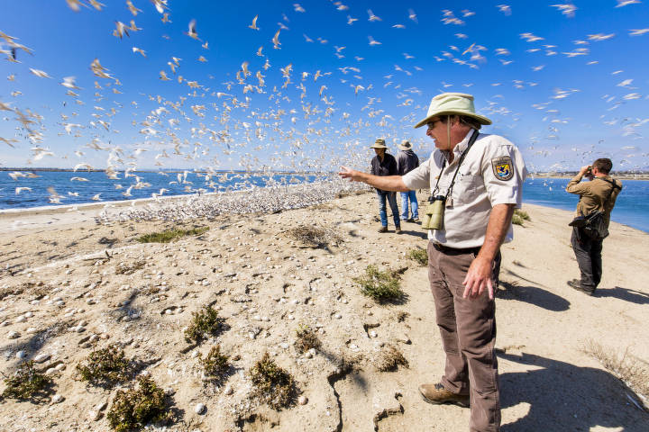
FWS 2025 Budget Submission
The President’s budget proposal for the Service prioritizes investments for:
Biodiversity
Habitat Conservation
Invasive Species Prevention and Control
ES Recovery
Birds
Service Capacity
Refuge Staffing
ES Consultation Capability
MB Permitting
FAC offices- native fish conservation
Climate Change
Distillation of climate science into management tools
Building a shared base of knowledge with our partners

Slide 4
FWS 2025 Budget Submission
The 2025 President’s Budget Request for FWS totals $1.9 billion.
An additional $2.0 billion is available under permanent appropriations, most of which is provided directly to States for fish and wildlife restoration and conservation.
The discretionary portion of the request is an increase of $163.4 million above the 2024 enacted level.
Much of the Service’s increase directly supports conservation and retaining biodiversity on the landscape.

Slide 5
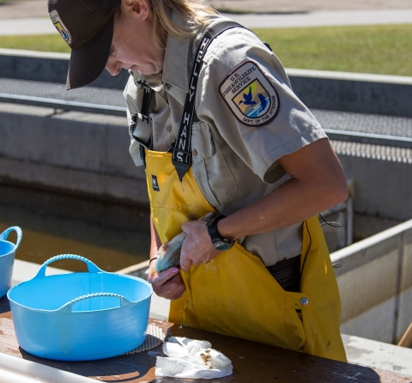
FWS 2025 Budget Submission
Conservation Capacity Needs
The NWRS has 500 fewer staff than they did 10 years ago. To begin to address this, we are requesting $602.3 million, +$75.3 million from 2024 enacted.
This includes an increase of $17.9 million for Refuge Law Enforcement
ES Consultation capability is at an all time low due to growing workload and a real decrease in funding. To meet this huge demand we are requesting $146.6 million, an increase of $28.4 million from 2024 enacted.
MB Permitting -Demand for the Service to improve the clarity and efficiency of its migratory bird permitting operations is at an all-time high. If Congress provides the requested $13.4 million, +$8 million from 2024 enacted, additional resources will go to support staff handling permitting in our regional offices.

Slide 6
Capacity increases continued
The budget proposes $126.4 million, a $15.9 million from 2024 enacted for Recovery of Threatened and Endangered Species. These funds will contribute to the delisting of species currently listed under the Endangered Species Act.
The Service’s request for Refuge Law Enforcement is $63.4 million, $17.9 million above 2024 enacted.
The 2025 budget request for the Partners for Fish and Wildlife Program is $68.1 million, +$9.1 million from 2024 enacted.
The Service’s Office of Law Enforcement investigates wildlife crimes and enforces the laws that govern the Nation’s wildlife trade. Funding is proposed at $110.8 million, an increase of $18.9 million above 2024 enacted.
FAC offices- Support for native fish conservation is lagging as fisheries offices lose staff due to funding shortages. Our request is $32.9 million, an increase of $12.5 million from the 2024 enacted to provide more capacity for these offices.

Slide 7
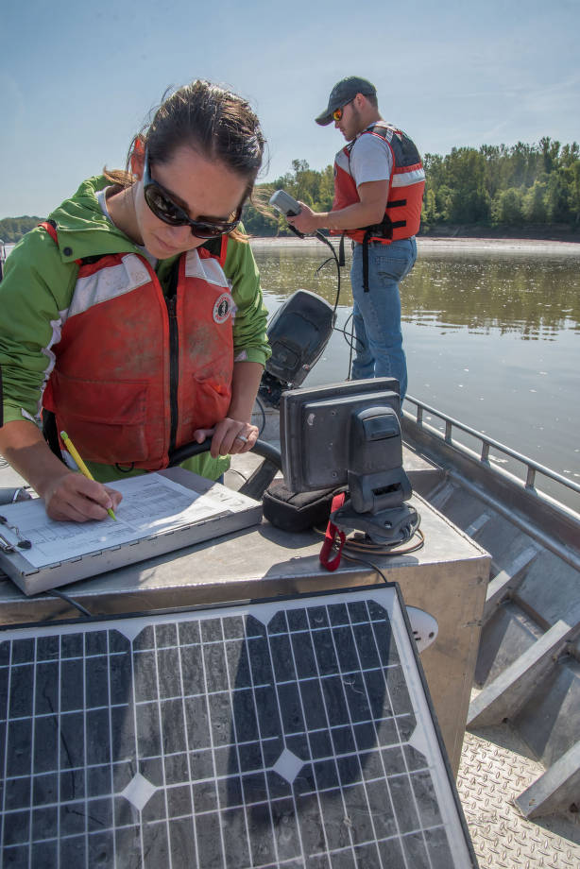
FWS 2025 Budget Submission
Advancing Climate Science
The request includes $37.9 million, an increase of $12.1 million above 2024 enacted for the base work of the Science Applications program, including funding for Science Partnerships to work with partners on landscape level planning to address climate change and other threats to species and habitats.
$10.6 million, +$1.8 million from 2024 enacted) for translating science into useful tools for on-the-ground management to address climate change and other threats.
Climate adaptation is also a priority of our other programs, as they work in the field to address species and habitat conservation.

Slide 8
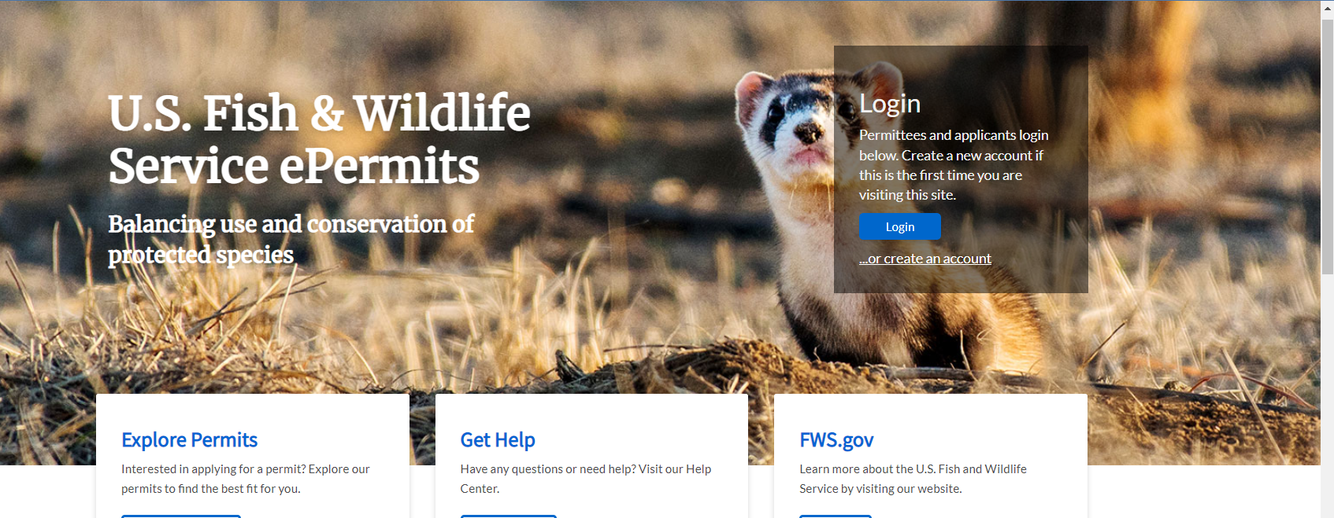
FWS 2025 Budget Submission
Program Details – ePermits
The budget consolidates funding for our multi-program ePermits system into one subactivity, and requests an additional $6 million for this year’s development activities.

Slide 9
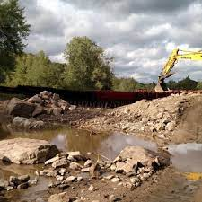
FWS 2025 Budget Submission
Altogether, the Budget includes $319.4 million for asset maintenance and construction.
Construction - $32.2 million in Discretionary Funds
The 2025 Construction budget is $12.9 million above 2024 enacted, including $21.0 million for line-item construction projects. The budget also includes $2.1 million for electric vehicle charging station infrastructure.
Deferred Maintenance - $95 million in Permanent Funds;
Starting in FY 2021 the Great American Outdoors Act (GAOA) Legacy Restoration Fund (LRF) provides mandatory funding for Refuge System Deferred Maintenance. This is in addition to the Deferred Maintenance funding under Refuges, which is $47.6 million. All of Refuge Maintenance is funded at $160.1 million.
In addition, Fisheries Maintenance is funded at $32.1 million.

Slide 10
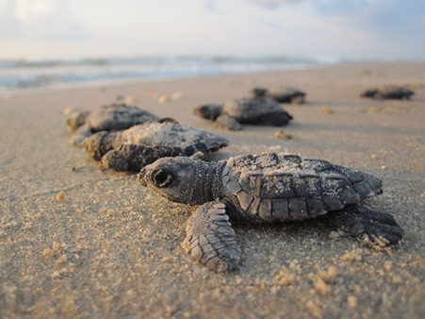
FWS 2025 Budget Submission
Program Detail – Grants - $147.4 million
Grants provide funds for our partners to augment Service conservation efforts.
Cooperative Endangered Species CF - $14.4 plus $40.2 million in permanent LWCF funding
North American Wetlands CF - $33.0 million
Multinational Species CF - $21 million
Neotropical Migratory Birds CF- $5.1 million
State & Tribal Wildlife Grants - $73.8 million

Slide 11
Legislative Proposals
The budget proposes to expand authority beyond existing reimbursable and Economy Act authorities by enabling Federal agencies to transfer funds provided under the Bipartisan Infrastructure Law to the U.S. Fish and Wildlife Service and the National Marine Fisheries Service for consultation and other environmental clearances. This authority was granted to the Service in the 2024 enacted.
Resource Protection: Under current law, when Service resources are injured or destroyed, the costs of repair and restoration falls upon the appropriated budget for the affected field station or office. This is the case even when parties are ordered to pay restitution. Competing priorities can leave damaged Refuge System resources languishing until Congress appropriates funds to address the injury. This provision would allow persons responsible for harm—not taxpayers—to pay for any injury they cause.
Further, the Service is asking to increase the amount of funding that can go toward administering its North American Wetlands and Neotropical Migratory Bird Conservation Fund Grants, plus reducing the match for NMBCF.
Good Neighbor & Stewardship Contracting Authority: Good Neighbor Authority enables states, counties, and Tribes to provide ecosystem restoration services on Service lands. Stewardship Contracting Authority would allow the Service to trade forest products for land management services.

