Slide 1
LEAD-FREE HUNTING AMMUNITION
PILOT INCENTIVE PROGRAM
U.S. FISH AND WILDLIFE SERVICE 2024

Slide 2
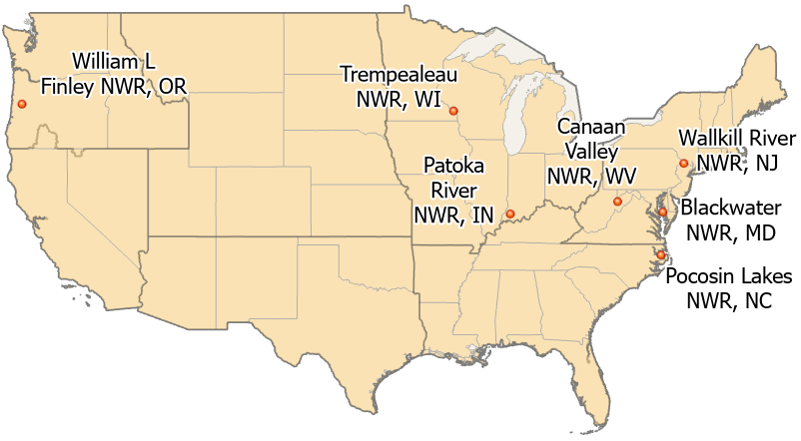
LEAD-FREE HUNTING AMMUNITION
PILOT INCENTIVE PROGRAM
U.S. FISH AND WILDLIFE SERVICE 2024

Slide 3
LEAD-FREE HUNTING AMMUNITION
PILOT INCENTIVE PROGRAM
Refuge | Applications Received (as of 12/16/24) | Estimated Potential Hunters
Blackwater National Wildlife Refuge (MD) | 55 | 2,000 (no permit limit)
Canaan Valley National Wildlife Refuge (WV) | 7 | 175 (no permit limit)
Wallkill River National Wildlife Refuge (NJ/NY) | 7 | 220 permitted
Pocosin Lakes National Wildlife Refuge (NC) | 0 | 100 (no permit limit)
Patoka River National Wildlife Refuge (IN) | 1 | 300 (no permit limit)
Trempealeau National Wildlife Refuge (WI) | 1 | 45 permitted
William L. Finley National Wildlife Refuge (OR) | 3 | 15 permitted
Grand Total | 74
U.S. FISH AND WILDLIFE SERVICE 2024

