Slide 1
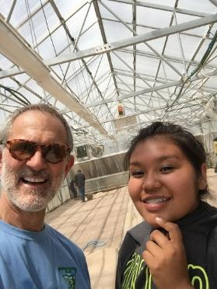
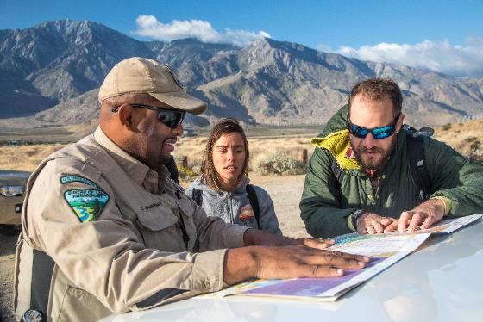
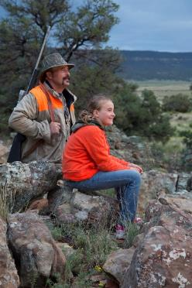
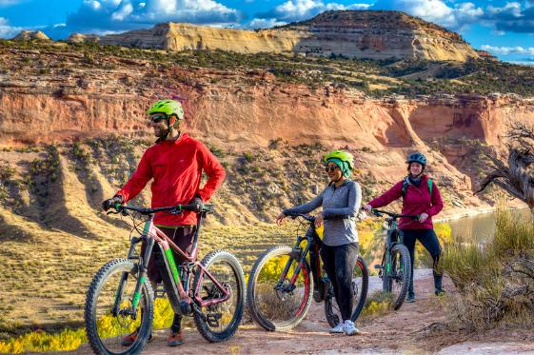
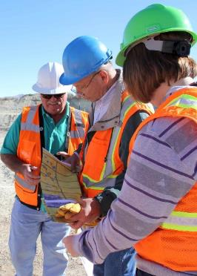
Great American Outdoors Act (GAOA)
National Parks and Public Lands Legacy Restoration Fund
Hunting and Wildlife Conservation Council
April 17, 2023

Slide 2
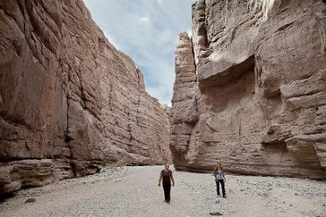
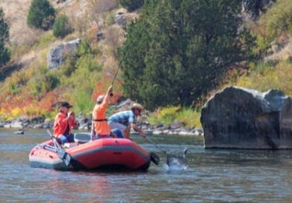
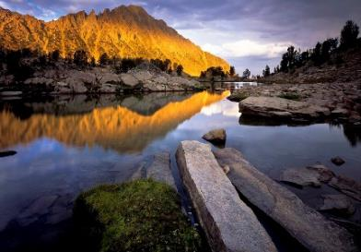
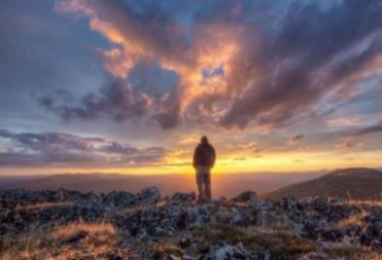
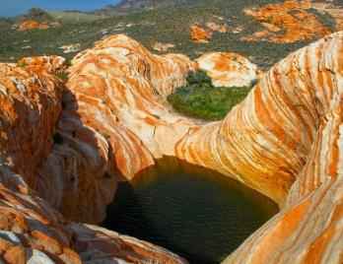
Great American Outdoors Act
Great American Outdoors Act (Public Law 116-152)
Signed into law on August 4, 2020
Established the National Parks and Public Land Legacy Restoration Fund (LRF) - commonly referred to as LRF or GAOA
Bureau of Land Management Portion: Maximum 5% or $95 million per year
Focuses on projects that address deferred maintenance (DM) or infrastructure deficiencies
- Minimum 65% for non-transportation projects
- Maximum 35% for transportation (roads, bridges, parking lots)
Encourages Accessibility improvements to accommodate visitors/employees w/disabilities

Slide 3
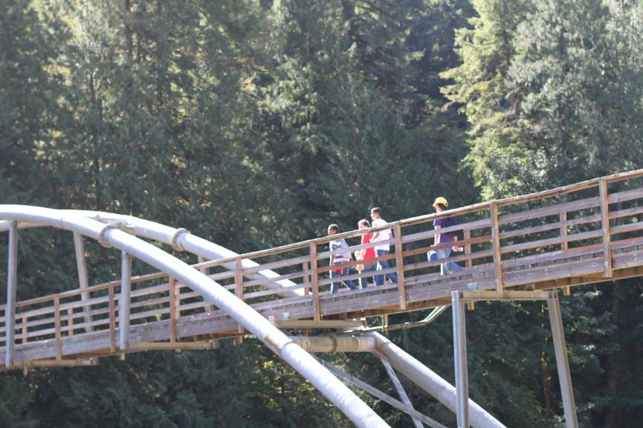
Great American Outdoors Act
BLM Assets and Deferred Maintenance
Assets are defined as parcels of real property, physical structures or groupings, landscapes, tangible property with specific services or functions; and that are tracked and managed as a distinct, identifiable entities by the agency
Asset Portfolio is approximately $26.3 billion
- Buildings
- Bridges
- Dams
- Roads
- Recreation and Administrative Sites
- Trails
BLM Deferred Maintenance Backlog: ~ $5.3 billion
- Maintenance not performed when scheduled or should have been accomplished.

Slide 4
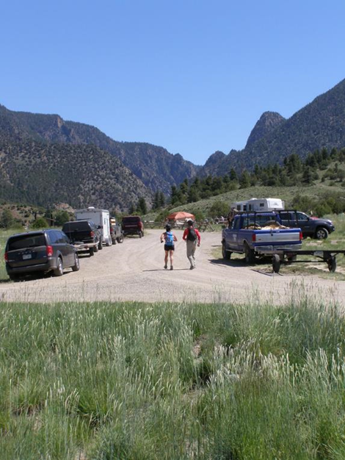
Great American Outdoors Act
Primary Objective: Reduce Deferred Maintenance
We are selecting projects with the potential to:
Protect Those We Serve: Public safety, volunteer/workforce safety, fire suppression
Maximize Citizens Served: High use facilities, improve ADA accessibility, expand outdoor recreation/public access
Improve BLM’s Financial Health: Deferred maintenance reduction, financial leveraging, and portfolio right-sizing
Plan for the Future: Ability to support conservation, recreation, and education opportunities into the future

Slide 5
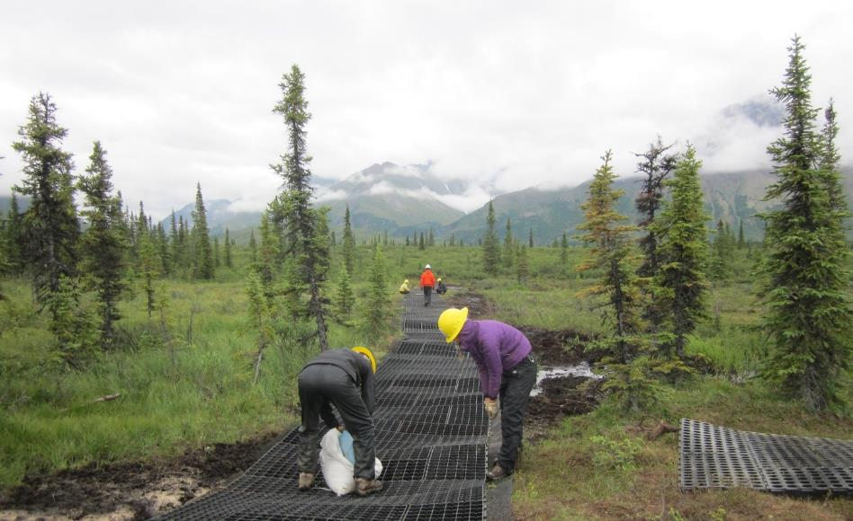
Great American Outdoors Act
FY21-FY23 BLM GAOA Projects
Distribution:
Buildings and Structures: 35%
Demolition: <1%
Recreation Assets: 23%
Transportation: 27%
Water and Utilities: 15%

Slide 6
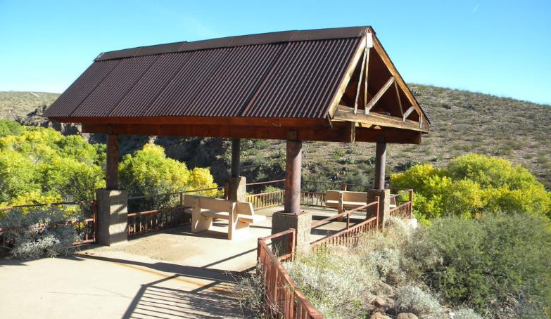
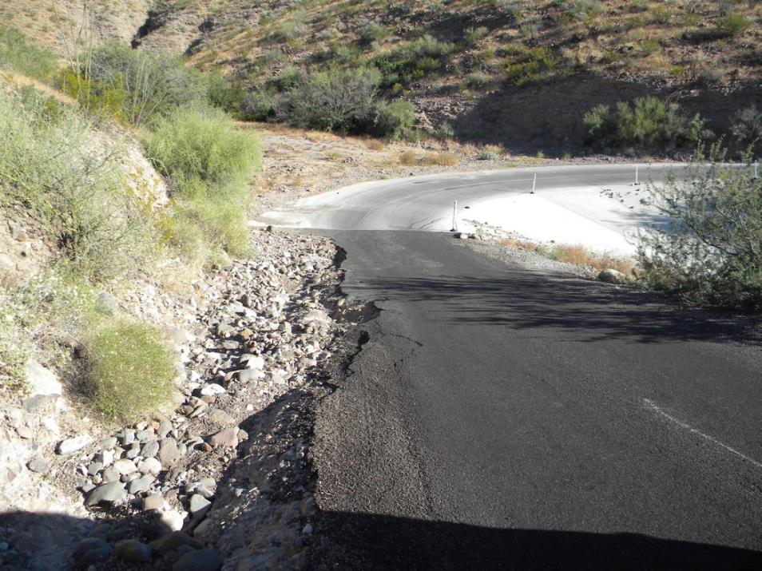
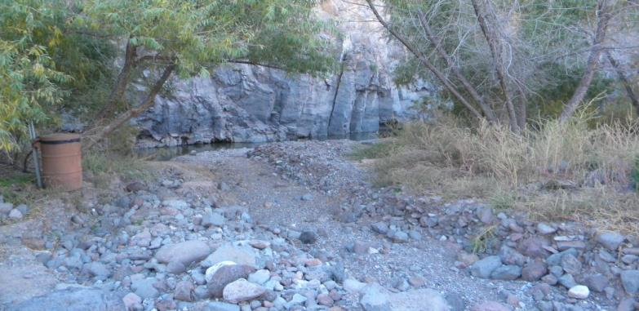
Great American Outdoors Act
GAOA Project in AZ
Gila Box Riparian National Conservation Area recreation site and road repairs
Notes:
Recreation. Primarily in design, one part in construction. This project repairs numerous campgrounds and recreation areas in the Gila Box Riparian (NCA) to improve the visitor experience in this unique area with woodlands, river beaches and rock cliffs. The project will repair or replace picnic tables, fire rings, kiosks, fencing, host site facilities, in addition to roads and low water crossings to increase visitor safety when traveling within the NCA.

Slide 7
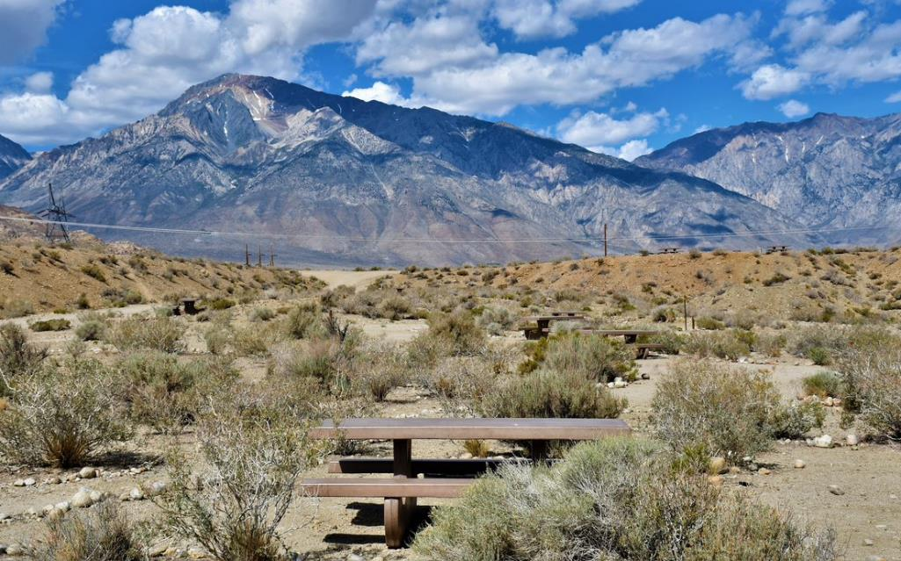
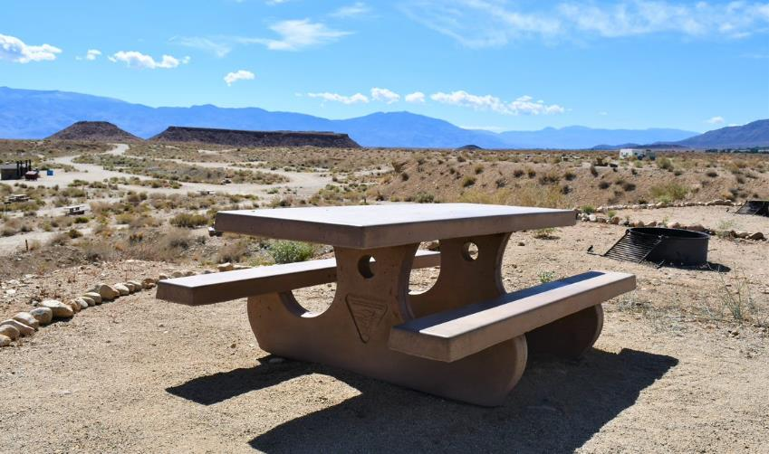
Great American Outdoors Act
GAOA Project in CA
Completed Pleasant Valley Pit Campground repairs
Notes:
Recreation. Project complete. Repair camping near popular Happy Boulders Climbing area and world class bouldering at the nearby Buttermilks. Work includes replacing wooden picnic tables with concrete ADA accessible picnic tables, replacing broken camp-site posts, replacing rock fire rings with ADA accessible steel fire rings to keep camp fire size contained, as well as improving the host site and replacing the degrading wooden informational kiosk.

Slide 8
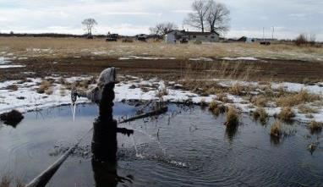
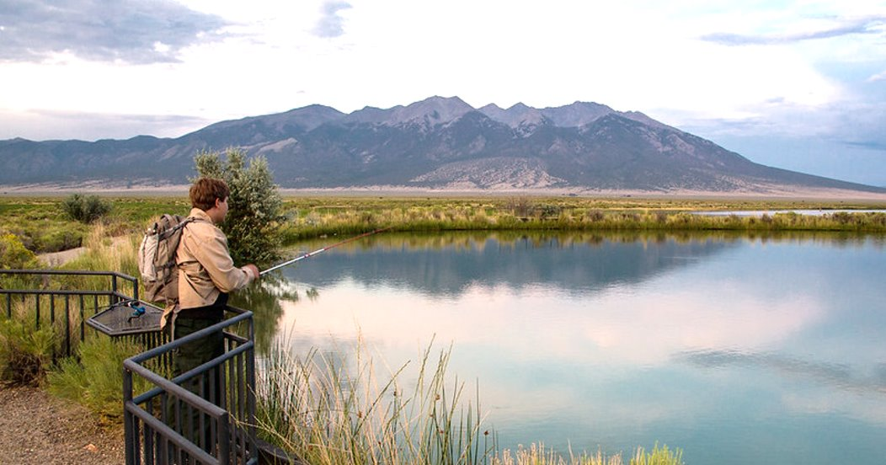
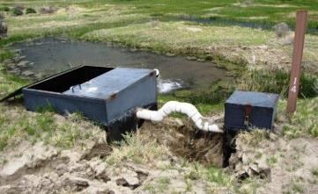
Great American Outdoors Act
GAOA Project in CO
San Luis Valley water infrastructure
Notes:
Water and Utilities. Design. Blanca Wetlands and McIntire-Simpson Wetlands provide nearly 12,000 acres of ecological habitat to birds, fish and wildlife. A ​series of aging wells and water delivery systems convey water at these sites which offer the public various recreational opportunities. This project will perform repairs and replacement to the water infrastructure.

Slide 9
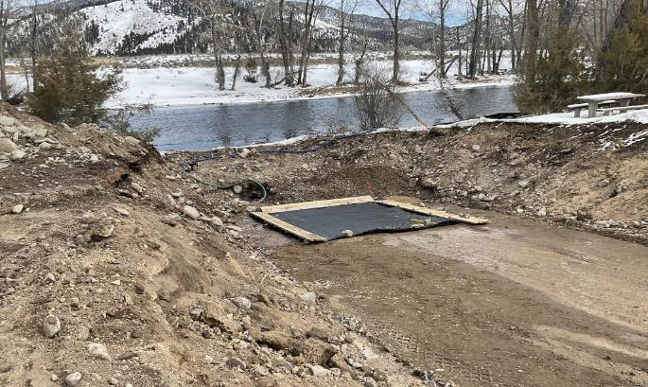
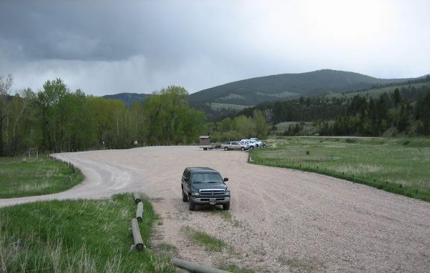
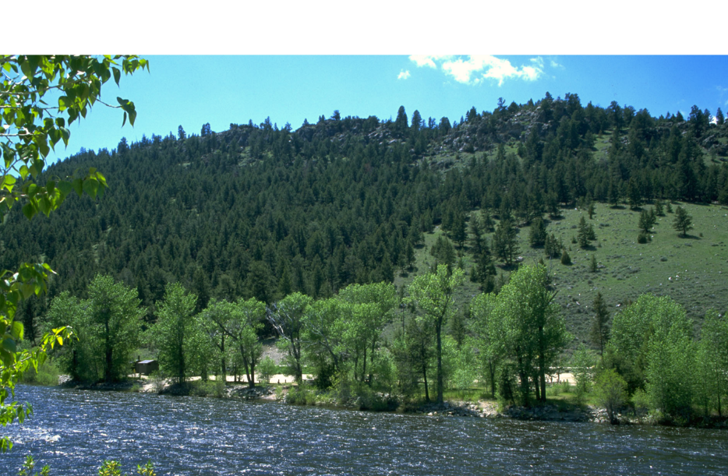
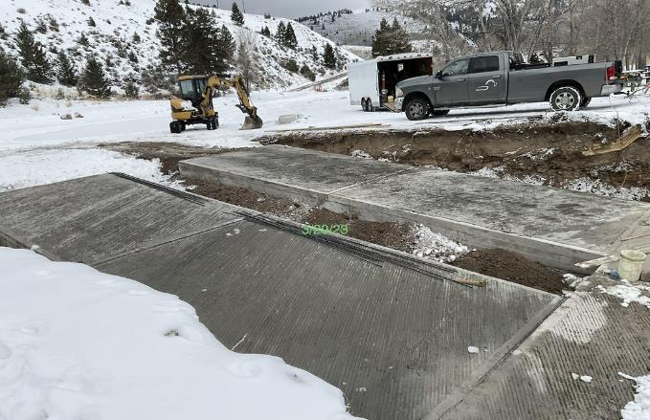
Great American Outdoors Act
GAOA Project in MT
Big Hole recreation sites
Notes:
Recreation. Construction. The Big Hole Recreation Sites serve as the primary access route to four separate day-use sites and provides access for numerous recreational activities. This project will improve condition and safety hazards in the parking lots and an repair and replace boat ramps to improve fishing and boater access.

Slide 10
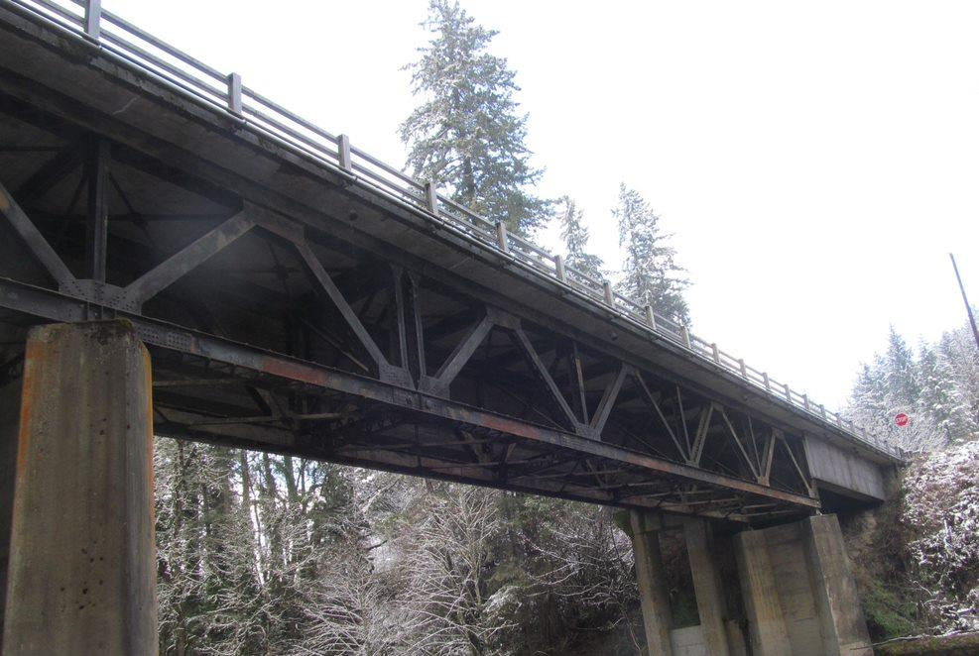
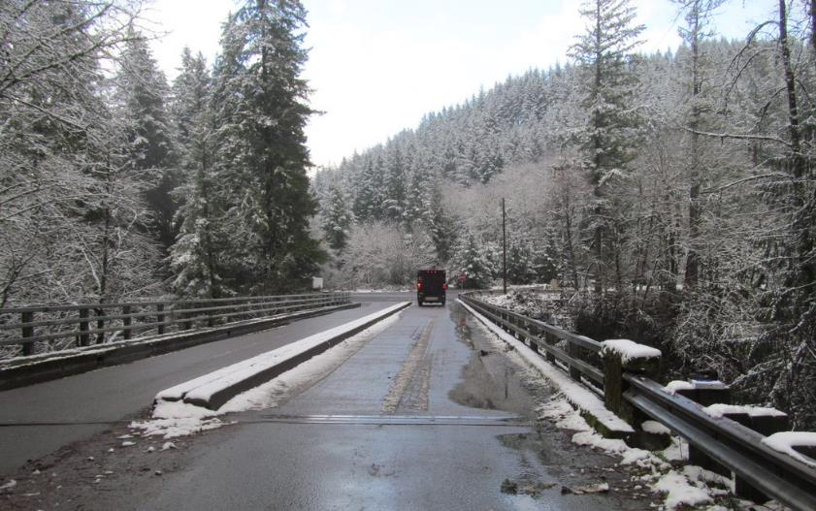
Great American Outdoors Act
GAOA Project in OR
South Fork Molalla bridge replacement
Notes:
Transportation. Pre-design. Replace structurally deficient bridge to maintain safe access to public lands.

Slide 11
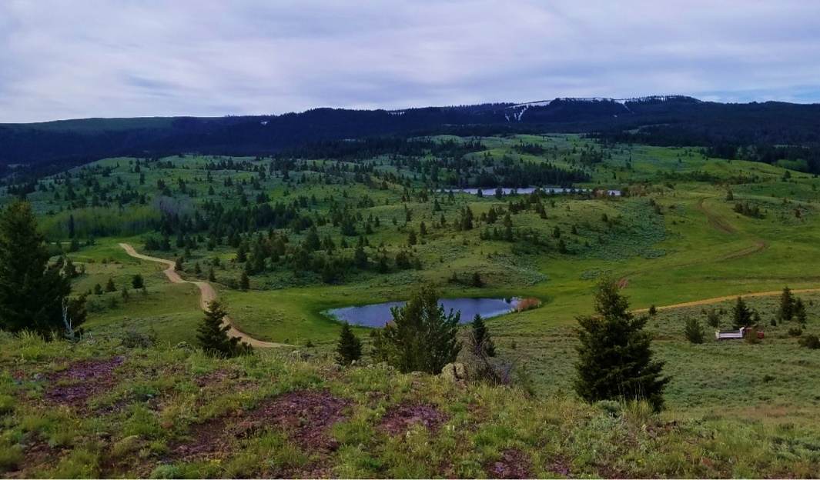
Great American Outdoors Act
GAOA Projects in FY24 and beyond
Continuing to focus on larger projects that have been “out of reach” due to annual discretionary funding limitations
Prioritized at the national level
Targeting GAOA objectives and Administrative priorities
More project information: https://www.doi.gov/budget/gaoa

Slide 12
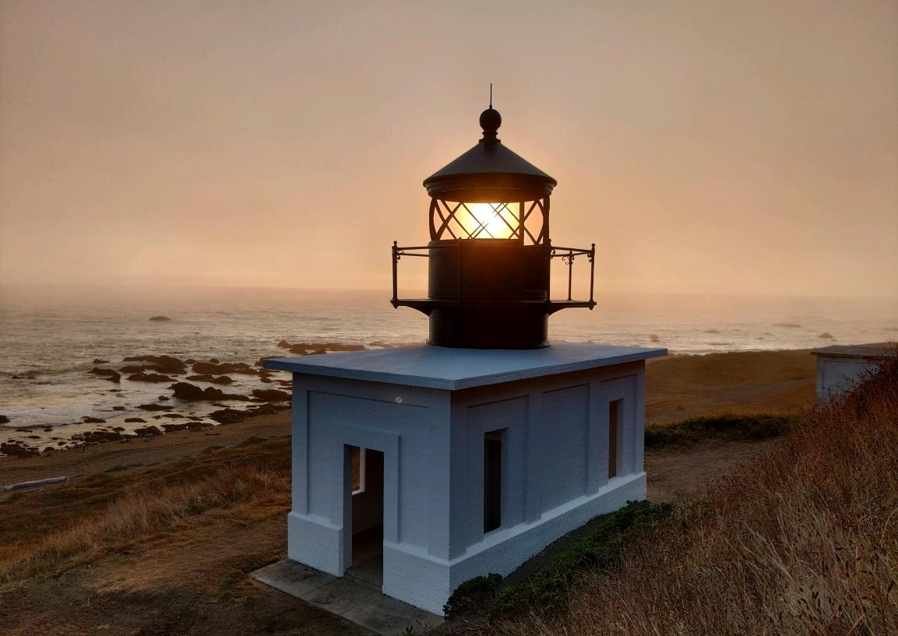
Great American Outdoors Act
Thank you for your time, we appreciate your feedback!
www.blm.gov/gaoa

