Slide 1
Bipartisan Infrastructure Law, Inflation Reduction Act, & Great American Outdoors Act
Overview

Slide 2
Funding summary BIL | IRA | GAOA
Scale-up Reforestation &
Restore Priority Watersheds
Improve
Recreation
Infrastructure
& Access
Implement Wildfire Crisis Strategy
Our Way of Doing Business
Equity, working with tribes,
Keystone Agreements

Slide 3
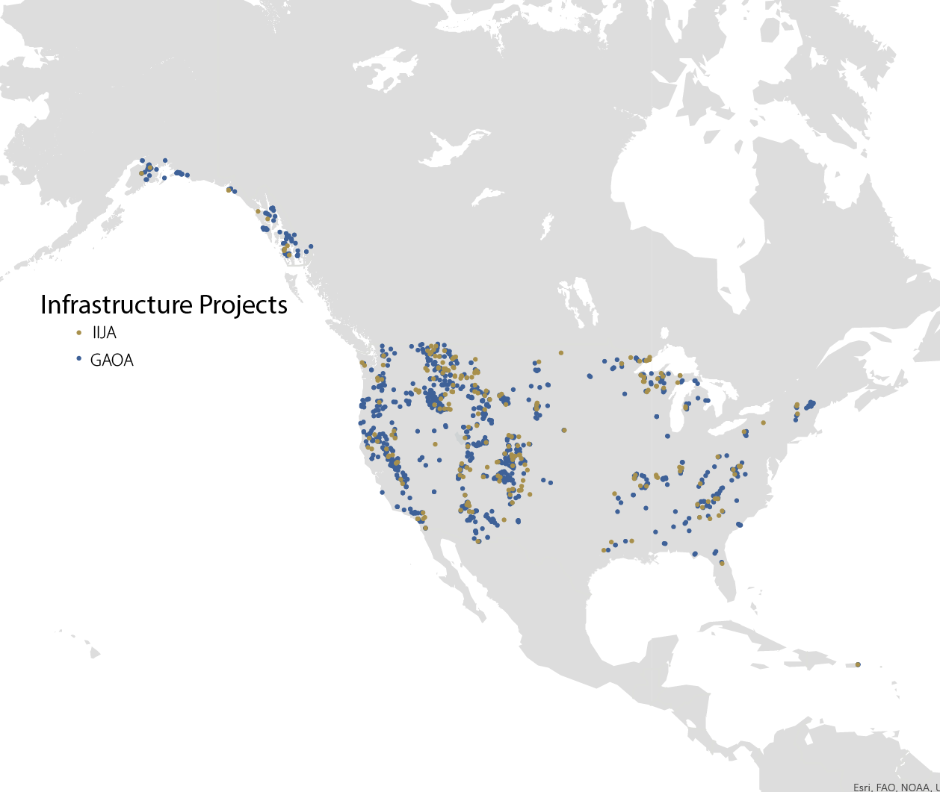
FUNDING SUMMARY
BIL: $5.5 Billion
To restore ecosystems and reduce wildfire risk to communities
IRA: $5 billion
To address the wildfire crisis and implement state, private, and Tribal forestry projects
GAOA: $7.7 billion
To invest in America’s outdoor recreation infrastructure, public lands access, and land & water conservation
Notes:
BIL: $5.5 Billion
Large-scale work with federal, Tribal, state and local government partners to restore ecosystems and reduce wildfire risk to communities
IRA: $5 billion
Fuels and forest health treatments to protect communities from wildfire; competitive grants to non-Federal forest landowners; State and Private Forestry programs; and administrative costs to implement the law’s provisions
GAOA: $7.7 billion
Establish the Land Legacy Restoration Fund & permanent funding of Land & Water Conservation Fund for federal land acquisition and Forest Legacy grants to states
Together, BIL and IRA will provide $10.5 billion to the agency to address the wildfire crisis, restore ecosystems, address critical infrastructure needs and implement State, Private, and Tribal Forestry projects.

Slide 4
Wildfire crisis strategy
PROTECTING PEOPLE’S LIVES AND THE INFRASTRUCTURE AND NATURAL RESOURCES THEY DEPEND ON
Notes:
Under this 10-year strategy, we will work with partners to: ■ Treat up to an additional 20 million acres on National Forest System lands. ■ Treat up to an additional 30 million acres of other Federal, State, Tribal, and private lands. ■ Develop a plan for longterm maintenance beyond the 10 years.
We invested in 10 landscapes in April 2022 using funding from the Bipartisan Infrastructure Law, and then announced 11 additional landscapes in January 2023 using an all-lands approach.
These targeted investments will span upward of 45 million acres across 21 landscapes. The work on these landscapes will focus on protecting people’s lives and the infrastructure and the natural resources they depend on.

Slide 5
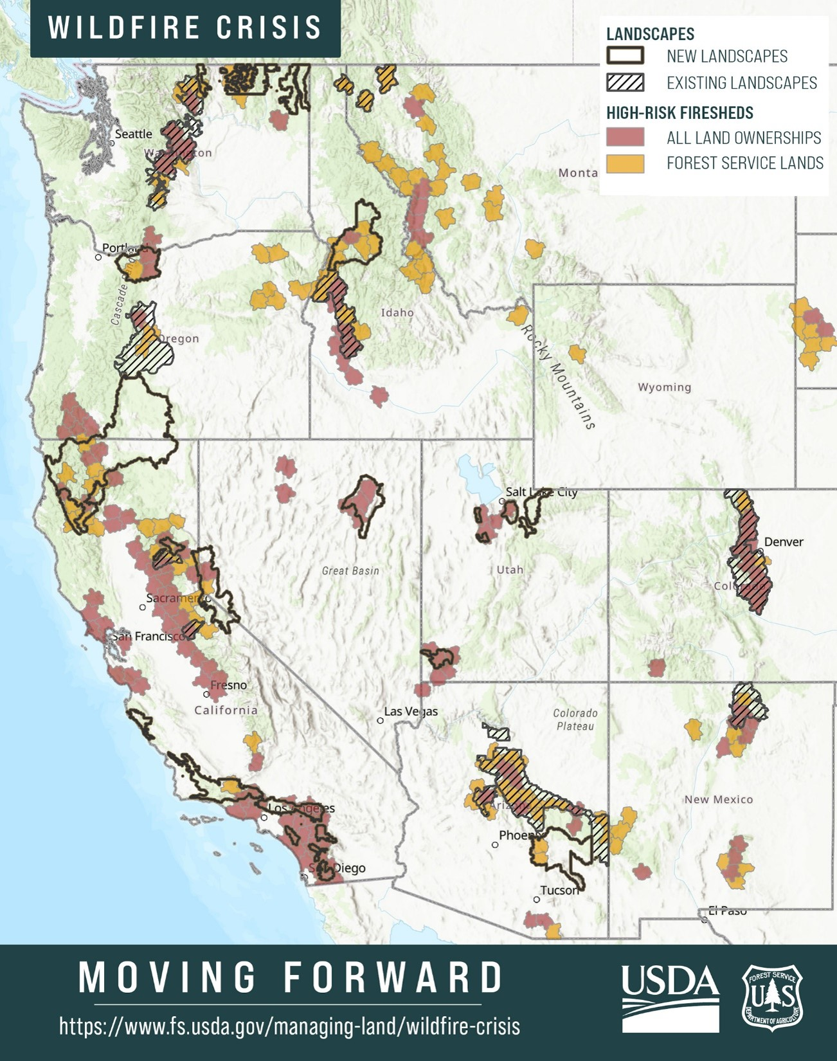
Investment in 21 landscapes
Hazardous fuels reduction projects in 134 out of 250 high-risk western firesheds
Notes:
The Bipartisan Infrastructure Law and the Inflation Reduction Act have delivered a historic investment in our agency’s work, and we have leveraged these investments to launch the Wildfire Crisis Strategy in 2022 to protect communities, critical infrastructure, and to make forests more resilient.
We invested in 10 landscapes in April 2022 using funding from BIL, and then announced 11 additional landscapes in January 2023 using an all-lands approach.
These targeted investments will span upward of 45 million acres across 21 landscapes. The work on these landscapes will focus on protecting people’s lives and the infrastructure and the natural resources they depend on.
Along with our partners, we are currently covering 134 unique high risk firesheds out of 250
These targeted investments will span upward of 45 million acres across 21 landscapes. The work on these landscapes will focus on protecting people’s lives and the infrastructure and the natural resources they depend on.

Slide 6
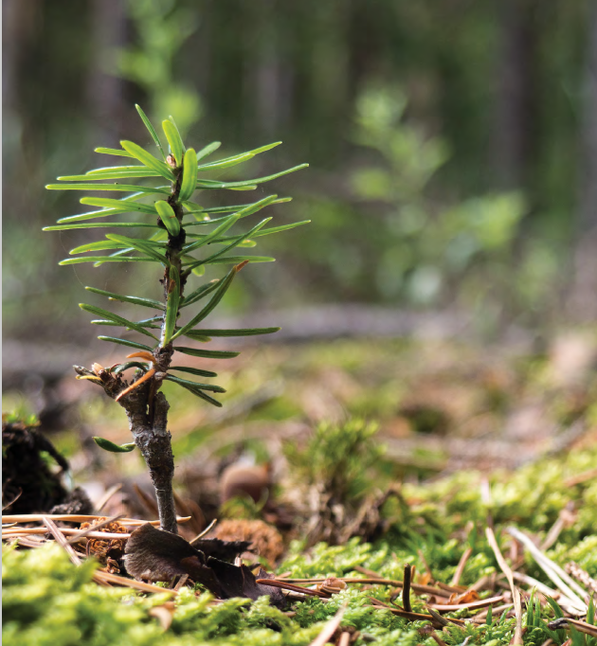
Scale-up Reforestation & Revegetation
REPLANT Act
Raises amount of available funding for reforestation
Provides resources to address reforestation backlog by planting 1 billion trees over 10 years
Native Seed & Nursery Partnerships
Recently announced $10 million investment to meet reforestation needs, increase capacity for nurseries and seed orchards, and meet future demands for seedlings
Established new agreement with Chicago Botanical Garden trains over 1700 seed collectors to address insufficient supply of native seeds
Notes:
The Repairing Existing Public Land by Adding Necessary Trees or REPLANT Act was signed into law as part of the Infrastructure, Investment, and Jobs Act (Public Law 117-58, Title III, Section 70301-70303) on November 15, 2021
The REPLANT Act directs the Forest Service to plant more than a billion trees over the next decade, removes a cap of $30 million (Reforestation trust fund) and is now expected to provide the agency significantly more resources every year to do so.
According to Forest Service Chief Randy Moore, the reforestation strategy (PDF, 7 MB) will serve as a framework to understand reforestation needs, develop shared priorities with partners, expand reforestation and nursery capacity, and ensure the trees planted grow to support healthy, resilient forests.

Slide 7
$25.5 million Collaborative Aquatic Landscape Restoration Program
Improve water quality, reduce sedimentation into streams and restore priority watersheds across tribal, state and federally managed public lands
$40 million Legacy Roads and Trails Program
Improve water quality and aquatic habitat while making transportation systems safer, more sustainable and more durable
Restore Priority Watersheds
Notes:
FY22 investments.
The Watershed Condition Framework establishes a new consistent, comparable, and credible process for improving the health of watersheds on national forests and grasslands. This framework will help focus our efforts in a consistent and accountable manner and facilitate new investments in watershed restoration that will provide economic and environmental benefits to local communities.
STEP B: Prioritize watersheds for restoration based on ecological, economic, social considerations, partnership opportunities, and potential benefits.

Slide 8
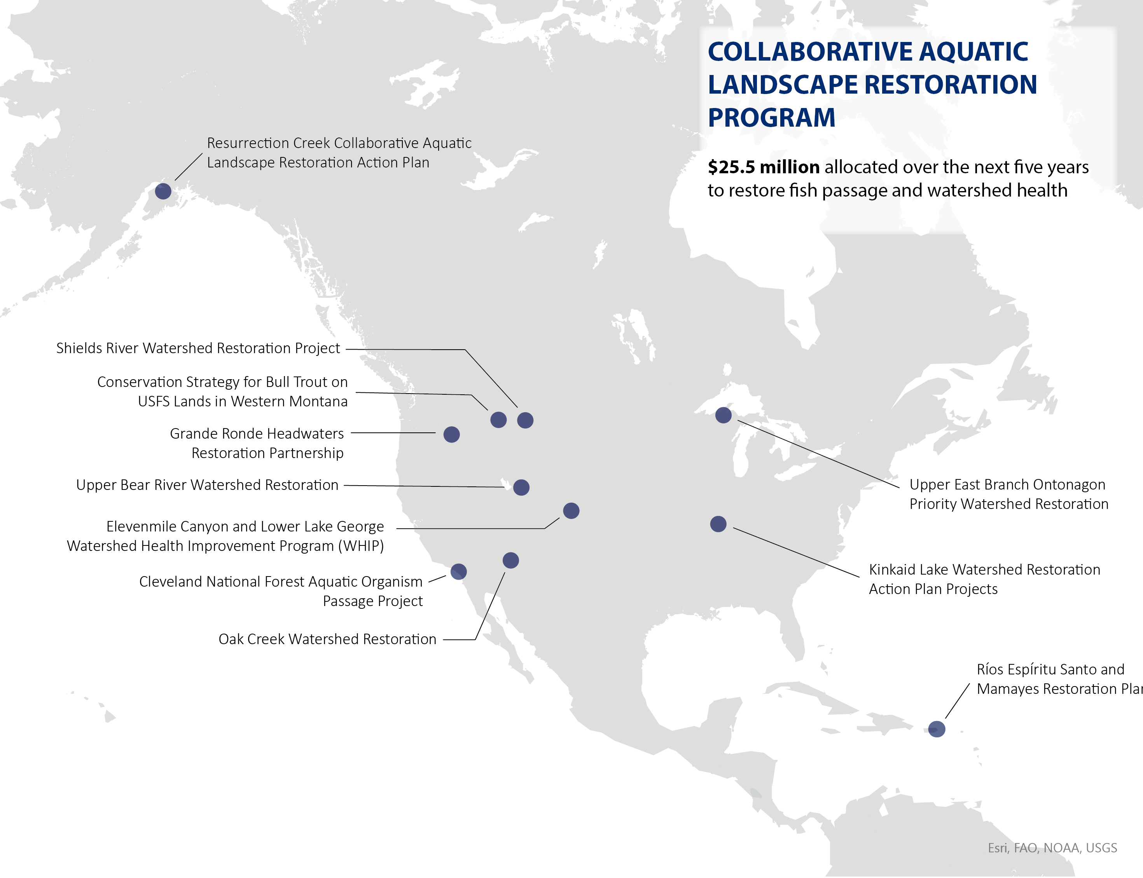
MI-improving stream function in 3 priority watersheds in the Upper East Branch Ontonagon River in partnership with Trout Unlimited & The Nature Conservancy
UT- restoring fish passage on 58 miles of rivers and streams alongside a suite of partners
PR- addressing water quality in 3 watersheds through activities like removing invasive species & planting riparian plants

Slide 9
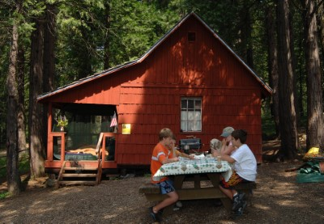
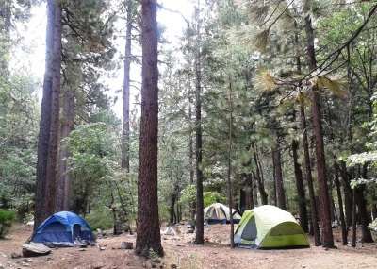
IMPROVE Recreation INFRASTRUCURE AND ACCESS
Over $37 million in investments to improve vital recreation infrastructure on national forests and grasslands
$19 million for recreation sites and $18 million for cabins and historic buildings
To add or improve amenities at popular sites, such as expanding parking & building new restroom facilities
Adapt recreation sites to a changing climate, by addressing risks from floods & wildfires

Slide 10
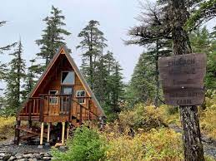
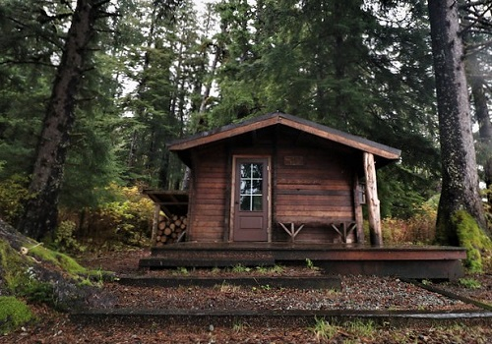
Recreation cabins in alaska
Renovation and construction of about 35 public-use cabins on the Chugach and Tongass National Forests
Working with the National Forest Foundation of through an agreement of $13.9 million from BIL and $3.7 million in matching funds

Slide 11
Great American Outdoors act 2020
Legacy Restoration Fund LWCF Forest Legacy Fund

Slide 12
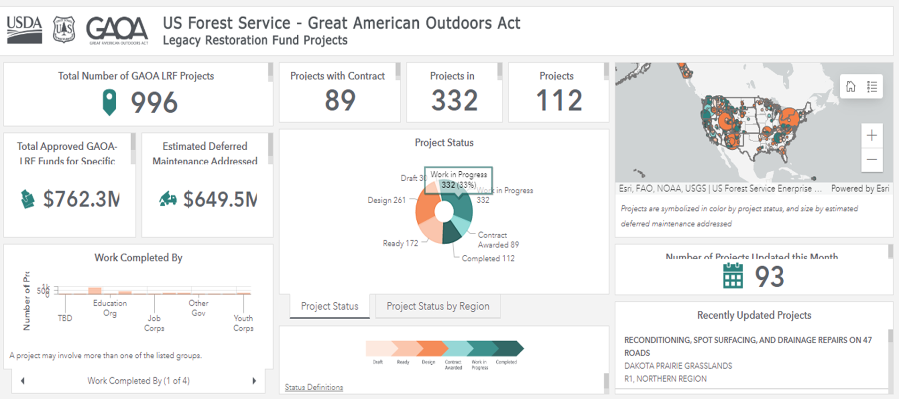
Legacy Restoration Fund Dashboard
Notes:
Brad- Thank you for the introduction. I will now share with the council some numbers and story's about how Great American Outdoors Act is making an impact on our recreation infrastructure and access. Since GAOA passage we have approved 996 and has addressed an estimated 650 million dollars in Deferred Maintenance. This is our public facing dashboard where you can find specific projects in each states or national forest. And track the progress.

Slide 13
Legacy Restoration Fund
Critical Wilderness Stock Program Support
Project Cost: $465,000
To address deferred maintenance at equine stock handling facilities across Custer-Gallatin NF. Work includes: moving and replacing pasture fence to facilitate wildlife movement, building maintenance, lead paint mitigation, water system maintenance and road and parking facility improvements.
Notes:
During project selection our LRF working group uses priority outcomes of
Reduce deferred maintenance
Address housing shortage
Benefit tribes & underserved communities
Partner contributions
Support Wildfire Crisis Strategy implementation
Climate change mitigation and adaptation

Slide 14
LWCF Focus areas
At-risk natural & cultural resources
Resilience and biodiversity of lands, waters, & ecosystems to climate change impacts
Access to outdoor recreation
Wildfire Crisis
Strategy Landscapes
Local partnership support
Engaging at-risk communities
Notes:
LWCF program:
Before GAOA passage average funding of $66 million annually
GAOA ensured permanent funding of the Land and Water Conservation Fund (LWCF)
increased NFS Land Acquisition funding to about $125 million annually to secure public access and improve recreation opportunities on public lands; protect watersheds and wildlife; and preserve ecosystem benefits for local communities .
LWCF program:
protects unique and important at-risk natural and cultural resources
strengthens the resilience and biodiversity of our lands, waters, and ecosystems to climate change impacts
Increases access to outdoor recreation
engages strong local partnership support and provide benefits to a broad audience that includes underserved or at-risk communities
All projects prioritize recreation – either creating new recreation access, or enhanced recreation access, and that includes hunting and fishing access
protects unique and important at-risk natural and cultural resources
strengthens the resilience and biodiversity of our lands, waters, and ecosystems to climate change impacts
Increases access to outdoor recreation
engages strong local partnership support and provide benefits to a broad audience that includes underserved or at-risk communities

Slide 15
LWCF Alabama’s Talladega and Conecuh NF
Proposed Project Cost: $4 million
To acquire 2,000 acres in Alabama & allow for expansion of longleaf pine and red-cockaded woodpecker habitat
Notes:
FY24 LWCF project list, we’ve proposed a $4 million project to acquire 2,000 acres in Alabama, including the 1,800 acre Evergreen Forest Tract. Once acquired, this land will become part of the Hollins Wildlife Management Area, which includes 29,355 acres managed by the State of Alabama for all game species and is one of the top 5 public lands to hunt in Alabama. The Talladega Ranger District where the land is located is extremely popular among deer and turkey hunters. Hunters from all over the state travel here for turkey

Slide 16
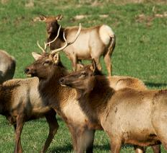
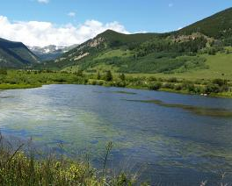
Forest Legacy Program: State, Private, Tribal Forestry
Conserve forestlands threatened by conversion to non-forest use
Through conservation easements or fee-simple purchase
2.97 million acres of forest conserved at present
Notes:
Provides grants to states through a competitive process to conserve forestlands threatened by conversion to non-forest use
2.97 million acres of forest conserved at present
T&E habitat and use for wildlife (including breeding ground, wintering yards, winter range and conserving connectivity)
Economic impact of timber and non-timber uses (including hunting and fishing are all considered during project review and prioritization

Slide 17
Forest Legacy Program
Funded FY22
Michigan Black River Ranch
Project Total: $10,665,000
8,850 acres
Notes:
At 8,850 acres, Black River Ranch is one of the last remaining large, intact, forested, privately-owned tracts of land in Michigan's Lower Peninsula. The tract is adjacent on three sides to the Pigeon River Country State Forest, known as the "Big Wild" due to its wilderness-like nature and home to Michigan's only elk herd. The tract provides habitat for a variety of game and non-game species such as elk, white tailed deer, black bear, bobcat, ruffed grouse, woodcock, turkey, bald eagle, merlin, upland sandpiper, Kirtland warbler, and furbearing species such as otter, muskrat, beaver, and mink. Elk viewing and hunting contributes over $6.36 million annually to the local economy. The tract is also home to several threatened and endangered species. The project contains over 14 miles of Black River, East Branch & Stewart Creek corridor, all designated "blue-ribbon trout streams". Black River is considered the premier brook trout stream east of the Mississippi & the only river managed exclusively for native brook trout in the Lake Huron basin.

Slide 18
Our Way of doing business
Forest Service Equity Action Plan
Justice 40 covered BIL programs
Working with and engaging tribes
USDA FS Climate Adaptation Plan
USDA Secretary’s Memo on climate resilience and carbon stewardship of America’s national forests and grasslands
Shared Stewardship with states, partners, and tribes
Image: Horizonline Pictures
Notes:
The Forest Service Equity Action Plan represents a broad set of high-leverage actions with potential for creating high impact and enduring systemic change that benefit employees, Tribes, partners, and the public. Delivering the Forest Service’s mission in a purposefully equitable manner requires changing traditional perspectives, processes, actions, and performance measures to ensure the full suite of benefits, outcomes, and opportunities to participate are made available to all, especially in rural and urban places that have been marginalized or overlooked.
J40 Covered Programs: 19. Collaborative Forest Landscape Restoration Program∗,3 20. Hazardous Fuels Management*,3 21. Ecological Health Restoration Contracts* 22. Financial Assistance to Facilities That Purchase and Process Byproducts for Ecosystem Restoration Projects* 23. Landscape Scale Restoration Water Quality and Fish Passage* 24. Recreation Sites* 25. Restoration Projects Via States and Tribes*,3 26. Restore Native Vegetation on Federal/Non-Federal Land*,3 27. Revegetation Effort to Implement National Seed Strategy*
USDA FS Climate Adaptation Plan
USDA Sec Memo references BIL Implementation:
use the direction provided by this memorandum to inform BIL project selection, design, and implementation so that investments reflect the intended outcomes of restoring ecosystem integrity and fostering ecological resilience alongside community resilience and include consideration of multiple ecosystem values for risk reduction and restoration, including carbon, water, biodiversity and old-growth.

Slide 19
Keystone Agreements
Large-scale, national-level agreements
Accessible for individual forests and regions
Implementation for up to 5-20 years
Authorities allow for similar agreements with Tribes and/or Tribal organizations
Current Keystone Agreements
National Wild Turkey Federation (NWTF)
National Forest Federation (NFF)
Mule Deer Foundation (MDF)
Trout Unlimited (TU)
The Nature Conservancy (TNC)
Student Conservation Association (SCA)
National Fish and Wildlife Foundation (NFWF)

Slide 20
For more information
Brad Kinder
BIL and IRA Coordinator National Forest System
Bradley.Kinder@usda.gov
Betty Jewett
Acting Director GAOA
Betty.Jewett@usda.gov
Rob Harper
Director, Biological and Physical Resources
Robert.Harper@usda.gov
Image: Benjamin Hayes

